Slide 1
Railway Reform in Great Britain
John Thomas, Director of Policy

Slide 2
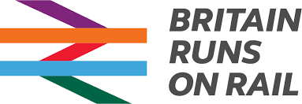
About RDG
The Rail Delivery Group (RDG) brings together passenger train operators, freight train operators, as well as Network Rail.
Together with the rail supply chain, the rail industry – a partnership of the public and private sectors - is working with a plan In Partnership for Britain’s Prosperity to change, improve and secure prosperity in Britain now and in the future.
The RDG provides services to enable its members to succeed in transforming and delivering a successful railway to the benefit of customers, the taxpayer and the UK’s economy.
Notes:
The Rail Delivery Group (RDG) brings together passenger train operators, freight train operators, as well as Network Rail. Together with the rail supply chain, the rail industry – a partnership of the public and private sectors - is working with a plan In Partnership for Britain’s Prosperity to change, improve and secure prosperity in Britain now and in the future.
The RDG provides services to enable its members to succeed in transforming and delivering a successful railway to the benefit of customers, the taxpayer and the UK’s economy. In addition, the RDG provides support and gives a voice to passenger and freight operators, as well as delivering important national ticketing, information and reservation services for passengers and staff.

Slide 3
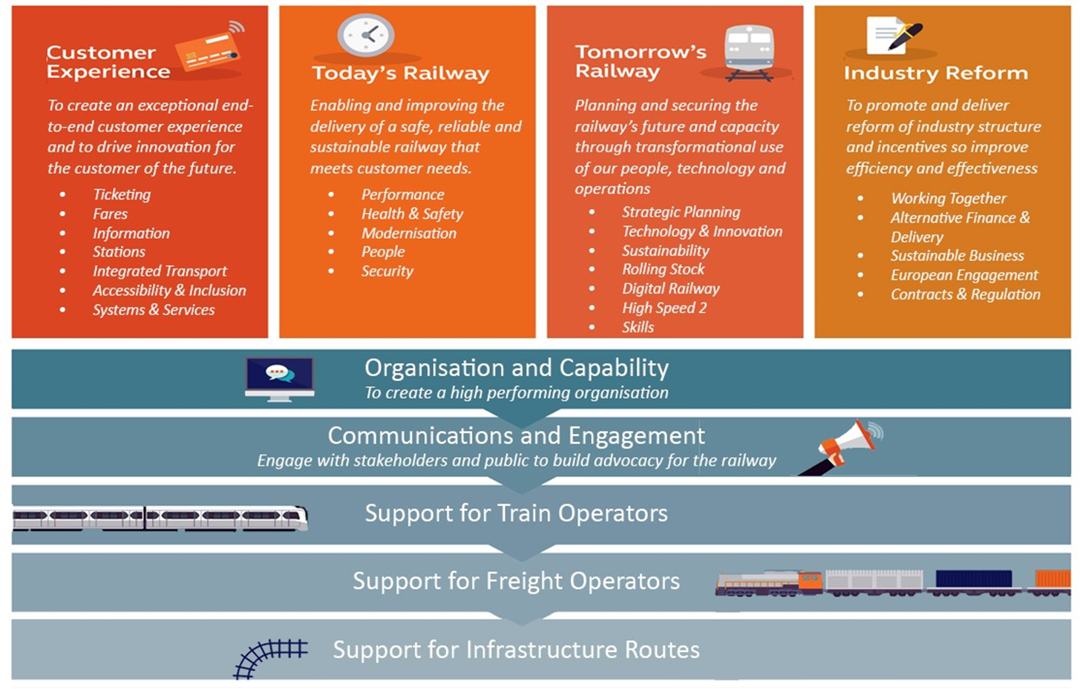
About RDG
Notes:
How we deliver our work.

Slide 4
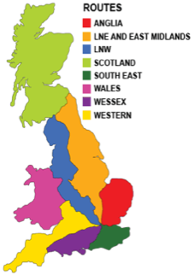
Industry structure
Infrastructure managers
  Network Rail
  HS1, HS2
Operators
  16 franchised operators
  4 open access operators
  1 international operator
  5 freight operators (2 international)
Funders
  Department for Transport (DfT)
  Transport Scotland
Regulator
  Office of Rail and Road (ORR)
Notes:
Fully separated infrastructure management running nine routes (including freight and national operators)
Network Rail maintains and develops Britain's rail tracks, signalling, bridges, tunnels, level crossings and many key stations
Stations not managed by Network Rail are run by the train operator
Passenger franchises (public service contracts) are seven to ten years
Open access operators subject to rules to avoid cherry picking from the public service contract – the NPAT
Eurostar is the international operator running on an open access basis
Freight operators

Slide 5
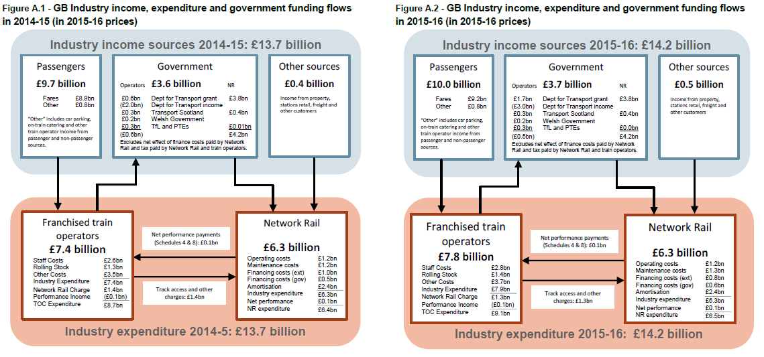
About RDG

Slide 6
Where we have come from
The rail industry in Great Britain (GB) was liberalised 20 years ago
Since then passenger journeys have more than doubled, freight has had some of the strongest growth in Europe.
We have achieved this whilst maintaining high safety standards, second only in Europe to Luxembourg.
Notes:
Passenger
Passenger numbers have more than doubled since 1997-98, the first full year of rail franchising
Average annual journey growth has been 3.84%, compared to 0.5% in the 18 years prior
Rail journeys per head of population have increased by 82%
Freight
Before 1997-98, rail freight was in steady decline (down 59% between 1953 and 1996-97)
It has since stabilised with growth in 13 of the 19 years since then
A sharp fall in coal moved (from 6.5 to 1.4 bn tonne kilometres) almost single-handedly drove the decline between 2014-15 and 2016-17
Domestic intermodal carried has increased by 93% since 1998-99

Slide 7
Rail customers in the UK are more satisfied than those of any other major European railway

Slide 8
Costs and financing
In 1997-98, the railway ran at a £2bn a year loss in terms of its day-to-day costs, in 2015-16 it more than covered those costs
Net payments from Train Operating Companies to government increased to £843 million in real terms, while government funding as a share of total rail industry income remained at 26% in 2015-16
Since 2010-11, passenger train company costs per passenger mile have declined by 8.8% in real terms
Network Rail operating costs have fallen by 46% since 2003-04
Freight efficiency has improved as longer and heavier freight trains are now in operation. The number of trains has fallen by 44% since 2002-03 but tonnes per freight train have increased by 63%

Slide 9
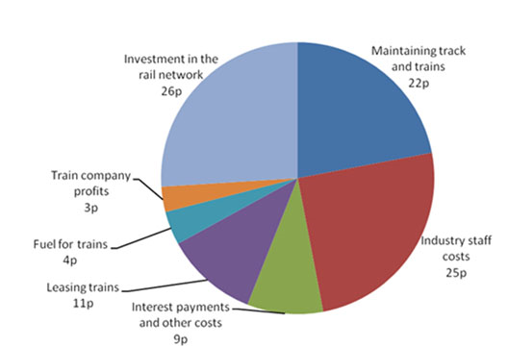
97p from every pound generated by train operators goes towards running and improving the railway

Slide 10
Some of our challenges
Congested network
  In GB the network utilisation rate is about 60% higher than the EU average. The saturation of the network and continued demand increase mean that individual delays have a greater impact requiring more investment. The industry is delivering £50bn+ investment in part to address capacity.
Aligned incentives
  Developing consistency between the charges and incentives regime set by ORR, and the incentives set by DfT in franchises. RDG is leading the industry in reviewing incentives and how they can be aligned between infrastructure manager and operator.
Sustainable operating models
  Understanding what is needed to ensure that business models are sustainable so that they continue to deliver for customers and the economy. The industry has a working group looking at sustainable passenger and freight business models and alternative financing.
Improving efficiency
  The efficiency of renewing and enhancing the network has been a challenge. Network Rail is developing plans at a route level with its train operator customers to improve efficiency.
Smart, simple ticketing
  In GB the fares structure is complex and inflexible due to regulation put in place at the point of liberalisation. By the end of 2018, customers will be able to use mobile phones as tickets on seven out of 10 journeys.

Slide 11
In Partnership for Britain’s Prosperity
The rail industry’s plan to secure growth across our country
Our railway is a unique asset for generating prosperity across Britain. The country will be stronger with an improving railway, working in partnership. Investment, improvement and innovation will deliver new growth and productivity across the country. But these economic benefits, shared by every region and our people, are not secure without a plan for lasting change across the industry.

Slide 12
Four commitments for change
Strengthen the railway’s contribution to the economy, keeping running costs in the black, feeing up taxpayers’ money
Increase customer satisfaction by improving the railway to remain the top-rated major railway in Europe
Boost local communities through localised decision-making and investment
Create more jobs, increase diversity and provide our employees with rewarding careers
Notes:
Commitment one: Strengthen the railway’s contribution to the economy, keeping running costs in the black, freeing up taxpayers’ money
What this means:
Securing almost £85bn of extra economic benefits across the country and enabling further investment
Maintaining private sector investment to bolster government funding
No return to day-to-day running costs in the red
Commitment two: Increase customer satisfaction by improving the railway to remain the top-rated major railway in Europe
What this means:
Delivering simpler ticketing, more services, quicker journeys and better value-for-money for our customers, with the support of government
Introducing the most transparent performance and punctuality measures in Europe, with to-the-minute punctuality reporting, setting the industry apart from the UK’s aviation industry
Building confidence in our services with the creation of a new independent railway ombudsman, supported by the industry, to rule on complaints
Commitment three: Boost local communities through localised decision- making and investment
What this means:
Setting up local supervisory boards or equivalents made up of Network Rail, train operators and passenger groups, giving customers and communities a stronger voice
Creating vibrant, attractive railway stations that are community hubs – building on the decade-long, £5.2bn investment in railway stations across the country
Giving our backing to public and private infrastructure projects across the country, like Transport for the North’s plan to extend the number of customers one hour away from the North of England’s four major cities to 1.3m
Enabling more people to benefit from the opportunities that travelling by train opens up
Commitment four: Create more jobs, increase diversity and provide our employees with rewarding careers
What this means:
Investing more than £250m per year in our workforce training, improving employee engagement and customer experience
Changing the industry to better reflect the diverse customers we serve
Attracting new talent to rail, with new high-status apprenticeships, to create a
progressive dynamic workforce

Slide 13
Network Rail’s Transformation Plan
Devolved into 9 route businesses operating within a national framework
Aligning track and train by creating shared targets between NR and train operators at a route level
Externally market tested services to devolved routes – do or buy mindset
Contestability of some enhancements
System Operator function so that railway is planned for and operates as a whole
Technical authority to set and maintain high standards
Digital Railway programme
New regulatory framework with route-based determinations to support the transformation
Notes:
Devolution: placing accountability closer to customers and passengers, so that decisions can be more relevant to their needs and taken faster
Alignment: focused on what passengers and freight customers, and ensuring a stronger voice for these customers

