Slide 1
An excursus on rail reform in the EU
27 November 2017, UNECE, Geneva
Libor Lochman, CER Executive Director

Slide 2
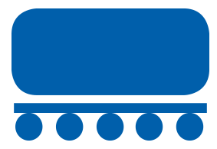
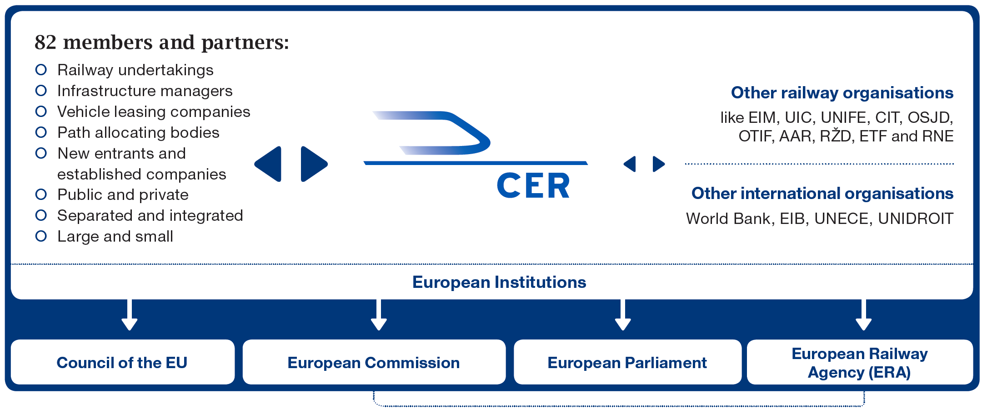
CER – who we are:
The major rail lobby association
73%
80%
96%

Slide 3
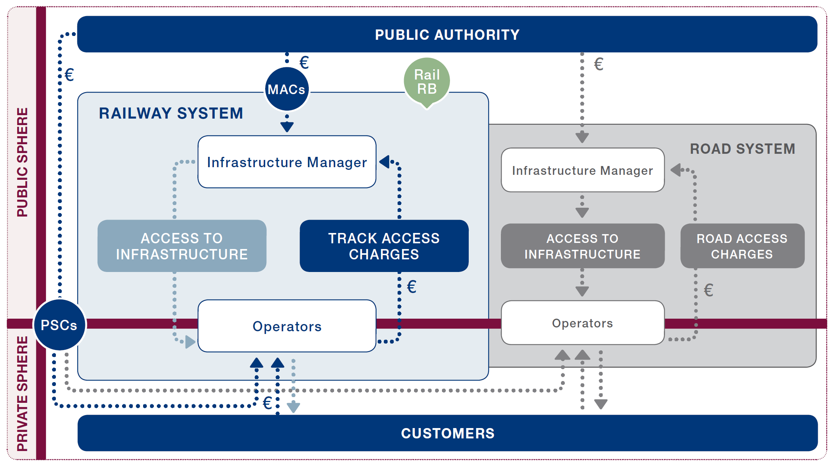
The EU now legislates all aspects of the rail system

Slide 4
EU rail legislation (1)
International freight market opening
Accounts separation
Establishment of RB
Compulsory NSs
MACs
Opening int’l and domestic freight mkt
Establishment of ERA
‘01
‘04
‘07
1st Railway Package
Inter-operability directives
2nd Railway Package
3rd Railway Package
Opening int’l passenger market
Rail passenger rights
Certification of train drivers
‘07
The Trans-European Network
Working conditions of cross-border mobile workers
Public Service Transport
State Aid Guidelines
‘08
Public procure-ment
Environ-mental legislation
Safety directive (revision)
Environmental noise
Diesel emissions
Environmental liability

Slide 5
EU rail legislation (2)
Rail freight corridor regulation
Euro-
vignette
Passenger rights on all modes
‘12
‘14
‘16
4th railway package
Reinforced accounts separation
Independence of IM’s essential functions
Longer and stronger MACs
New principles for TACs
NDTACs and ETCS TACs
Acess to Rail Related Services
Recast of the 1st railway package
New TEN-T and CEF
State Aid Guidelines
Opening of domestic passenger markets for both commercial services and PSOs

Slide 6
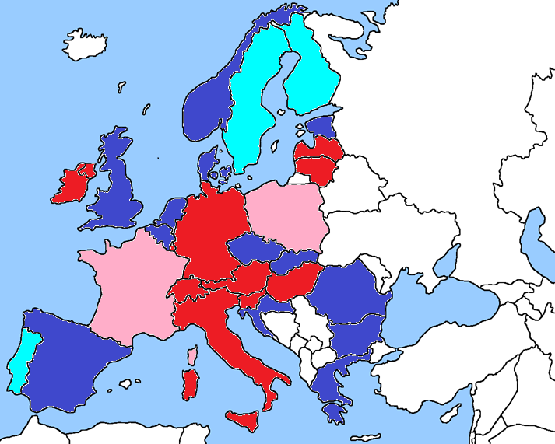
Rail governance
Integrated system
Integrated systems with enhanced independency of the IM
Separated IM
Separated multimodal IM

Slide 7
So where do we stand?
…what to do?

Slide 8
Governance structure?
Rail Freight
MODAL SHARE GROWTH
2002 - 2012
Rail Freight
NEW ENTRANTS
Share in 2014
(%)
Less than 25% new ←
entrant market share
→ More than 25% new
entrant market share
Data Source: European Commission’s RMMS 2007-2014 (excluding HR & LU)

Slide 9
Financing is the key! Rail freight modal share
Rail Freight
MODAL SHARE GROWTH
(2002 – 2012)
Rail FINANCING
(1000€/line.km/yr
2002-2012)
Integrated / Unbundled
Data Source: European Commission’s RMMS 2007-2014 (excluding HR & LU)

Slide 10
The 4th Railway Package: final piece of technical harmonisation and market opening to be implemented!
Market Pillar
Higher competitive pressure
More legal certainty across borders
Better environment for private investments
More standardisation achievable
Revised Directive 2012/34 and PSO Regulation
NSA
NSA
NSA
ERA
NSA
NSA
NSA
NSA
NSA
Safety & Interop Directives + new ERA Regulation

Slide 11
What’s more ahead of us to boost rail competitiveness?
Intermodality
Digitalisation of operations
For ticketing & info to customers, train tracking, etc.
ERTMS
Implementation and migration
Research & Development
S2R and S2R2 topics
Functional specifics for rolling stock procurement
Definition of EU-wide specifics
Mobility Package
re: User- and Polluter-Pays Principle
EU fiscal and VAT policy
Redressing VAT imbalances
Passenger Rights
Redressing imbalances like force majeur application
Sector’s initiatives

Slide 12
Key elements of the sustainable rail development
Intermodal regulatory level playing field
Innovation
Infrastructure
Stable regulation after
The 4RP implementation
Notes:
States must make sure to put in place an institutional framework which preserve a fair intramodal competition
Adequately staffing the Rail Regulatory Body
Guaranteeing the independence of the essential function of the infrastructure managers: path allocation and infrastructure charging
States must make sure to put in place an institutional and legal framework which preserve a fair intermodal competition
Putting enough resources at disposal, and in a fair way
Establishing a fair policy of charging for the access to respective networks
Making sure each modes‘ costs reflect all negative externalities

Slide 13
Thank You
Libor Lochman
CER Executive Director
libor.lochman@cer.be

