Slide 1
EU Rail reform :
creating a
Single European Rail Area
27 November 2017, UNECE, Geneva
Sian Prout
Head of Unit
Single European Rail Area
European Commission
DG MOVE

Slide 2
Policy Context
Rail
is a vector of economic and social cohesion and connectivity in EU;
contributes to the decarbonisation strategy, as one of the more environmentally friendly transport modes
makes a substantial contribution to the EU economy, directly employing 900,000 people…
…but also absorbs €35 bn in yearly subsidies, translating into cost of €80 per EU citizen
Source: Fifth Report on Monitoring development of the Rail Market, COM(2016) 780 final (data 2014) ,Rail Transport and environment 2015 (UIC/CER)

Slide 3
Context
… and while passenger rail has been increasing since 1995, rail freight is still recovering from 2009 crisis point
moreover, modal share only slightly increased for passenger rail and has remained stagnant for rail freight since 2004
Source: Fifth Report on Monitoring development of the Rail Market, COM(2016) 780 final, data 2014

Slide 4

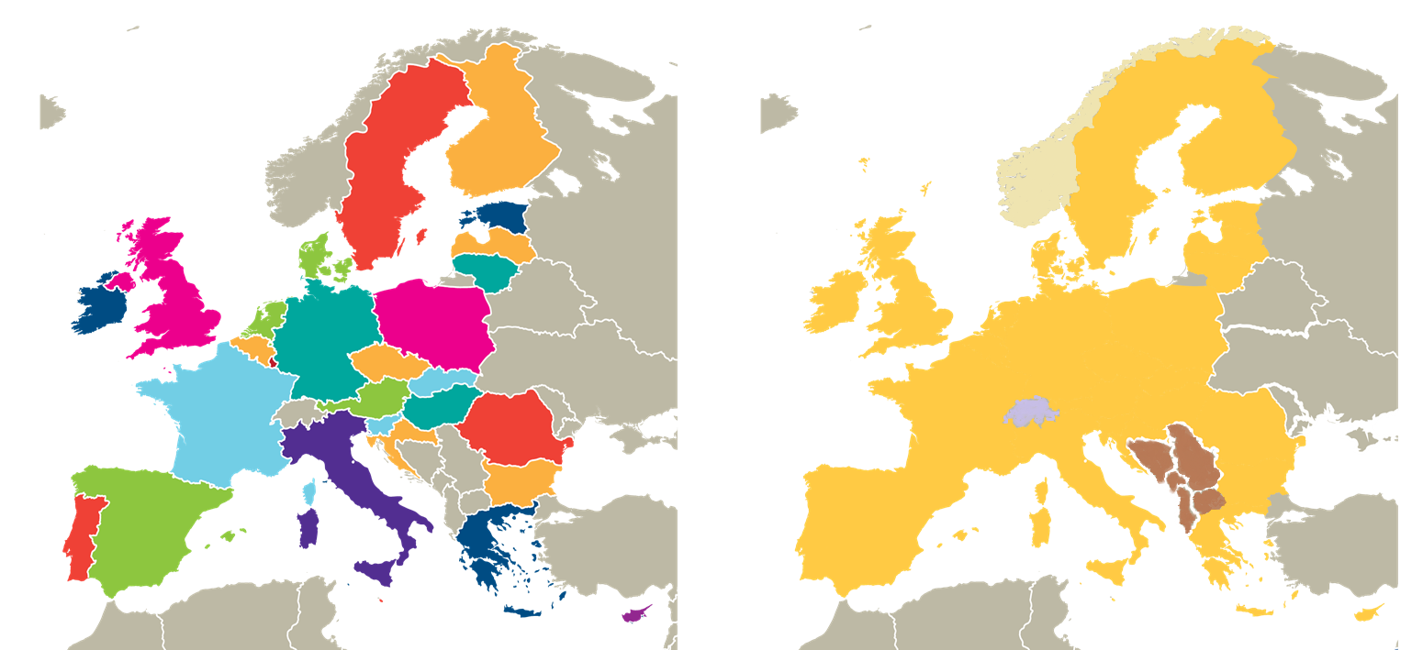
AN AVIATION STRATEGY FOR EUROPE
Challenges
To move
From this …. to this …
4

Slide 5
Challenges
To move from …
To reach …
fully integrated State railways
monopolies
lack of market orientation
increasting costs and indebtness
outdated technologies
stagnating modal share
Single European
Railway Area
a level playing field
high quality, customer oriented transport services
cost efficient operations, lower need for public funding
market driven innovation
Policy actions
Competitive, attractive railways

Slide 6
Challenges
  The legacy of a fragmentated structure of the European railway system
  Problem of historical debt and need for financial robustness (Article 9)
  Fierce competition from road and air sectors
  EU rail market shortcomings:
    fragmentation of production
    insufficient collaboration and partnership across the rail industry
    differing operating procedures among rail users
    limited standardisation
    low efficiency levels

Slide 7
Main policy areas
Enabling competition
Facilitating international freight
Framework activities
Rail Freight Corridors governance structure to tackle rail freight issues
Coordination of capacity offer, traffic management, infrastructure works
Harmonisation of processes and procedures
Opening markets to competition
Independence of infrastructure manager from railway undertakings
Independence of railways from the State
Rules on track access charges and capacity allocation
Sustainable funding of infrastructure
Equal access to service facilities
Independent rail regulatory bodies
Transparency of financial flows
Competitive tendering of public service contracts
Rail market monitoring
Ticketing
Noise mitigation
Stakeholder platforms to facilitate cooperation

Slide 8
Railway market opening to competition a stepwise approach
1st major railway law: Directive 91/440 on financial & organisational separation between Railway Operation and Infrastructure Management
STEP 0 1991
1st railway package: make existing legislation more effective, facilitate network access, improve rail freight, reduce delays at borders
STEP 1 2001
2nd railway package: revitalise railways & accelerate construction of an integrated EU railway area, improving safety, interoperability & opening up of rail freight market [1 January 2007] + Creation of ERA
STEP 2 2004
3rd railway package: opening up of international passenger transport market [1 January 2010] - Regulation of passenger rights and certification of train drivers (EU licence)
STEP 3 2007
Recast of 1st railway package into Directive 2012/34/EU
STEP 4 2012
4th railway package: set up structural and technical reforms to eliminate the last obstacles to the creation of a Single EU railway market. To promote competition and innovation on national markets of railway transport
STEP 5 2016

Slide 9
Focus: Opening Up Of Markets To Competition
Fourth railway package (2016)
Domestic passenger services (competitive award for public service contracts)
2023
Recast of first package (2012)
Domestic passenger services (open access)
2020
Rail freight corridor Regulation (2010)
Third railway package (2007)
International passenger services
2010
Second railway package (2004)
Domestic freight services
2007
International freight on entire network
2006
First railway package (2001)
International freight transport on TEN-T freight network
2003
First rail market legislation (1991)
International combined transport of goods & international groupings
1993

Slide 10
Fourth Railway Package of 2016:
Key Policy Objectives
Creation of the Single European Railway Area
Removal of administrative and regulatory barriers; full market opening; effective enforcement of EU legislation
More effective separation between infrastructure management and rail service provision
Strong Regulatory Bodies ("market authorities")
Strong European Railway Agency ("system authority")
More interoperability and improved safety

Slide 11
Single European Railway Area:
Fourth Railway Package of 2016
Market Pillar
To open domestic passenger markets
through open access and competitive tendering of PSO contracts
To improve governance of the railway system
Technical Pillar
To simplify procedures ensuring rail interoperability and safety
To reduce significantly costs and administrative burden for railway undertakings wishing to operate across Europe

Slide 12
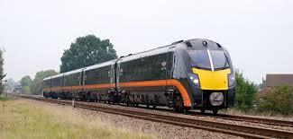
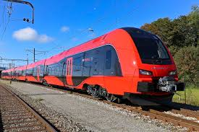
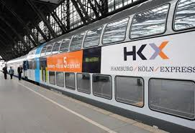
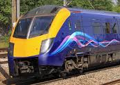
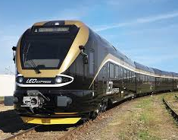
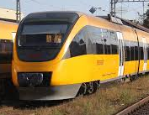
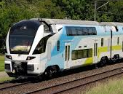
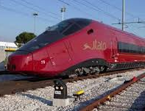
Market for rail passenger transport
Two ways of providing passenger transport:
Under a public service contract awarded by a competent authority (e.g. State, local/regional authority, etc.)
  Mainly for services that are not profitable
  Railway companies receive compensation from the State, or pay the state to obtain a contract whereby they recuperate through ticket sales
  Market opening for PSO services: EU legislation encourages transition from direct award to competitive tendering of PSO contracts
As commercial 'open access' service in competition with other operators
  Member States can limit access rights if the economic equilibrium of a public service contract covering the same line would be compromised

Slide 13
4th Railway Package
Technical pillar, adopted June 2016, to be transposed by June 2019
Market pillar, adopted Dec. 2016, to be tranposed by
  revision of Recast December 2018 (then 2020)
  Principle of competitive award for PSO by December 2019 (with transitional period 2023)

Slide 14
Secondary legislation already in place
Implementation/
Enforcement
Modalities for calculation of direct cost;
Framework agreements;
Licensing;
Criteria for applicants,
Principle purpose and economic equilibrium test;
Coordination of works under Annex VII;
Noise differentiated TAC;
Data collection with a view to rail market monitoring;
Access to service facilities.

Slide 15
Track access charges – principles of EU law
Member States define charging framwork, infrastructure managers determine and collect charges
Charges for use of infrastructure must be used to fund the business of the infrastructure manager (e.g. maintenance, renewal, etc.)
Equivalent and non-discriminatory charges for different railway undertakings performing services of an equivalent nature in a similar part of the market
Charging scheme to be based on same principles over whole network

Slide 16
Other recent initiatives
Revision of Passenger Rights Regulation;
Delegated Act on specific objectives for revision of TSIs (September 2017);
Our current priorities and actions :
Complete the legislative work : economic equilibrium, noise, in process of adopting all implementing acts on autorisation of vehicles and single safety certificats ;
Improve implementation, enforcement (MOVE/COMP);
Evaluate : RFCR, TDD;
Metering of traction electricity;
New challenges : security, digital, ticketing.

Slide 17
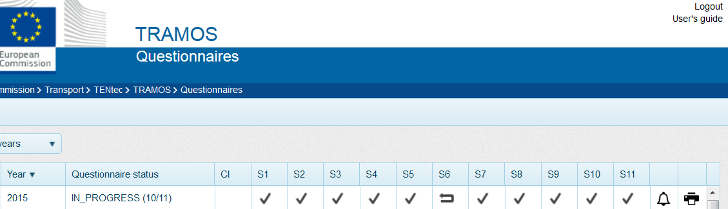
Better oversight of the market
Implementation/
Enforcement
More reliable and accessible market data through
Transport Monitoring System – Rail (TRAMOS - Rail)
  Allowing Member States to submit their RMMS data online
  Performing real time data quality checks both for Member States and EC
  Further developments to allow stakeholders to access validated, historical, cross-country RMMS data

Slide 18
Other issues
Soft measures/sector initiatives
  Sector statement
  Ministerial declaration
Platforms
Efficiency of Infrastructure Managers
KPI's
National rules
Innovation through Shift2Rail

Slide 19
Timeframe of Policy Actions
Noise mitigation
Ticketing
Stakeholders' platforms
Rail Freight Corridors governance, capacity offer, traffic management, infrastructure works, harmonisation
Rail Market monitoring
Independence, track access charges, capacity allocation, sustainable funding, equal access, independent regulatory bodies
Opening markets to competition
First rail market legislation (1991)
First railway package (2001)
Second railway package (2004)
Third railway package (2007)
Rail freight corridor Regulation (2010)
Recast of first package (2012)
Fourth railway package (2016)

Slide 20
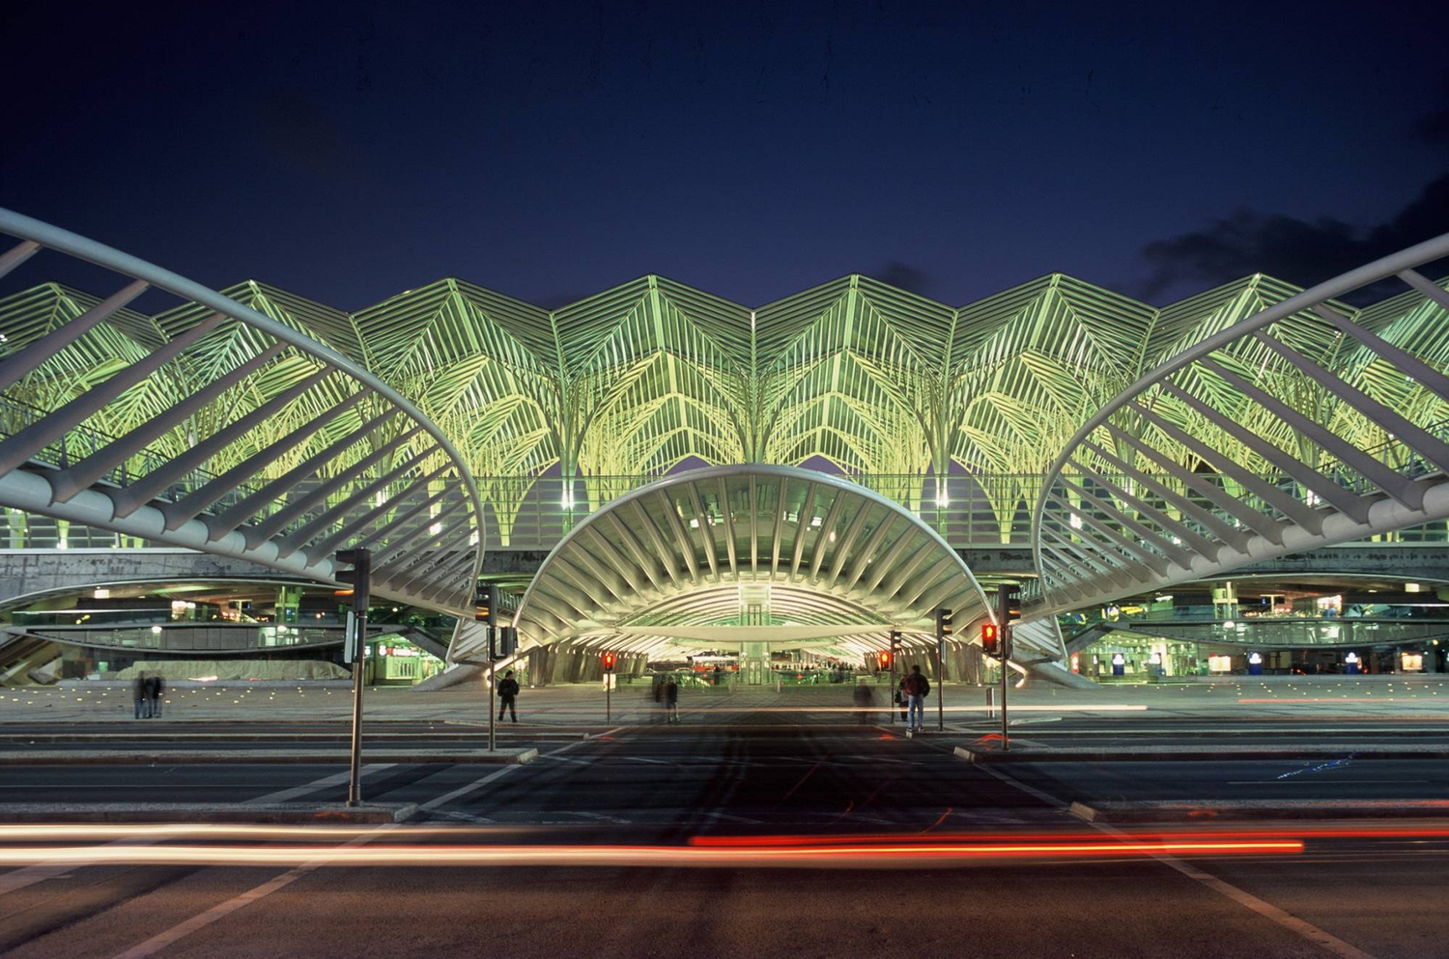
Thank you for your attention!
Thank you for your attention

