Slide 1

AECS
Accident Emergency Call System
Submitted by the expert from OICA
Informal document GRSG-111-39
(111th GRSG, 11-14 October 2016,
Agenda item 13)

Slide 2



1. Regulatory framework for emergency call systems
Russia: ERA Glonass (Accident Emergency Response system)
Eurasian Custom Union: Russia, Belarus, Kazachstan, Armenia, Kyrgyzstan
2. EU: eCall
3. UNECE: AECS (Accident Emergency call System)
4. Help Net Japan (voluntary emergency call system)

Slide 3
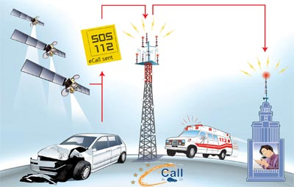
2. Emergency call process
2
3
3
4
5
1
① Vehicle crash happens
② Vehicle sends emergency MSD (Minimum Set of Data) and voice call to 112
③ Mobile Network Operator (MNO) & infrastructure transmit MSD and voice to 112 Public Service Access Point (PSAP, call center)
④ PSAP receives MSD and voice call
⑤ PSAP sends emergency services

Slide 4
3. Basic system lay-out and test requirements
GNSS antenna can be:
External antenna dedicated to AECS
External antenna for navigation system
Antenna integrated in AECD unit
…….
MNO antenna can be:
External antenna dedicated to AECS
External antenna for other Vehicle communicaton functions
Antenna integrated in AECD unit
…….
Positioning function can be:
Dedicated AECS positioning module within AECD unit
Take info from vehicle navigation module
...
GNSS
Satellite
GNSS
ANT
MNO ANT
Can be:
Dedicated power supply
12V starter battery
traction battery
….
Trigger detection can be
Dedicated AECS crash sensor
Take signal from vehicle SRS unit
…
SRS
UNIT,
SENSOR
AECS control unit
BAT
Audio can be:
Dedicated AECS audio speaker/micro
Integrated with vehicle audio
….
Indicator can be:
AECS indicator integrated in AECD
Separate indicator in instrument panel/common place
...
MIC
AUDIO
SW
SP
INDICATOR
Complexity of the certification process is also determined by
Integration of the emergency call system in the vehicle (one box system, semi integrated or fully integrated)
Supplier responsibility

Slide 5
4. UN ECE AECS lay-out
1. Current Regulation Proposal (2 procedures to obtain UNECE AECS certification)
Part I
AECD
Device
Part II
AECD installation
AECS certificate
AECD certificate
Formal Document: ECE-TRANS-WP29-GRSG-2016-19e
Part III
Vehicle with AECS
AECS certificate
Informal Documents:
GRSG-111-06e (AECS secr. Justification)
GRSG-111-07e (AECS secr. Amendment
GRSG-111-13e (Russia amendment for Roll over)
2. Additional proposal by OICA for a 1st revision of the AECS Regulation
Part I a
AECC
Component
Part I b
AECD
Device
Part II
AECD installation
AECS certificate
AECD certificate
AECC certificate
Part III
Vehicle with AECS
AECS certificate
Informal Document:
GRSG-111-15e (OICA proposal for component approval)

Slide 6
5. UN ECE AECD details
Part I: AECD (Device)
Part II: AECD (installation)
AECD
certificate
AECS
certificate
Par. 7.1: General functioning
Par. 16.1: Installation requirement
Par. 16.2: Vehicle impact & trigger
Annex 9: Post-crash performance
Par. 7.2: EMC
Par. 7.3: Positioning
Par. 16.3: Positioning
Annex 8: Test method
Annex 8: Test method
Par. 7.4: Access to PLMN
Par. 16.4: AECS Control
Par. 7.5: Info & warning signal
Par. 16.5: Info & warning signal
Par. 16.6: Hands free audio
Par. 7.6: Power supply
Par. 16.7: Power supply
Par. 7.7: Resistance to impact
Annex 7: Test method
Annex 9: Post-crash perform.

Slide 7
6. UN ECE AECS details
Part III: AECS (vehicle)
AECS
certificate
Par. 25.1: General requirements
Par. 25.2: EMC
Par. 25.3: Positioning
Annex 8: Test method
Par. 25.4: Access to PLMN
Par. 25.5: Vehicle impact & trigger
Annex 9: Post-crash performance
Par. 25.6: AECS Control
Par. 25.7: Info & warning signal
Par. 25.8: Hands free audio
Par. 25.9: Power supply
Par. 25.10: Resistance to impact
Annex 7: Test method
Annex 9: Post-crash perform.

Slide 8
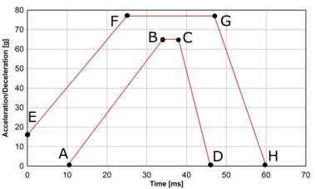






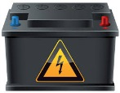



7. Resistance to impact (device)
Component set
High g test
Function check
60g (or 65g for EU)
Data transmission check
Position data check
3 possible methods
GRSG discussion
1. AECD control unit
AECD control unit
With intended fixation & part of wire harness
AECD test bench
1. “Over the air” transmisison
- Real network and PSAP
2. Mobile Network antenna
GNSS
antenna
or
AECD control unit
2. “over the air” transmission
- Mobile network & PSAP simulator
With intended fixation & part of wire harness
or
Manual button
3. Main power supply
If no back-up battery
3. “wired” transmision”
- Mobile network simulator
- Antenna VSWR measurement
w/o fixation
Wired test can be used for test facility in regions that have MNO frequency restrictions
For EU it can also be performed as a component test by supplier -> OICA has also prepared a AECC (Accident Emergency call Component) certification proposal as a first revision of the AECS Regulation

✓
✓

Slide 9
8. Optional GNSS Positioning test (device or vehicle)
Device or vehicle
Check performance
GNSS testing
Static Accuracy
Dynamic accuracy
Dynamic shadow accuracy
Cold start
Reacquisition
Sensitivity and calibration
If we use a 3 GNSS compatible GNSS module we can use UNECE Regulation to replace Regional positioning requirement in EU and Russia
EU: GPS + Galileo & EGNOS
Russia : Glonass
UNECE (optional): GPS + Glonass + Galileo & EGNOS optional
If not covered by UNECE certification it needs to be covered at national or Regional level
✓
✓
✓

Slide 10
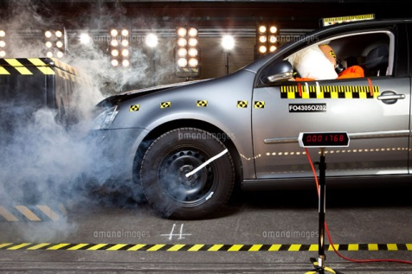


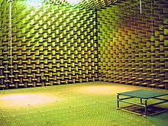
9. Full scale impact test (vehicle)
Impact test
Function check
UNECE R94
UNECE R95
Voice communication
Data transmission
Position check
4 possible methods:
1. “Over the air” transmisison
- Real network and PSAP
or
2. “Over the air” transmission
- Mobile network simulator & PSAP simulator
or
3. “wired” transmision” (not for ERA Glonass)
- Mobile network simulator
- Antenna VSWR measurement
or
4. Transport vehicle to shielded room (not allowed for ERA Glonass)
“over the air” transmission
- Mobile network & PSAP simulator
OICA is also preparing a post-crash verification method using HMI (as part of 1st revision of AECS Regulation)
Internal Impact testing protocols need to be updated to incorporate post crash emergency call functional tests
✓
✓
✓

Slide 11
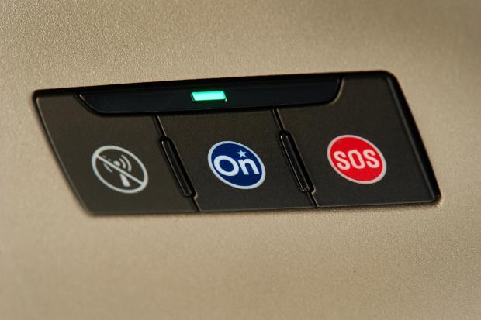
10. In vehicle-self test (device or vehicle)
Induce malfunction
Check malfunction signal
ECU is in working order (e.g. no internal hardware failure, processor/memory is ready, logic function in expected default state)
External mobile network antenna is connected
Mobile network communication device is in working order (no internal hardware failure, responsive)
External GNSS antenna is connected
GNSS receiver is in working order (no internal hardware failure, output within expected range)
Crash control unit is connected
No communication failures (bus connection failures) of relevant components in this table
SIM is present (this item only applies if a removable SIM is used)
Power source is connected
Power supply state of charge (UNECE only)
✓
✓
✓

Slide 12

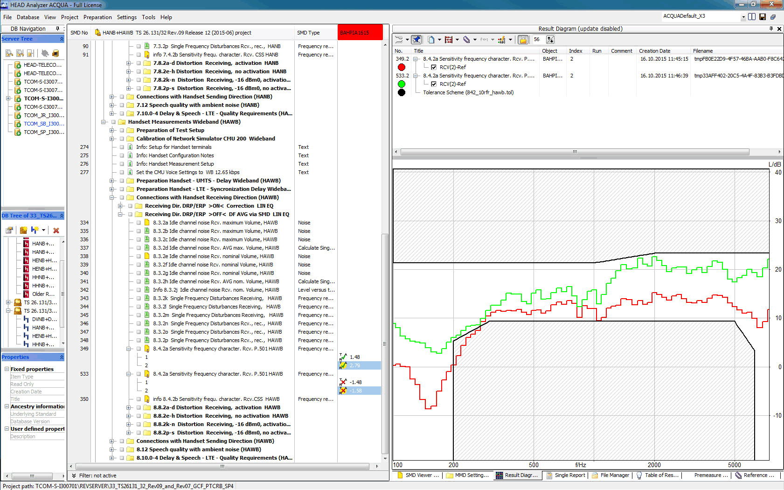
11. Audio tests (Vehicle)
Applicable standard
Vehicle test
Validation
1. Pre-crash audio test (Optional)
Based on ITU P1140 (Hands Free audio systems for emergency call)
If UNECE AECS is adopted it can replace the national requirement of a signatory Contracting Party.
✓

✓

Slide 13
12. Power supply capacity
Requirement
Device test
Vehicle
5-60-5 power supply requirement
The emergency call system should have the capability for
5 min talking
60 min stand by
5 min. Talking
If power supply is part of device (e.g. back-up battery)
- demonstrate
If AECS power supply comes from vehicle power supply (e.g. starter battery)
Demonstrate or calculate
✓

✓

Slide 14
13. Next Steps
AECS proposal for discussion (and adoption?) at UNECE GRSG-111 in Oct. 2016
UNECE WP.29 in March 2017?
Ratification by United Nations in Sept. 2017?
In parallel discuss
AECC component certification proposal
post-crash verification method using HMI
-> Not clear how further discussion can be done (new IG mandate, ad hoc expert group, … ?)

