Slide 1
GRSG meeting Geneva 2016
Informal document GRSG-111-31
(111th GRSG, 11-14 October 2016,
Agenda items 7 and 9)

Slide 2
CTIF
INTERNATIONAL ASSOCIATION OF FIRE AND RESCUE SERVICES

Slide 3
CTIF
Several commissions and working groups.
Commission for Extrication and New Technology.
Commission’s objectives:
Availability of crucial information for every firefighter worldwide & free of charge.
Create a band of trust between manufacturers, government and other organizations.
Assure safe working conditions.
Focus on the victims during rescue operations.

Slide 4
CTIF
How?
Working together with Euro NCAP!
Standardization information through ISO!
Going further than part 1 (rescue sheet)
Propulsion energy identification
Standard template rescue sheet for buses and trucks
Standard template Emergency Response Guide
By using the same 10 ‘ISO chapters’
Best practice procedures concerning the power source in a vehicle(Li-ion batteries, CNG, Hydrogen…), return of experience, lessons learned…

Slide 5
Euro NCAP vs Proposal CTIF

Slide 6
Euro NCAP vs Proposal CTIF

Slide 7
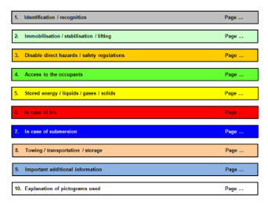
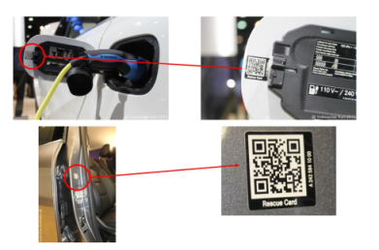
Euro NCAP vs Proposal CTIF

Slide 8
ISO propulsion energy identification
Used Colors
GREY | DIESEL
RED | GASOLINE
GREEN | CNG
WHITE | CRYOGEN LNG
BLUE | HYDROGEN
ORANGE | HIGH VOLTAGE
WHITE | LPG

Slide 9
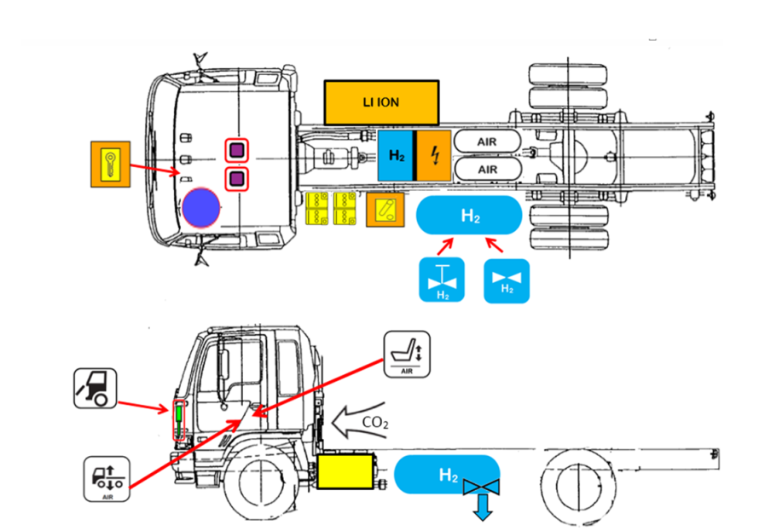
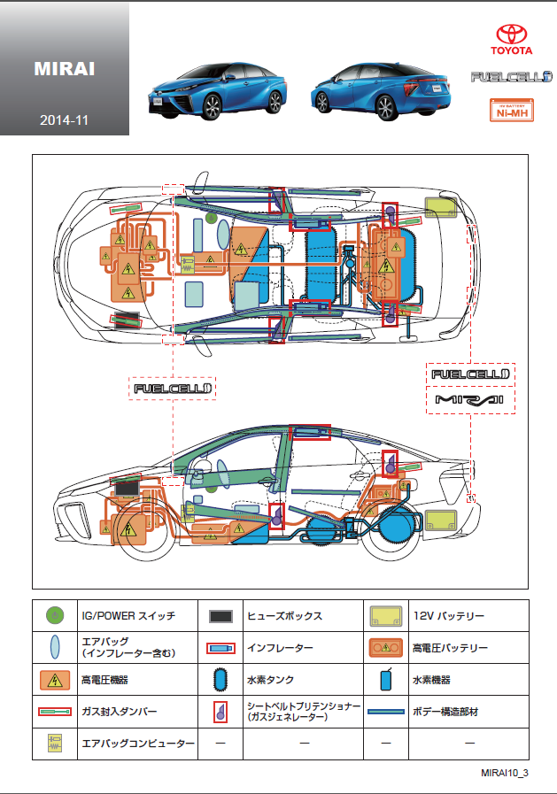
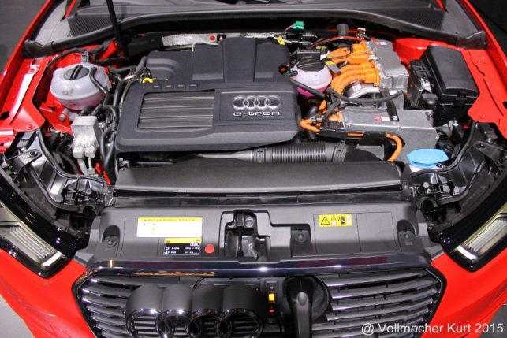
ISO propulsion energy indentification
These colors are also used in Rescue Information and to color vehicle components

Slide 10
ISO propulsion energy indentification
2
3
1
4
1 | First energy source
2 | Second energy source
3 | Density towards air
4 | Stored state

Slide 11
ISO propulsion energy indentification
SYMBOLS
1) FIRST ENERGY SOURCE
2) SECOND ENERGY SOURCE
3) DENSITY TOWARDS AIR
4) STORED STATE
CNG
LNG
LPG

Slide 12
ISO propulsion energy indentification
DIESEL

Slide 13
ISO propulsion energy indentification
GASOLINE

Slide 14
ISO propulsion energy indentification
CNG

Slide 15
ISO propulsion energy indentification
LPG

Slide 16
ISO propulsion energy indentification
LNG

Slide 17
ISO propulsion energy indentification
FULL ELECTRIC (HIGH VOLTAGE)

Slide 18
ISO propulsion energy identification
HYBRID: GASOLINE AND ELECTRIC
(HIGH VOLTAGE)

Slide 19
ISO propulsion energy indentification
FUEL CELL: HYDROGEN AND ELECTRIC
(HIGH VOLTAGE)

Slide 20
ISO propulsion energy indentification
HYBRID: DIESEL AND HYDRAULIC

Slide 21
10 ISO chapters template

Slide 22
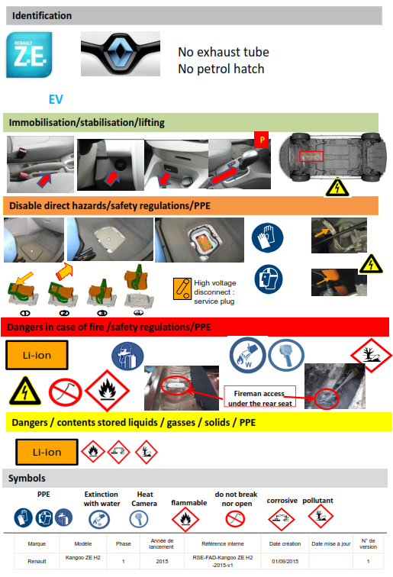
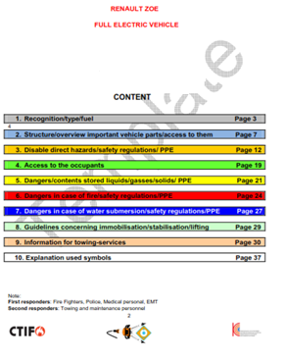
Standard secondary pages rescue sheet(data sheet) versus ISO ERG
Quick rescue information
Detailed rescue information
Rescue Sheet
Emergency response guide
(ERG)

Slide 23
10 ISO chapters template used in ISO ERG
Usable for all means of transport: car /bus /truck /train/tram/ airplane…

Slide 24
Rescue sheet bus front page

Slide 25
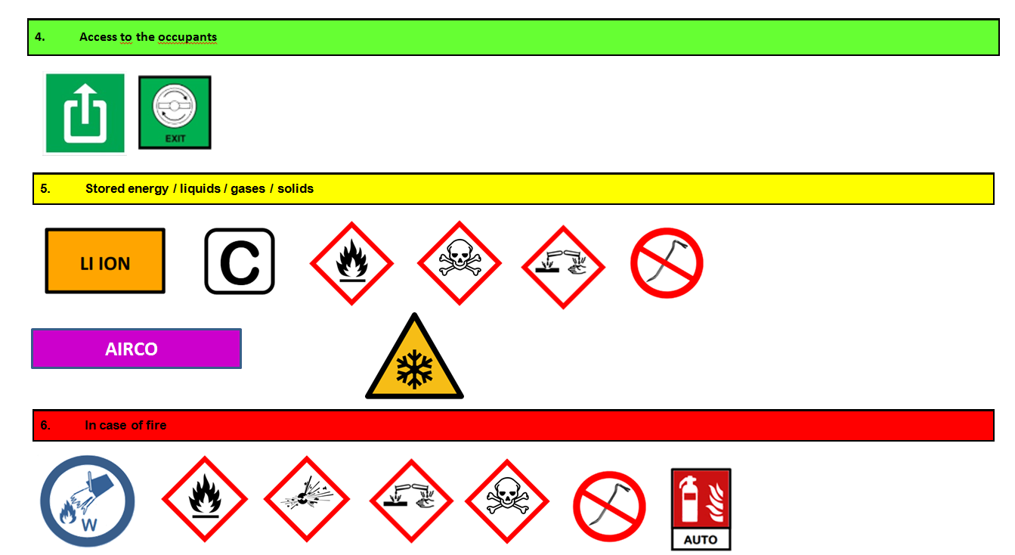
Rescue sheet bus secondary page(s)

Slide 26
Rescue sheet truck front page

Slide 27
Rescue sheet bus secondary page(s)

Slide 28
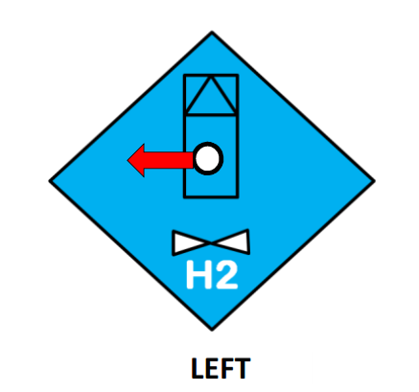
New designed symbols

Slide 29
Interested to become a Commission member?
Every (official) representative of any country is welcome in our commission!
Please contact:
Chairman: Major Tom Van Esbroeck
tom.vanesbroeck@brandweerzonecentrum.be
ISO Project Leader: Kurt Vollmacher
kurt.vollmacher@brandweerzonecentrum.be

