Slide 1
Transmitted by Chair of the
AECS IWG
Informal document GRSG-110-22
(110th GRSG session, 26 – 29 April 2016 Agenda item 16.)
Progress report of GRSG informal group
on Accident Emergency Call System
(AECS)
Denis Zagarin
Chairman of the GRSG informal group on AECS

Slide 2
Background
June 2013 Geneva. 160th WP.29
WP.29 approved the request of the Russian Federation to establish a new GRSG informal group on Automatic Emergency Call Systems (AECS)
(WP.29 report ECE/TRANS/WP.29/1104)
Terms of Reference (IWG AECS):
The target completion date for the work of the informal group shall be the 111th session of GRSG in October 2016, Vehicles of categories N2, N3, M2, and M3 may be covered in a later stage.
(GRSG 109-th Report ECE/TRANS/WP.29/GRSG/88 par. 49)
AECS IWG’ meeting schedule
The last meeting of AECS (13th) took place in Paris (France)
12 – 14 April, 2016

Slide 3
Draft UN Regulation review (informal document)
Scope
1.1. This Regulation applies to:
(a) Part I: the approval of Accident Emergency Call Devices which are intended to be fitted to vehicles of categories M1 and N1;
(b) Part II: the approval of vehicles of categories M1 and N1 with regard to the installation of an Accident Emergency Call Device which has been approved to Part I of this regulation.
(c) Part III: the approval of vehicles of categories M1 and N1 with regard to their Accident Emergency Call System when equipped with an Accident Emergency Call Device which has not been separately approved according to Part I of this Regulation.

Slide 4
Draft UN Regulation review (informal document)
1.2. It does not apply to:
(a) Communication module functionality and communication antenna functionality, unless otherwise prescribed in this Regulation;
(b) The data additional to MSD to be convened to PSAP, the format of the data, the mechanism and logic of data transmission, data exchange protocol, operation modes and conditions of transitions between such modes, performance of the test call and test data transfer, response to protocol commands received from infrastructure and network registration logic;
Privacy, data protection and personal data processing;
Periodical Technical Inspection

Slide 5
Draft UN Regulation review (informal document)
1.3 Vehicles
in the scope of neither Regulation No. 94 nor Regulation No. 95 and not fitted with an automatic triggering system,
of category M1 in the scope of Regulation No.94 and not equipped with frontal airbag
of category N1 in the scope of Regulation No.95 and not equipped with side airbag, or
shall be excluded from the scope of this regulation.
1.4 GNSS positioning may be approved at the request of the applicant.
However, if the applicant opts to request approval of AECD/AECS without the GNSS positioning as described in this regulation, national requirements of the Contracting Parties apply.
1.4a Pre-crash hands-free audio performance may be approved at the request of the applicant.
However, if the applicant opts to request approval of AECS without the hands-free audio performance assessment as described in this regulation, national requirements of the Contracting Parties apply.
1.5 Vehicles of the following categories shall be excluded from the scope of this regulation:
- Armoured vehicles^{1,}
- M1 vehicles with a total permissible mass above 3.5t

Slide 6
Draft UN Regulation review (informal document)
Definitions:
“AECD (Accident Emergency Call Device)” means a unit or a set of units performing at least the following functions:
receiving and/or generating the automatic and manual triggering signals,
providing a warning signal, and
sending the data.
It may in addition perform one of the following functions:
- receiving or determining the vehicle location,
- allowing bidirectional audio signals for voice communication;
unless specified otherwise in this regulation.
“AECS” (Accident Emergency Call System) means an AECD when installed in a vehicle.

Slide 7
Draft UN Regulation review (informal document)
Part I. approval of Accident Emergency Call Devices (AECD) which are intended to be fitted to vehicles of categories M1 and N1
EMC
Position determination
Mean of access to mobile networks
information and warning signal
Power supply
Resistance to impact
Part II. APPROVAL OF vehicles with regard to the installation of an AECD of an approved type
Position determination
AECS control
information and warning signal
Hands-free audio performance
Power supply
AECS post-crash performance
Part III APPROVAL OF vehicles with regard to their AECS WHEN EQUIPPED WITH an AECD which has not been separately approved according to Part I of this Regulation
(Requirements = Part I + Part II)

Slide 8
Issues which should be taken into GRSG account:
Approach related to AECD’ components approval
Which allows suppliers that provide components for use in emergency call systems to perform the relevant tests under their responsibility and offer these components as AECD approved
devices to manufacturers (proposed by OICA, document - AECS-13-03)
Possible solutions:
to elaborate the approach until target completion date of AECS (in parallel with the finalization of the general approach of draft UN Regulation);
to elaborate the approach after UN Regulation adoption (as amendments to UN Regulation).

Slide 9
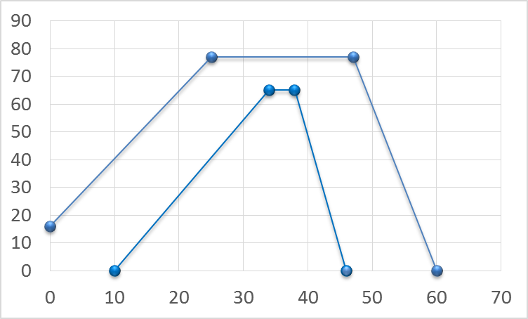
Issues which should be taken into GRSG account:
2. Resistance to mechanical impact of AECD
Description of test pulses
Acceleration/deceleration, g
Point | Time (ms) | Acceleration (g)
A | 10 | 0
B | 32 34 | 60 65
C | 35 38 | 60 65
D | 46 | 0
E | 0 | 16
F | 25 | 77
G | 47 | 77
H | 60 | 0
F
G
B
C
E
A
D
H
Time, ms
draft Commission Delegated Regulation on eCall
agreed by most of Contracting Parties of AECS at 13th meeting

Slide 10
Other issues discussed at AECS
AECS post-crash performance
HMI test method
can be used only if the AECD/AECS is capable to check and diagnose the electrical connections between all of the main devices (AECD control unit, PLMN communication module, GNSS receiver , antenna, power source, microphone, loud speaker etc.) and status of PLMN and GNSS modules (internal failure), PLMN coverage etc.
Manual triggering
manual triggering performance of AECD/AECS (checking of MSD emission and/or two-way voice communication)
Conclusion after 13th AECS meeting:
Items can be elaborated and proposed by interested parties at the later stage after UN Regulation adoption

Slide 11
Next steps
AECS experts to provide comments on document GRSG-110-15 until end of June 2016
AECS Secretary to collect the final comments and to send the draft regulation to GRSG as an official document before 15 July 2016
AECS Secretary to elaborate, in cooperation with the informal group experts a justification paper, to be finalized and sent to GRSG by mid September 2016
After GRSG-110, according to the outcomes of the session, Secretary to organize, if necessary, a Doodle Poll for a possible Webex meeting

Slide 12
ФИО исполнителя(ей), контактные данные (если требуется).

