Slide 1
Possible implementation of WLTP into a UN Regulation
Informal document GRPE-73-26
73rd GRPE, 6-10 June 2016,
agenda item 3(b)
WP.29 Secretariat

Slide 2
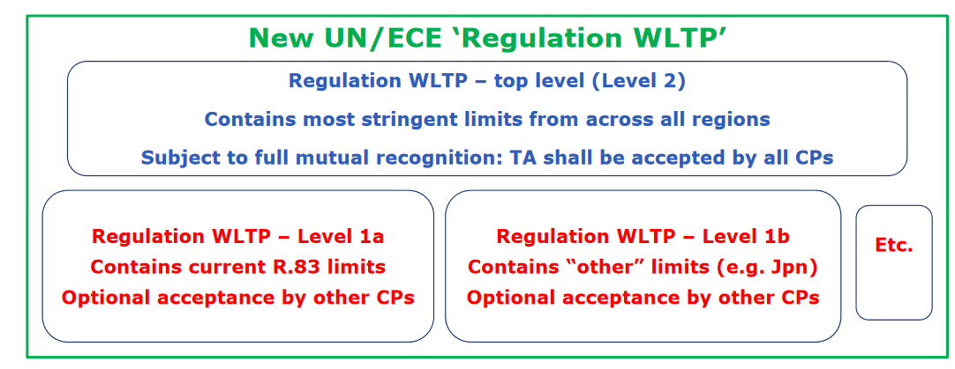
Background information about the November 2015 WP.29 session
At its November 2015 session WP.29 agreed to transpose UN GTR on WLTP into a UN Regulation according to the second route proposed by the representative of the EU consisting in developing a UN Regulation on WLTP in a hierarchical manner with different levels of stringency that reflect different national / regional requirements.

Slide 3
Background information about the January 2016 GRPE session
At the January 2016 GRPE session the secretariat reminded that, according to the provisions of the 1958 Agreement, the latest series of amendments to a Regulation (or its original version in the absence of series of amendments) were always subject to mutual recognition.
GRPE endorsed the approach to focus first on the levels below (Level 1a, Level 1b, etc.) when developing the new UN Regulation on WLTP, while having in mind the need of Level 2 for IWVTA.
GRPE agreed to further investigate the best way to integrate all levels in the new UN Regulation on WLTP and to resume discussion at the next GRPE session in June 2016.

Slide 4
Possible structure of WLTP UN Regulation
Universal 01 series
00 series – A
00 series – …
00 series – B
In a first stage, GRPE agreed with the following strategy:
Original text of the UN Regulation contains different categories/levels A, B, etc. reflecting different regional requirements.
The marking and the approval number help to differentiate.
Top level (Level 2 – most stringent) is likely to require more time to be defined.
Subject to mutual recognition
Corresponding to the
EU Regulation:
EURO 6 emission LV
WLTP with extra-high
…
Corresponding to Regulation in Japan:
Japanese emission LV
WLTP without extra-high
…
Corresponding to any
other Regulation
needed, if any

Slide 5
Options
“Options” means different technical requirements in a UN Regional which are not considered equivalent to meet the requirements for type approval purposes and, thus, are not mutually recognized between Contracting Parties.
The term “options” is not defined in the 1958 Agreement (http://www.unece.org/fileadmin/DAM/trans/main/wp29/wp29regs/505ep29.pdf).
“Options” shall be avoided according to paragraph 11 of the General guidelines for transitional provisions (http://www.unece.org/fileadmin/DAM/trans/main/wp29/wp29wgs/wp29gen/ECE-TRANS-WP29-1044r1e.pdf): “Bearing in mind that the application of UN Regulations is optional, UN Regulations shall not include options, or transitional provisions, to cope with the national/regional mandatory application of these Regulations. This issue has to be dealt with nationally/regionally by Contracting Parties.”

Slide 6
Alternatives
“Alternatives” means different technical requirements in a UN Regional all of them considered equivalent with regard to meet the requirements for type approval purposes.
According to the provisions of:
1958 Agreement – Revision 2 currently in force (see Article 1, http://www.unece.org/fileadmin/DAM/trans/main/wp29/wp29regs/505ep29.pdf)
1958 Agreement – Draft Revision 3 (see Article 1, http://www.unece.org/fileadmin/DAM/trans/doc/2016/wp29/ECE-TRANS-WP29-2016-002e.pdf
the General guidelines for transitional provisions (see para. 10, http://www.unece.org/fileadmin/DAM/trans/main/wp29/wp29wgs/wp29gen/ECE-TRANS-WP29-1044r1e.pdf),
alternative technical requirements may be used in a UN Regulation provided that all UN type approvals granted in accordance with any of the alternative requirements in that UN Regulation are accepted by all Contracting Parties applying that Regulation.

Slide 7
Possible way forward to avoid “options” in the case “alternatives” are not accepted by all Contracting Parties
Regional levels (Level 1a, Level 1b, etc.) to be published in the original version of the new Regulation on WLTP, whereas the harmonized Level 2 to be introduced by the 01 series of amendments to that new Regulation
The original version of the WLTP Regulation and its 01 series of amendments can be adopted by WP.29 at the same time
The original version of the Regulation could contain introductory provisions as it was the case e.g. in Regulations Nos. 116 and 117
Possible introductory provisions: “As from the date of entry into force of this Regulation, Contracting Parties shall not grant type approvals according to this Regulation until [the date of entry into force of the 01 series of amendments].”
This possible way forward would only make sense under Revision 3 of the 1958 Agreement and would be subject to the endorsement of the Office of Legal Affairs (OLA) and all Contracting Parties to the 1958 Agreement

Slide 8
Possible way forward to avoid “options” in the case “alternatives” are not accepted by all Contracting Parties
Adoption of the original version of the WLTP Regulation and the 01 series of amendments by WP.29
6 months – OLA notification for the original version
Original version comes into force but not yet applicable as by the introductory provisions
6 months – OLA notification for the 01 series of amendments
First series of amendments comes into force
Original version is now applicable
Latest series of amendments (Level 2 – most stringent one) only subject to mutual recognition
N.B. Similar process was done for the entry into force of Regulations Nos. 132 (REC) and 135 (PSI), but without introductory provisions.

