Slide 1
EXPLANATIONS TO ECE/TRANS/WP.29/GRE/2016/18 OPTIONAL PERFORMANCE BASED CLASS B1 PASSING BEAM (REG. No 112)
Transmitted by the expert from Poland | Informal Document No. GRE-76-26 (76th GRE, 25-28 October 2016) agenda item 7 (f))
Tomasz Targosinski Ph. D. Eng
Poland
73 GRE 14-17 April 2015

Slide 2
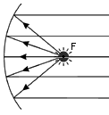
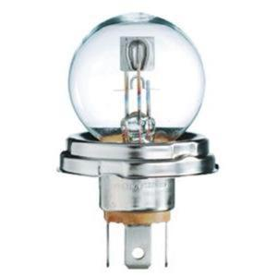
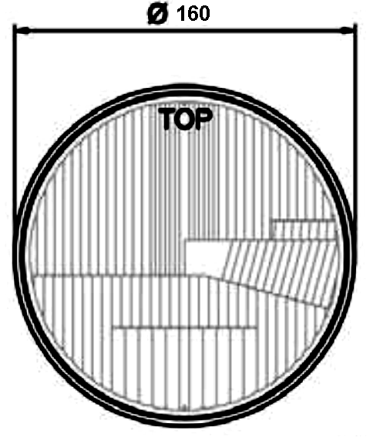
FIXED DESIGN FACTORS INCLUDED IN REQUIREMENTS OF REG. 112
FOCAL DISTANCE
BETWEEN LIGHT SOURCE AND REFLEECTOR
LUMINOUS FLUX
OF LIGHT SOURCE
GEOMETRICAL SHAPE AND SIZE
OF FILAMENT
GEOMETRICAL SIZE
OF HEADLAMP
Shield for CUT-OFF
USE OF „STANDARD” HEADLAMP (an effective diameter not less than 160 mm) AND „ETALON” BULB

Slide 3
FIXED DESIGN FACTORS
LUMINOUS FLUX
AFTER REMOVING FLUX THE OTHER FACTORS
WILL INFLUENCE THE FINAL QUALITY OF BEAM PATTERN

Slide 4
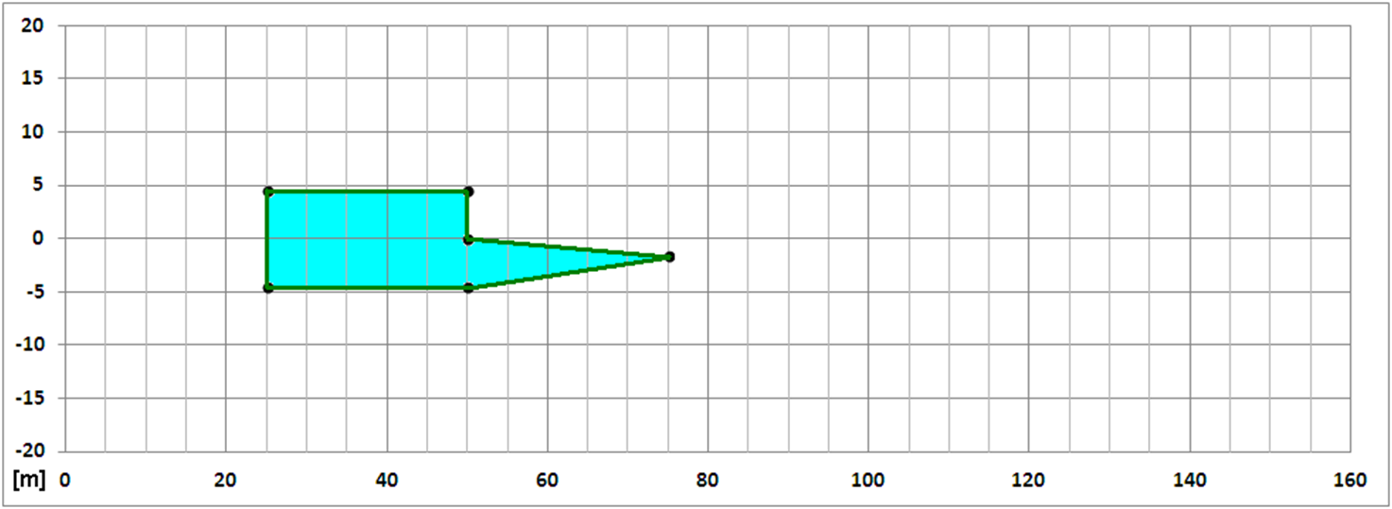
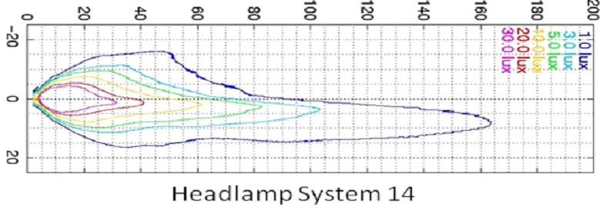
REQUIREMENTS AREA OF EXISTING REG. No. 112
GOOD PERFORMING HALOGEN HEADLAMP
(2004 - TWELVE YEARS OLD)

Slide 5
REQUIREMENTS AND TECHNOLOGY POSSIBILITY

Slide 6
Feedback received
PROPOSAL SLIGHTLY MODIFIED

Slide 7
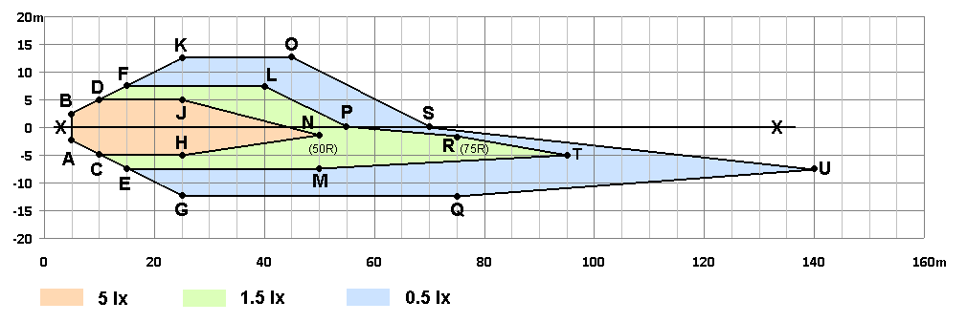
EXISTING AREA OF REQUIREMENTS IN REG. 112
PROPOSED AREA OF REQUIREMENTS AND VALUES (SINGLE HEADLAMP)
Slightly modified according feedback

Slide 8
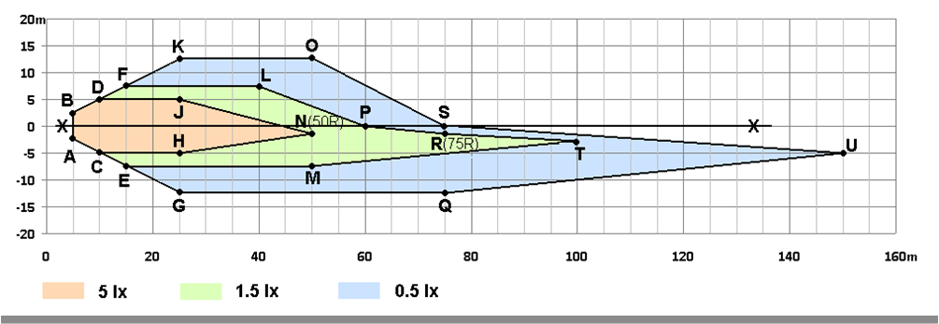
PROPOSED VALUES AND REAL POSSIBILITY (HALOGEN HEADLAMP – 2004)

Slide 9
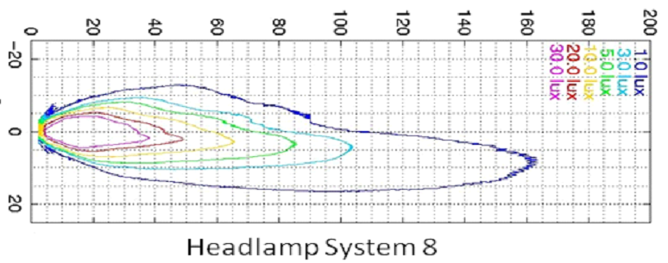
ANOTHER EXAMPLE

Slide 10
GOOD PERFORMING HID SYSTEM

Slide 11
OPTIONAL REQUIREMENTS (CLASS B1 Reg. 112)
PROFITS:
REAL PERFORMANCE BASED REQUIREMENTS
REMOVE ALL OLD ”DESIGN” FACTORS
ALLOW FOR USE ANY LIGHT SOURCE INDEPENDENTLY ON FLUX, POWER, SIZE ETC.
OPTIONAL – NO OBLIGATION TO FOLLOW BUT:

Slide 12
PROFITS:
OPTIONAL – NO OBLIGATION TO FOLLOW BUT:
- IF HEADLAMP WILL MEET „STRONGER” (B1 – LED LEVEL) REQUIREMENTS CAN BE
EFFECTIVELY PROMOTED/ADVERTISED TO THE CUSTOMERS
- FREEDOM FOR LED HEADLAMPS - NO NEED TO FOLLOW „1000lm” FLUX
REQUIREMENT
- TIME TO THE FINISH OF SIMPLIFICATION PROCESS CAN BE USED TO COLLECT
EXPERIENCE WITHOUT ADDITIONAL EFFORT
- IN FUTURE WILL BE POSSIBLE CORRECTION (SIMPLIFICATION) OF REQUIREMENTS
BEFORE EVENTUAL INTRODUCING IT AS OBLIGATORY
- NO PROBLEM WITH OBJECTIONS FROM SOME MANUFACTURERS – IT IS NO
OBLIGATION TO FOLLOW THIS REQUIREMENTS

Slide 13
THANK YOU FOR YOUR ATTENTION
Notes:
13

