Slide 1
Task Force on Electro-magnetic Compatibility (TF EMC) Status report of TF to GRE-76 Tuesday, 25 October 2016
Submitted by TF EMC
Informal document GRE-76-18
(76th GRE, 24-28 October 2016, agenda item 7(c))

Slide 2
TF EMC Status Report
TF EMC had its 3rd meeting on Monday, 24th October 2016.
Document available on the UNECE TF workspace.
TF EMC will report on:
Current development of R10.05 (proposals from China and further modifications)
Drafting roadmap for the new supplement to R10.05
Clarifications of Transitional Provisions of R10.05
Future development of R10 based on OICA ideas

Slide 3
TF EMC Status Report – R10.05 Current Development
(Proposals from China)
TF EMC has reviewed the proposals from China (GRE/2015/35) and have sent comments to the Chinese delegate.
China answered back to TF EMC with positive comments and agreed changes.
TF EMC 3rd meeting: Spain raised one question on one remaining technical item which has to be discussed within OICA.
All other modifications were agreed and included in the next draft Supplement of R10.05.

Slide 4
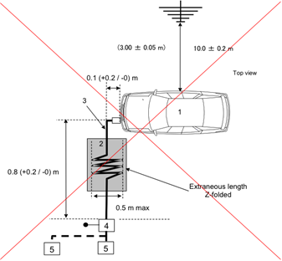
TF EMC Status Report – R10.05 Development Details
(Other Modifications)
Focus of the work on the current version of the R10:
Correction of technical and editorial errors on figures of test-setups of RESS charging (consistency with last ISO and CISPR figures):

Slide 5
TF EMC Status Report – R10.05 Development Details
(Other Modifications)
Focus of the work on the current version of R10:
Clarification of the possible usage of Open Test Sites and Open Area Test sites (e.g. no use of OTS for ESA tests).
Harmonization of the wording for semi-anechoic chambers : “absorber lined shielded enclosure (ALSE)”.
Clarification for ESA in charging mode bench test between “table-standing” and “floor-standing” set-up.
Detailed description of the test-setup of RESS testing.
Aligning the figures and descriptions of Open Test Sites with CISPR 12.
Implementation of some further changes proposed by China and discussed internally at OICA.

Slide 6
TF EMC Status Report – Drafting Roadmap
Preparation of a new Supplement to R10.05 (no major technical changes).
Distribution of the current draft (under finalization) to TF EMC in the course of November 2016.
Review of the document and further discussion within TF EMC until beginning of March.
Propose an informal document for GRE-77 (4-7 April 2017), as draft Supplement 2 to R10.05.
Adoption of the working document at GRE-78 in October 2017.

Slide 7
TF EMC Status Report – Clarifications of TPs
TF EMC has reviewed the EC request concerning Transitional Provisions of R10.05 (TF-EMC-03-04).
TF EMC discussed at its 3rd meeting and came up with a conclusion which will be transferred to the representative of EC.

Slide 8
TF EMC Status Report – Future Development of R10
(OICA ideas)
Several technical topics for the further development of R10 were discussed within OICA.
OICA agrees that the creation of a technology roadmap could be useful to identify future trends and to draft consequently an R10.06 proposal.
In 2017, such roadmap will be prepared by OICA and supplied to TF EMC for further discussions and opinions.

