Slide 1
Research on Daytime Running Lamps of Motorcycles
Transmitted by the expert from Japan
Informal document No. GRE-75-09
(75th GRE, 5-8 April 2016
agenda item 7 (i))
Expert from JAPAN

Slide 2
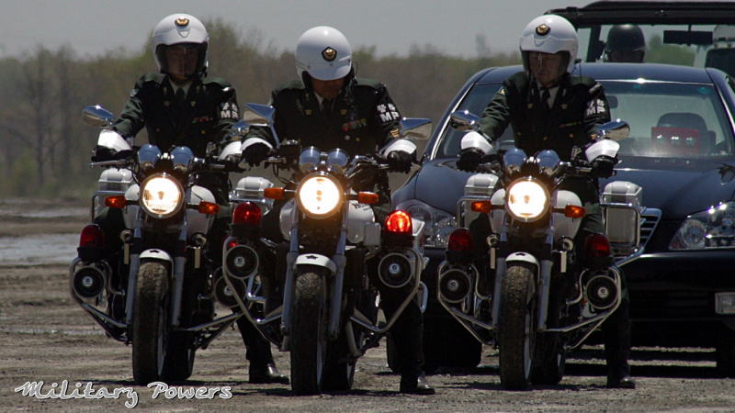
Background and Purpose
Permanent lighting of motorcycle headlamps mandatory since 1996
Effective in reducing motorcycle accidents
Instead of headlamps,
daytime running lamps (DRLs) are permitted as option since 2009.
Japan conducted the research in order to verify the effects of Motorcycles DRLs on road traffic in terms of glare.

Slide 3
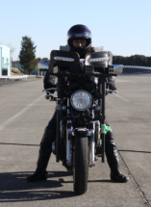
Test Conditions
Items | Conditions
Sky illuminance | Day (10,000 lx) Dusk (2,000 lx, 1,000 lx) Night (0 lx)
Motorcycle lamp | Passing beam（ＬＢ）: originally installed Daytime running lamp（ＤＲＬ）
Motorcycle speed | 40, 60, 80 km/h
Eye-point height of test subjects | 1,200 mm
Motorcycle lamp height | Centre of ＬＢ：873 mm Centre of ＤＲＬ：1,200 mm
Motorcycle lamp light source | ＬＢ：Halogen (H4 bulb) ＤＲＬ：ＬＥＤ
DRL
Passing beam
Related requirements about Motorcycle DRL
*Intensity: not less than 400 cd in the axis of reference
not exceed 1,200 cd in any direction (UN-R87)
*Height: 250 mm ~ 1,500 mm above the ground (UN-R53)

Slide 4
Outline of Research
* Purpose: to study whether drivers of 4-wheeled vehicles feel glare caused by an oncoming motorcycle with the DRL or low beam (“LB”) ON.
* The situation: a motorcycle is approaching when the 4-wheeled vehicle is turning right.
* The drivers made sensory evaluations of the glare caused by an oncoming motorcycle with the DRL or LB ON.
Driver (Test subject)
[With the LB ON]
3.5m
[With the DRL ON]
6m

Slide 5
Results: Evaluation of glare by the drivers
Night : 0 [lx]
Dusk : 1,000 [lx]
9: Imperceptible
8:
7: Satisfactory
Percentages of test subjects’ evaluation ratings
6:
5: Tolerable
4:
3: Disturbing
2:
1: Intolerable
Dusk: 2,000 [lx]
Day : 10,000 [lx]
9: Imperceptible
8:
7: Satisfactory
Percentages of test subjects’ evaluation ratings
6:
5: Tolerable
4:
3: Disturbing
2:
1: Intolerable

Slide 6
Summary
* The lower sky illuminance becomes, the more glare was felt.
*About 80% of the test subjects feel glare caused by DRLs at night.
The DRLs of motorcycles shall not be used at night.

Slide 7
Thank you for your attention !

