Slide 1


The Euromed RRU project
George Emmanoulopoulos
Key Expert « Railways transport»
ROAD – RAIL – URBAN TRANSPORT
Geneva, November 22, 2016

Slide 2














EuroMed Regional Transport Project
‘Road, Rail and Urban Transport’ in brief
LEEGO
Duration: started: 20/12/2011 → ends: 31/12/2016
Project office: Tunis
Key experts: Michalis Adamandiadis (TL & Road Tr.)
George Emmanoulopoulos (Rail)
David Moncholí i Badillo (Urban)
Partner countries
Jordan Egypt Lebanon Algeria Morocco Tunisia Israel Palestine Libya

Slide 3
Objectives of the EuroMed RRU project
It is about Land transport(Road , Rail, Urban Transport)
Focuses to:
  Regulatory reform and adaptation
  Operational conditions, to facilitate international transport
  Interoperability & Safety
Provides TA for sustainable and efficient transport and for Learning from experience in the EU and the wider Mediterranean region
Implements actions of RTAP 2014-2020 (Action 12: Safety and interoperability in the railway sector, Action 8: Harmonisation of the international land transport haulage, Accession to and participation in all relevant international transport (road and rail) conventions and organisations should be encouraged, in particular OTIF, CIT, UNECE)

Slide 4
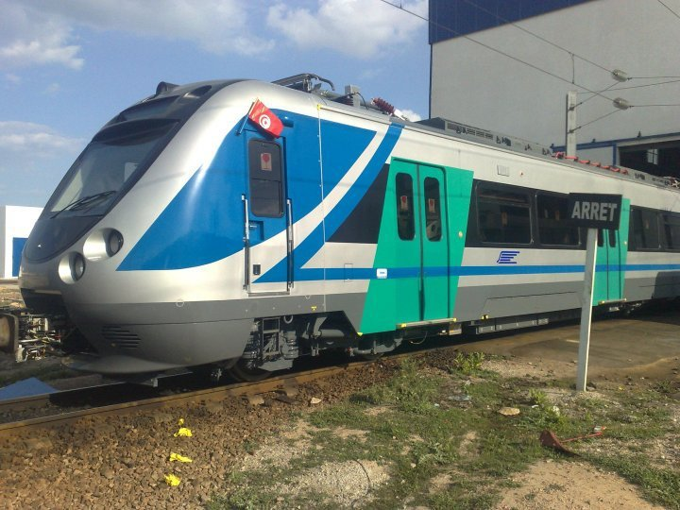
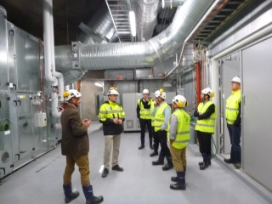
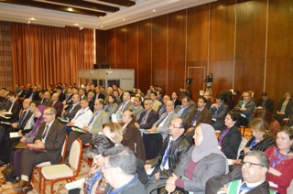
EuroMed RRU Implemented activities
Rail Transport
Cooperation activities with ERA,UIC, CIT, OTIF, UNECE, SNCF,ETCR, IPEMED
TA to Tunisia, Israel, Jordan, Algeria, Egypt on rail safety
All: Officers from Partner countries trained on railway safety issues(Brussels Nov’12)
Tunisia: Surveys for rail passenger satisfaction, focus groups, Quality manual for rail passenger transport, on the basis of EN13816
Jordan: Training seminar on rail safety & interoperability standards and regulations and οn railways restructuring practices, in Amman , Sept’2013, with the cooperation of UIC, Guidelines for accidents investigation and recommendations on the management and improvement of rail level crossings, Recommendations on how to organize Accident Investigation Body, 2014
Israel: Safety regulations for electrification were drafted
Morocco, Tunisia: Awareness raising workshops about the benefits of CIM with cooperation of CIT

Slide 5
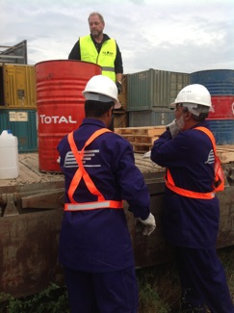
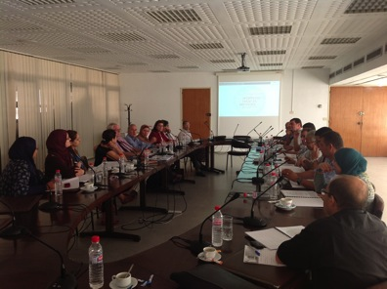
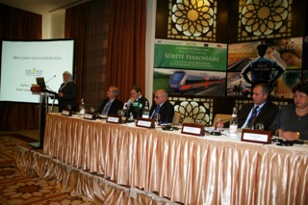
RRU Railway highlights
Various: Study tours from partner countries(Tunisia, Israel, Jordan) for rail safety ( to France SNCF, Finland FTA & VR
Algeria: Diagnostic report and action plan for TA on rail safety rules, 2014
UNECE WG SC2 for railways, Geneva, participation of delegates from partner countries, Nov’2014, Nov’2015 , Nov’2016
ETCR, College of Europe, two week seminar, in Bruges, July 2013, July 2014 participants from partner countries,
Egypt: International seminar on LXs in cooperation to UIC and UNECE, Cairo,March 2016
Tunisia: IPEMED conference in Tunis, in cooperation with SNCFT, MoT, SNCF, Nov’ 2014

Slide 6
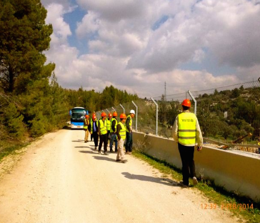
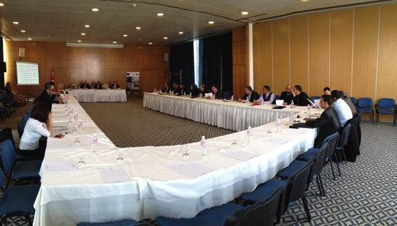

RRU Railway highlights
Tunisia: TA & Training workshops in Tunis, Sep’2014, on the implementation RID for transport of dangerous freight by rail, with the cooperation of UIC, OTIF, UNECE
Egypt: TA on rail Safety standards, AIB, verification/validation/accredidation of rolling stock, regulation EIS, level crossings
Tunisia: Strategy to shift freight to rail,
Tunisia:T A for setting up a SMS for SNCFT and for rail safety regulations to MoT
Egypt and Israel: ERA awareness days on rail safety standards and regulations
Israel: Jerusalem Light rail LXs
Israel: TA on the SMS, on Rolling stock condition monitoring and track measurement, to assess bottlenecks in the application of TSIs (e.g Safety in Railway Tunnels, Energy)

Slide 7
Continuation of Technical Assistance
In the EU, the European Union Agency for Railways (ERA), is responsible for the standards and regulations related to railway safety and interoperability
After the end of Euromed RRU project, it is the Agency, which will most probably undertake to offer TA in the coming years, to the Euromed partner countries.
Discussions about this are under way between ERA and the EC.

Slide 8
Thank you for your kind attention
Tel/Fax : +216 71 234 098
Email : euromedrru@gmail.com
ROAD – RAIL – URBAN TRANSPORT

