Slide 1
FIA Protection Against Mileage Fraud by Common Criteria
Informal document GRSG-108-37
(108th GRSG, 4-8 May 2015, agenda item 3)
UNECE 2015-05-05

Slide 2
FIA Protection against Mileage Fraud by Common Criteria
Why does the FIA propose a protection against mileage fraud
Summary
Common Criteria
Target of Evaluation (Annex 5,2)
Protection Profile / Security Target (§2.6, §5.5.2, Annex 5)
Next Steps

Slide 3
FIA Protection against Mileage Fraud by Common Criteria
Why does the FIA propose a protection against mileage fraud
Mileage Fraud is a safety risk, it causes unexpected faults and leads to breakdowns
Mileage Fraud undermines legal requirements on the durability of environmental relevant components
Mileage Fraud leads to an annual loss of €5.6 - €9.6 billion for consumers
Mileage Fraud affects 8% – 12% of used car sales, rising to 30% - 50% for cross border transactions
Mileage Fraud can be done for many vehicles in about one minute via the OBD port. The frauding tools are available from 150,-€

Slide 4
FIA Protection against Mileage Fraud by Common Criteria
C-ITS Forum Structure
Summary
The FIA proposes to develop and verify the protection against mileage fraud with the methodology of common criteria according to ISO/IEC 15408 and ISO/IEC 18045.
Protection level: Manipulations must be so time effort and cost intensive that they are no longer cost-efficient compared to the higher sales price, risk of mortal danger or environmental perils that can be achieved during the complete lifetime of the vehicle.
While the Protection Profile is unique and the method of common criteria is standardized, the Vehicle Manufacturer can still individually decide, what measures he takes to meet his specific Security Tag. It will be stated in the VM-specific Security Target.
The type approval authority must only check the successful evaluation result for VM specific solution.
Notes:
4

Slide 5
FIA Protection against Mileage Fraud by Common Criteria
C-ITS Forum Structure
Common Criteria
FIA proposes the standardized methodology of „Common Criteria“ to ease the development for vehicle manufacturers and the approval for authorities of the protected mileage data.
The approach is technology neutral, as it defines a single Protection Profile, but leaves it up the manufacturer how to realize the solution by his individual Security Target.
The methodology of Common Criteria is an approved IT process, accepted in 27 countries around the world and under constant development to stay state of the art.
The base for ISO/IEC 15408 and ISO/IEC 18045 is given publically under http://www.commoncriteriaportal.org/cc/ (CC and CEM).
Notes:
5

Slide 6
FIA Protection against Mileage Fraud by Common Criteria
C-ITS Forum Structure
Common Criteria used for protection against Mileage Fraud
A Protection Profile (PP) document for the mileage data must be deployed. It state the assets to be protected, the required protection level and can be understood as a kind of “catalogue” for threats and protection mechanisms. This single document will be used as general base for all VMs
A Security Target (ST) document will map the Protection Profile to the individual realization in a system. Thereby, items from the “catalogue” PP will be selected and it will be described, how they act to reach the protection level. This allows a VM-specific implementation
An Evaluation will be performed by independent, accredited labs on the Target of Evaluation (TOE = implementation at the VM) under consideration of PP and ST in order to verify that the required Protection Level is met
The Evaluation Test Report (ETR) of the lab will reveal areas of improvements to VM and deliver a successful confirmation for usage towards the type approval authority
Notes:
6

Slide 7
FIA Protection against Mileage Fraud by Common Criteria
C-ITS Forum Structure
Common Criteria used for protection against Mileage Fraud
Framework Common Criteria
(ISO/IEC 15408 and ISO/IEC 18045)
Protection Profile for
Mileage Fraud Protection
Security Target for
VM individual realization
Evaluation Test Report for Target of Evaluation
Notes:
7

Slide 8
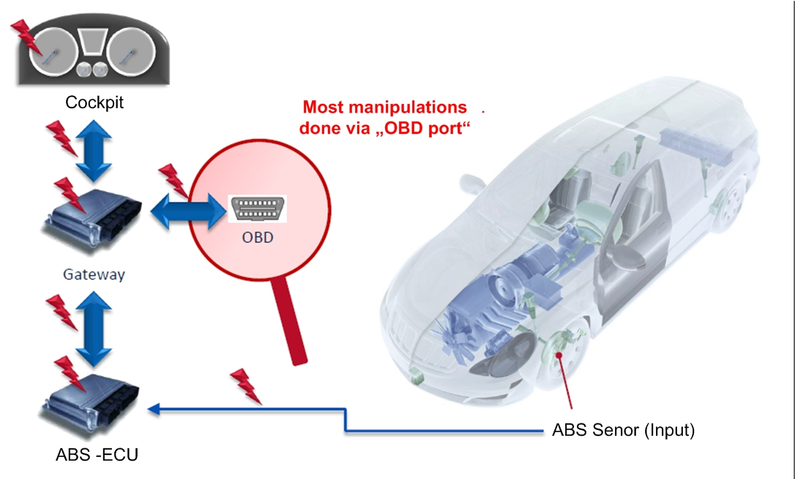
FIA Protection against Mileage Fraud by Common Criteria
C-ITS Forum Structure
Target of Evaluation (TOE, Annex 5, 2)
Most manipulations done via „OBD port“ in about 1 minute
2.4 The ABS Sensor counts the tours of the wheel. It is the initial data of the mileage
Manipulating the sensor leads to wrong mileage data
Notes:
8

Slide 9
FIA Protection against Mileage Fraud by Common Criteria
C-ITS Forum Structure
Target of Evaluation (TOE, Annex 5, 2)
Most manipulations done via „OBD port“ in about 1 minute
2.4 The communication channel system transfers data
„Man in the Middle attacks like resitors falsify the transferred data
Notes:
9

Slide 10
FIA Protection against Mileage Fraud by Common Criteria
C-ITS Forum Structure
Target of Evaluation (TOE, Annex 5, 2)
Most manipulations done via „OBD port“ in about 1 minute
2.4 The communication channel system transfers data
„Man in the Middle attacks like resitors falsify the transferred data
Notes:
10

Slide 11
FIA Protection against Mileage Fraud by Common Criteria
C-ITS Forum Structure
Target of Evaluation (TOE, Annex 5, 2)
Most manipulations done via „OBD port“ in about 1 minute
2.4 The communication channel system transfers data
„Man in the Middle attacks like resitors falsify the transferred data
Notes:
11

Slide 12
FIA Protection against Mileage Fraud by Common Criteria
C-ITS Forum Structure
Target of Evaluation (TOE, Annex 5, 2)
Most manipulations done via „OBD port“ in about 1 minute
2.1/2.2 The computation and storage subsystem computes the data from the ABS sensor to mileage numbers and stores it
Unprotected data in ECUs can be overwritten via the OBD port
Notes:
12

Slide 13
FIA Protection against Mileage Fraud by Common Criteria
C-ITS Forum Structure
Target of Evaluation (TOE, Annex 5, 2)
Most manipulations done via „OBD port“ in about 1 minute
2.1/2.2 The computation and storage subsystem computes the data from the ABS sensor to mileage numbers and stores it
Unprotected data in ECUs can be overwritten via the OBD port
Notes:
13

Slide 14
FIA Protection against Mileage Fraud by Common Criteria
C-ITS Forum Structure
Target of Evaluation (TOE, Annex 5, 2)
Most manipulations done via „OBD port“ in about 1 minute
2.3 The mileage display subsystem transfers computed data to readable numbers and displays them
Manipulations via resistors or OBD port lead to false displayed data
Notes:
14

Slide 15
FIA Protection against Mileage Fraud by Common Criteria
Protection Profile / Security Target (§2.6, & 5.5.2, Annex 5)
Security Target: 1000€ (higher sales price for tampered vehicle)
Target of Evaluation: Gateway ECU
Solution: Secured Data Storage behind a Firewall in the Gateway ECU
Most manipulations done via „OBD port“ in about 1 minute

Slide 16
FIA Protection against Mileage Fraud by Common Criteria
Protection Profile / Security Target (§2.6, & 5.5.2, Annex 5)
Security Target 6000€ (higher sales price for tampered vehicle) Target of Evaluation: Whole Odometer System
Solution: Encrypted Data Transfer and Storage of Data behind Firewall
Most manipulations done via „OBD port“ in about 1 minute

Slide 17
FIA Protection against Mileage Fraud by Common Criteria
Next steps
Find support in UNECE WP 29 for the FIA proposal
Setup an informal working group with all stakeholders to work out the protection profile

Slide 18
FIA Protection against Mileage Fraud by Common Criteria
Thank You
For Your Attention

