Slide 1
Comparison of Heavy Duty Hybrid Test Procedures Drafted in GTR n°4
Submitted by the expert from the United States of America
Informal document GRPE-70-15
(70th GRPE, 12 - 16 January 2015
agenda item 4b)
James Sanchez
US EPA
1/13/15

Slide 2
Goals of the Comparison
Compare emission results from the two methods
Evaluate the repeatability of the two procedures
Get hands-on experience with the two procedures
Complete work by end of February to inform WP.29 vote in March

Slide 3
Overview of the Comparison
Powertrain Testing at EPA
Create Engine Cycles with HILS
Create Engine Cycles from Powertrain Tests
Run Engine Tests at EPA
Analyze Results

Slide 4
Creating Cycles Using HILS
Integrate the HCM from powertrain tested at EPA with FPT’s HILS bench
Update CAN messages for the hybrid control module (HCM) that is part of the powertrain (need support from hybrid manufacturer )
Generate engine model parameters according to A.9.8.3
Run HILS and check that the engine cycle passes validation criteria in A.9.5.8
Rerun HILS if validation criteria is not met

Slide 5
Creating Cycle from Powertrain Test
Use CAN data to extract engine speed/load operation from powertrain tests
Create engine cycle by modifying engine speed/load cycle while staying within the criteria of A.9.5.8

Slide 6
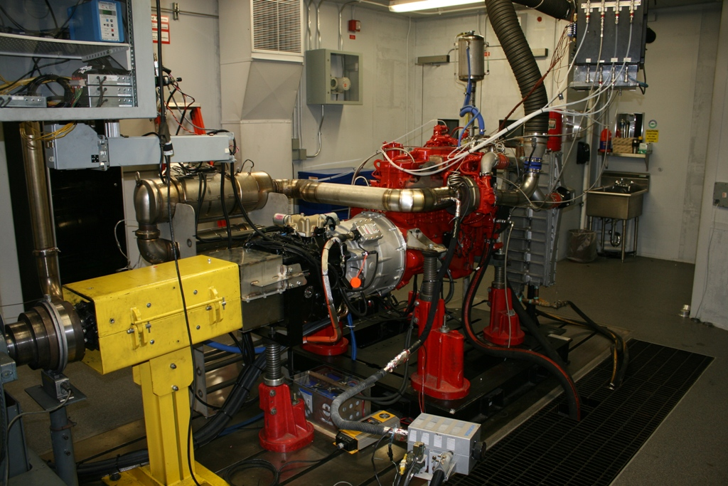
Test Article
Eaton parallel hybrid transmission with 6 speed AMT
2010 Cummins ISB 200hp

Slide 7
Vehicle Parameters
Vehicle parameters were calculated following subparagraphs of A.9.5.4.2.2 using hybrid powertrain rated power of 156.7 kW
m (kg) | 11315
A (m^2) | 6.669
Cr | 0.00669
Cd | 0.6235

Slide 8
PowertrainTesting
Cold and hot start WHVC tests
3 repeats
2 axle ratios
Run rated power test

Slide 9
Engine Testing
Cycles
Option 1: Engine cycles created using HILS
Option 2: Engine cycles taken from powertrain tests
Cold and Hot Start Tests
3 repeats
2 engine cycles

Slide 10
Status of the Comparison
Powertrain testing with both axles has been completed
Rated power tests have been completed with powertrain
Integration of EPA’s HCM with FPT’s HILS bench is in progress
Verified that the 2 HCMs (from the Iveco vehicle and EPA powertrain) are wired the same.
CAN communication with the HCM as been established
There are currently multiple error codes triggered due to some of the CAN messages not defined
Will need to work with Eaton to define all CAN channels. Timing to this is not certain due to the proprietary nature of the information needed.
Engine testing will start once engine cycles are determined. Testing will take approximately 2 weeks to complete.

