Slide 1
Quiet Car Research
WP.29-167-23
Transmitted by the World Blind Union
Dr. Edward C. Bell
Professional Development and Research Institute on Blindness
Louisiana Tech University
Ruston, Louisiana
United States

Slide 2
Problem Statement
Problem: Electric drive vehicles such as hybrid electric vehicles (HEVs), plug-in hybrid electric vehicles (PHEVs), and all-electric vehicles (EVs), travelling at low speeds are essentially silent.
Solution: the United Nations is developing an international minimum sound standard for electric and hybrid electric vehicles. The standard would require electric and hybrid electric vehicles to be equipped with a sound generating device known as an: “Acoustic Vehicle Alerting System (AVAS).”
Standard: The draft AVAS regulation includes a requirement that the device emit an overall sound level of 50 DBA when the vehicle is traveling at a speed of 10 KPH and 56 DBA when traveling at 20 KPH.
Concern: The WBU and NFB are concerned that the minimum overall sound level requirements for the AVAS delineated in the draft regulation have not been tested in a real-world environment.
Recommendation #1: the WBU/NFB would like to create a prototype AVAS that meets the sound specifications included in the draft regulation.
Recommendation #2: Once the prototype AVAS has been built, the WBU/NFB would like to test its efficacy in a number of typical real-world settings.

Slide 3
Partners
In consultation with the WBU,
the National Federation of the Blind
reached out to partners
in the United States for help.
San Francisco
Lighthouse for the Blind
Will spearhead efforts to develop a prototype AVAS system for testing.
Arup | A global firm of consulting
engineers, designers, planners and project managers
Will develop the AVAS and consult on acoustic design and measure
Professional Development and
Research Institute on Blindness,
Louisiana Tech University
Will conduct human trials on the efficacy of the AVAS prototype

Slide 4
Recommendation #1: Create an AVAS Prototype
2.2 “Acoustic Vehicle Alerting System” (AVAS) means a component or set of components installed to vehicles with the primary purpose to fulfill the requirements of this Regulation
Solution
AVAS Standard Requirements for development of a prototype:
Must contain a sound recognizable as a vehicle or motor
Must conform to standards 6.2.1 – 6.2.9.
Must emit sound in front and at the CenterPoint of the vehicle.
Must be able to be calibrated at 50 and 56 DBA, as measured at the 2 meter standard.
Must emit continuously while vehicle in motion 50 DBA at 10 KPH and 56 DBA at 20 KPH
Create WAV file that has vehicle engine noise, easily recognizable as such.
Standard device that can play the AVAS WAV file.
Loud speaker that can emit the AVAS sound at the desired levels.
Sound meter to calibrate the sound level at 50 and 56 DBA.
Tape measure to standardize distance from speaker of 2 meter from CenterPoint
Measure vertical distance of 1.2 meter from ground.
Note1: Did not address frequency or speed shift.
Note2: Did not consider vehicle traveling in reverse.

Slide 5
The AVAS prototype
What is it exactly?
A recorded sound of an actual automobile engine running at idle. The sound is played on a Victor Stream (Audio player used by blind persons) that is connected to a standard 2” speaker, capable of emitting sound greater than the minimum DBA standard.
What does it sound like?

Slide 6
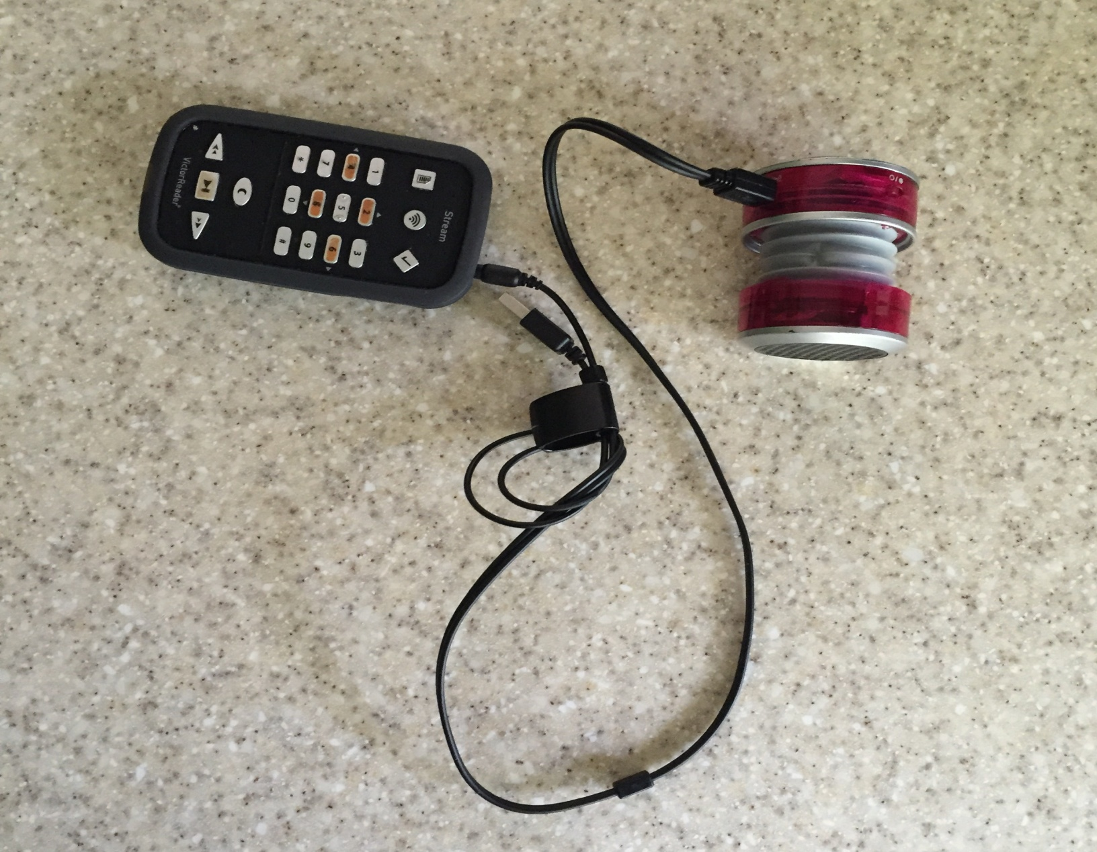
The AVAS Sound

Slide 7
AVAS Calibration
Arup Acoustics Specialist
Shane A. Myrbeck
Arup Acoustics Specialist
Devin Bean
Read and studied the proposed guidelines for the AVAS specifications.
Created the sound file that generated the AVAS noise at the specified frequencies.
Worked with the team to identify the playback machine and speaker set up.
Consulted on the placement and configuration of the prototype set up.
Traveled to Ruston, Louisiana during the human trials for on-site calibrations.
Measured the background noise of the testing sites.
Calibrated the AVAS prototype at 50 and 56 DBA, respectively.
Conducted calibration at the testing site, using the standards for 2 meter horizontal and 1.2 meter vertical distance.
Monitored the DBA output of the AVAS and ambient noises throughout the human trials.

Slide 8
Recommendation #2: Conduct Real-World Trials of the AVAS standard
Research Question:
Is the proposed standard for the AVAS device to emit a constant sound at 50 DBA while the vehicle is traveling at 10 KPH and for that sound to level out at 56 DBA when the vehicle reaches 20 KPH sufficient for blind (and sighted) pedestrians to effectively hear and respond to an approaching vehicle?
How do we test this in the real world?

Slide 9
Human Trials
Test Protocol
The test protocol must be intuitively reasonable.
The participants must be individuals who represent average blind pedestrians.
They must be neither very young nor very old.
They must have normal hearing (i.e., they must not be individuals with known or significant hearing loss).
The same is true for the test conditions. They must represent normal acoustic environments, not atypical noisy conditions such as construction sites with heavy equipment or jackhammers creating excessive noise.
The intent is to get a snapshot of how the AVAS works in real-world environments, not to address all the potential questions about its performance in every conceivable acoustic condition nor with subjects who represent the nearly infinite variety of human characteristics.

Slide 10
Human Trials Cont.
Professional Development and Research Institute on Blindness,
Louisiana Tech University
Real-World Trials: Modern city, San Francisco, light, moderate, and heavy traffic.
Adhere to UN Standards: Measure AVAS detectability in ideal situation.
Approach: Measure how well AVAS performs in comparison to “average” Internal Combustion Engine (ICE), and quiet (electric) car which does not have AVAS, under conditions as close as possible to the laboratory testing standards as can be achieved in the “real-world” environment.

Slide 11
Testing Conditions
2.1.2 Outdoor testing
The test site shall be substantially level.
The test track construction and surface shall meet the requirements of ISO 10844:2014.
Within a radius of 50 m around the center of the track, the space shall be free of large reflecting objects such as fences, rocks, bridges or buildings.
The test track and the surface of the site shall be dry and free from absorbing materials such as powdery snow, or loose debris.
In the vicinity of the microphones, there shall be no obstacle that could influence the acoustic field and no person shall remain between the microphone and the noise source.
The meter observer shall be positioned so as not to influence the meter reading. Microphones shall be located as specified in figures.
2.2 Metrological conditions are specified to provide a range of normal operating temperatures and to prevent abnormal readings due to extreme environmental conditions … The measurements shall be made when the ambient air temperature is within the range from 5 °C to 40 °C.

Slide 12
Testing Conditions Cont.
2.3 Background noise
2.3.1 Measurement criteria for A-weighted sound pressure level
The background, or ambient noise, shall be measured for a duration of at least 10 seconds. A 10 second sample taken from these measurements shall be used to calculate the reported background noise, ensuring the 10 seconds sample selected is representative of the background noise in absence of any transient disturbance. The measurements shall be made with the same microphones and microphone locations used during the test

Slide 13
Ruston, Louisiana
Ruston, Louisiana was chosen to conduct these human trials because it is the home for Louisiana Tech University and because it is situated in a small, rural environment that has the greatest likelihood of containing a test track that can approximate those in the proposed testing standards.
In reality, adhering to the outdoor testing standards as outlined does not seem completely possible in the real, lived world.

Slide 14
Ruston Regional Airport
Aviation Blvd, straight, 300 meters.
Good pavement, free from major cracks, bumps, or debris.
Ambient background measured at 40.6 DBA duration of one minute.
Birds chirping loudest sound (when planes not flying).
Terrain flat and smooth.
No obstacles that would block sound within 50 meters of line of traffic.
Weather conditions clear, warm, moderate humidity.
Testing times between 11:00 a.m. – 2:00 p.m. and 9:00 a.m. – 11:30 a.m., April 22, 23, respectively.

Slide 15
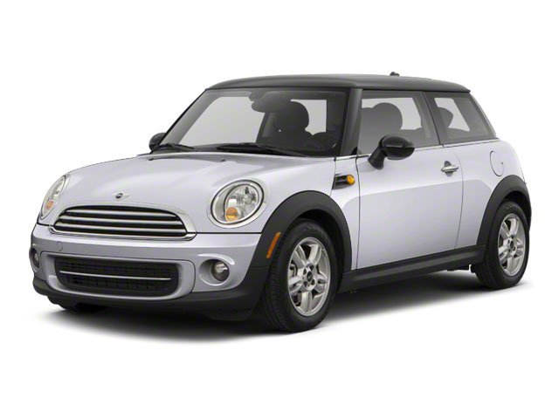
Test Vehicles
Internal Combustion Engine (ICE)
BMW Mini Cooper, Model 2008
Calibrated at 60 DBA at testing site.
Internal Combustion Engine Vehicles
Average of 43 random vehicles measured in Ruston, Louisiana.
Total of 43 vehicles, ranging in makes and models, spanning years of 1991—2015.
Average minimum DBA was 61.39; Max average DBA 63.58.
Range of DBA was 52.3—79.8.

Slide 16
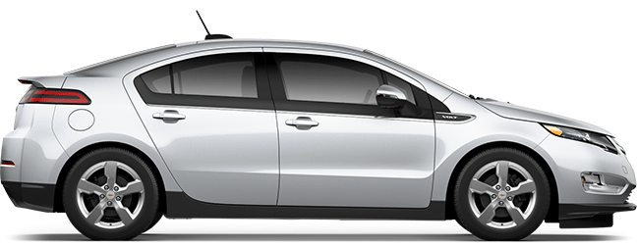
Test Vehicles
Two Hybrid Electronic Vehicles
(both fitted with an AVAS prototype device.)
Toyota Camry XLE Hybrid, Model 2012
AVAS mounted front bumper, CenterPoint, calibrated levels at 50 and 56 DBA.
Chevy Volt, Model 2012
AVAS mounted under front bumper, calibrated levels at 50 and 56 DBA.

Slide 17
The Humans
Identify between 20-30 adults between the ages of 18-65
Who are totally blind, legally blind, or willing to be blindfolded.
Have no diagnosis of hearing impairment.
Have no reason to suspect that a hearing impairment exists.
Be able to understand spoken instructions and comply with research protocol.
Be willing to sign a consent form to participate.
Be willing to stand on a street corner and indicate the approach of a vehicle by sound.

Slide 18
Research Protocol
Research Question: Can the average person hear the AVAS prototype emitting sound at the proposed levels at a sufficient distance to provide greater identification of electric or hybrid vehicles?
Method
Present vehicles under three conditions
Internal Combustion Engine (ICE) traveling at 10 KPH and again at 20 KPH.
Present Quiet Car (i.e., hybrid vehicle traveling in full electric mode), at the two testing speeds.
Present quiet car using AVAS prototype and calibrated at 50 and 56 DBA for the two testing speeds.

Slide 19
Research Protocol Cont.
Procedure:
Have vehicles travel at 10 and 20 KPH in front of participants.
Ask participants to raise their hand at the moment they first hear a vehicle approaching.
Research confederate stands behind the participant with stopwatch and clipboard to measure “Time to Detection.”
Vehicle will always be approaching from the participant’s left side
Vehicles always presented in same order (1) ICE, (2) QC, and (3) AVAS.
Vehicle will always be traveling first at 10 KPH and then again at 20 KPH.
Participants are not told which order vehicles are being presented, nor which has active AVAS.
Vehicles spaced apart far enough that sound of one has no impact on the other.
Control Variables:
Instructions are provided, repeated, and questioned to be sure.
Principal Investigator (PI) monitors background noise to ensure maximum quiet.
PI controls presentation of vehicles
Sound expert calibrates AVAS device before each round of testing, and helps ensure background noise remains low.
All trials are videotaped for further analysis and verification.

Slide 20
Research Design
Independent Variable (IV): three types of vehicles (ICE, QC, AVAS).
Dependent Variable (DV): Time to Detection. This is the number of seconds, to the tenth place, from when the approaching vehicle is first detected by the participant until the CenterPoint of the vehicle crosses the mid-point of the participant.
Trials: Two trials
Trial 1: all three vehicles traveling at 10 KPH, spaced apart, and
Trial 2: all three vehicles traveling at 20 KPH, spaced apart.

Slide 21
Findings: Demographics
A total of 24 individuals completed all trials for this study.
They included:
Adults were an average of 31 years old (Range: 18-58)
Participants were 16 females (66%) and eight males (33%);
Mostly Caucasian 16 (66%), 1 Black, 1 Asian, 2 Native American, 4 Hispanic;
Had no diagnosed hearing impairments.

Slide 22
What did the trial look like?

Slide 23
What did we find?
Trial 1: All Vehicles traveling at 10 KPH, AVAS calibrated at 50 DBA
Mean: This is “Time to Detection” or the number of seconds from the point at which the vehicle was first heard by the participant until it crosses his/her mid-point.
Variable | N | Mean | Std Dev | Minimum | Maximum
ICE10 | 24 | 22.84 | 5.85 | 12.91 | 32.56
QC10 | 24 | 7.48 | 4.83 | 0 | 16.72
AVAS10 | 24 | 8.96 | 4.05 | 1.91 | 19.28

Slide 24
What does this mean?
Trial 1: Analysis of Variance.
Are the mean-difference in “time to detection” important?
Yes
Significant beyond one in 1,000 probability that the time to detection is significantly different. R-Square = 0.669.
This means that the ICE vehicle is detected significantly sooner than either the quiet car or the AVAS prototype.
Furthermore, there is no statistical difference between the quiet car or the quiet car using the AVAS device at 10 KPH.
Source | DF | Sum of Squares | Mean Square | F Value | Pr > F
Model | 2 | 3447.05 | 1723.53 | 69.98 | <.0001
Error | 69 | 1699.32 | 24.6279
Corrected Total | 71 | 5146.37

Slide 25
Trial 2: 20 KPH

Slide 26
Trail 2: 20 KPH
Trial 2: All vehicles traveling at 20 KPH, AVAS calibrated at 56 DBA.
Mean: This is “Time to Detection” or the number of seconds from the point at which the vehicle was first heard by the participant until it crosses his/her mid-point.
Variable | N | Mean | Std Dev | Minimum | Maximum
ICE20 | 24 | 13.53 | 3.52 | 2.25 | 18.59
QC20 | 24 | 6.29 | 3.19 | 0 | 12.66
AVAS20 | 24 | 7.47 | 2.65 | 3.75 | 14.62

Slide 27
What does this mean?
Trial 2: Analysis of Variance.
Are the mean-difference in “time to detection” important?
Yes
Significant beyond one in 1,000 probability that the time to detection is significantly different. R-Square = 0.51.
This means that the ICE vehicle is detected significantly sooner than either the quiet car or the AVAS prototype.
Furthermore, there is no statistical difference between the quiet car or the quiet car using the AVAS device at 20 KPH.
Source | DF | Sum of Squares | Mean Square | F Value | Pr > F
Model | 2 | 724.231 | 362.115 | 36.67 | <.0001
Error | 69 | 681.323 | 9.87424
Corrected Total | 71 | 1405.55

Slide 28
Take Away Message
The proposed AVAS standard does not appear to add sufficient sound level to existing electric or hybrid vehicles to make them more detectable to the average blind person than is an electronic vehicle on the road today without the AVAS system.
More study needs to be done to determine what is a minimal noise level that satisfies the desire to reduce noise emissions while remaining safe for pedestrians.

