Slide 1
New Car Assessment Programme For Southeast Asia (ASEAN NCAP)
Informal document WP.29-165-13-Rev.1 (165th WP.29, 10-13 March 2015, agenda item 6)
Professor Dr. Wong Shaw Voon Chairman, ASEAN NCAP
165th World Forum for Harmonization of Vehicle Regulations Geneva, 10 - 13 March 2015

Slide 2
Executive Summary
New Car Assessment Program for Southeast Asia region (ASEAN NCAP) has been established since 8th December 2011.
Ever since, we have assessed 34 models from 18 car manufacturers all over the world.
We have tested 17 from Top 20 Manufacturers of ASEAN countries.
We covered minimum of 50% from the TIV of ASEAN Markets.
ASEAN NCAP (4-star) widely accepted as reference ‘standard’ for countries without crash regulation.

Slide 3
Executive Summary
ASEAN NCAP understood that new technology has been developed rapidly in the area of driving assist. ASEAN NCAP encouraged manufacturer to develop and equip the latest vehicle with the system with priority to be given to a system which able to help to reduce motorcyclist incidents and fatalities.
The roadmap has been produced through open and close consultation with car manufacturer, NCAPs colleagues and ASEAN NCAP Stakeholders.

Slide 4
The Road Traffic Injury Problem
Country | Index
Singapore | 5.1
Brunei | 6.8
Philippines | 9.1
Myanmar | 15.0
Cambodia | 17.2
Indonesia | 17.7
Laos | 20.4
Vietnam | 24.7
Malaysia | 25.0
Thailand | 38.1
Road safety death rate (per 100,000 population)
Global status report on road safety 2013

Slide 5
The Road Traffic Injury Problem
In order to achieve desirable result in future, priority need to be given based on road user.
Distribution of road safety deaths by road user type as follows;
Country | 4 wheels | 2/3 wheels | Cyclist | Pedestrian | Others
Indonesia | 6.1 | 35.7 | 1.7 | 21.1 | 35.4
Laos | 14.6 | 74.4 | 1.3 | 6.3 | 3.4
Malaysia | 26 | 58.7 | 2.8 | 9.1 | 3.4
Myanmar | 26.2 | 22.9 | 8.6 | 26.5 | 15.9
Singapore | 8.8 | 46.1 | 8.3 | 28.5 | 8.3
Thailand | 13.3 | 73.5 | 3.0 | 7.8 | 2.5
Cambodia | 11.8 | 66.6 | 4 | 12.0 | 5.7

Slide 6
The Road Traffic Injury Problem
The developing country will require a convenience mobility. Motorcycle will be efficient non safe mobility.
Tata has introduced the “0 Star” Tata NANO in Myanmar.
In Cambodia, dumping grounds for second hand car from developed countries?. ASEAN NCAP hopes that the imported second hand car will satisfy minimum safety level to reduce mishaps.
It will be ASEAN NCAP responsibility to drive manufacturer to provide a safer car to be offered for the region.
safety can and must be affordable.
Safety is not a privilege of the rich, but the right for all.

Slide 7
The Road Traffic Injury Problem
Our outcome depends on what we focus.
There is a need to understand 15-29 years old group socio demographic in ASEAN for better implementation of strategy.
Minimize their exposure to non safe mobility by providing safe and affordable alternatives.
Producing safer and affordable vehicle. ASEAN NCAP encourage and challenge manufacturer to produce safer and safer vehicle.

Slide 8
The Road Traffic Injury Problem
As a conclusion, producing safer mobility is not rhetoric. Understanding industry situation and consistently negotiate to produce the utmost result is the best way to handle NCAP program in the region.
Definitely, producing affordable safer vehicle will be one of the road safety solution, but not the total solution.
There is millions on non-safe vehicle running on ASEAN streets, its unfinished business of vehicle safety fighters.

Slide 9
The Road Traffic Injury Problem
ASEAN Top 3 Vehicle Production Statistics 2014
World Ranking | Country | Passenger | Commercial | Total | Percentage
9 | Thailand | 1,122,780 | 1,409,797 | 2,379,806 | 2.73%
15 | Indonesia | 925,111 | 283,100 | 1,208,211 | 1.38%
22 | Malaysia | 540,200 | 55,970 | 596,170 | 0.68%
vehicles registered
2013 – 3.4 million
2014 – 3.1 million

Slide 10
Strategic Approaches
For ASEAN NCAP to achieve its target, several strategic approaches have been addressed for immediate execution;
Reliable database of road fatalities and accidents
Effective communication with consumer and stakeholders.
Encouragement of crash avoidance technology fitment especially related to collision with motorcycle.
Supporting motorcyclist PPE and active safety devices i.e. ABS for Motorcycle.
Promoting safer cars.
Removal of non safer cars from the system
Highlights on the aged car and after-repaired issues - crashworthy and roadworthy.
Improving safety beyond rating (Research Test i.e. braking and pedestrian).

Slide 11
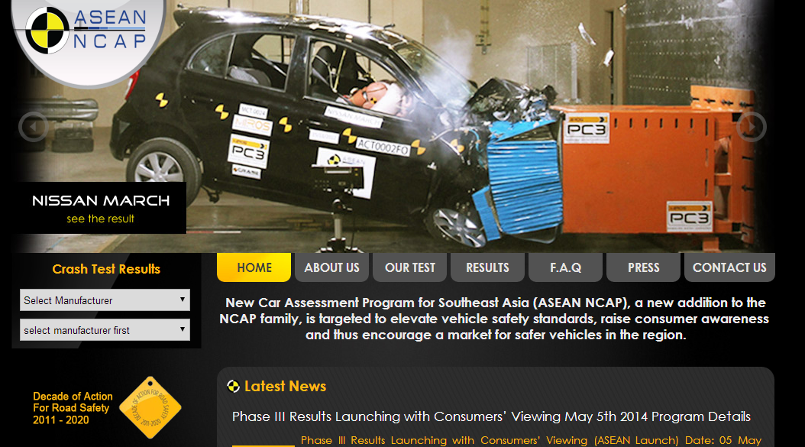
Communications Main Platform
Website – aseancap.org
Crash test results
News & press release
Link to other media/social media

Slide 12
Other Communications Platforms
Social/Electronic Media
Facebook
Twitter
Flickr (photos)
Youtube Channel
Wikipedia
Exhibitions
Relationship with media and OEMs’ media reps
Press release
Bloggers
OEMs’ ads mentioning ASEAN NCAP
ASEAN Community
Universities/Higher Education
Automobile Associations

Slide 13
Encouragement of Crash Avoidance Technology
Focus to avoid collision with motorcycle.
The recent technology of AEB must work for avoiding or mitigating collision with m/c, otherwise the great potential impact of AEB is not unlocked to the region.
Lane watch and BSI that work to prevent collision with m/c
Although ASEAN NCAP highly promoted the fitment of latest crash avoidance technology in our market, the focus should be on how we can save motorcyclist.

Slide 14
Encouragement of Crash Avoidance Technology
Simple yet effective solution would be able to reduce motorcyclist casualty.

Slide 15
Promoting Safer Cars
ASEAN NCAP focus on Top 30 of ASEAN volumes with minimum of 4-star rating.
However, it is very dynamic and keep changing position year by year.
To maintain the exclusivity of Top 30, ASEAN NCAP reconsidering to further looks into Top 50 for ensuring the safety quality of Top 30 cars.
Manufacturer is encouraged to launch the new vehicle with rating.

Slide 16
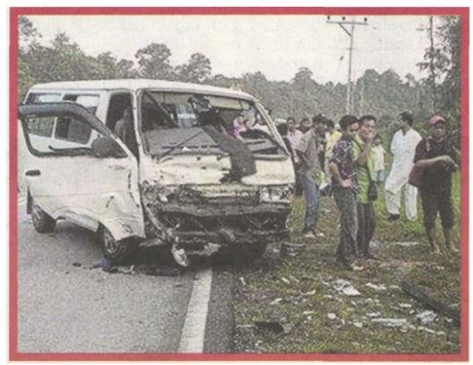
Promoting Safer Cars
ASEAN NCAP also need to consider other people movers such as Van, because it is also among top 30 vehicle i.e. Daihatsu Granmax, Suzuki Futura, Mitsubishi L300).
A special edition of ASEAN NCAP may be introduced in special phase to cover this type of vehicle.

Slide 17
Promoting Safer Cars
ASEAN NCAP fully support the Global NCAP Fleet Safety Guide and Safer Car Purchasing Policy 2014-2015.
Although ASEAN NCAP mainly about passenger cars, there should be a synergize activity to level up motorcycle safety. ABS system, passive safety of car for motorcyclist
ASEAN NCAP would play a major role in encouraging partnership with Motorcycle industry.

Slide 18
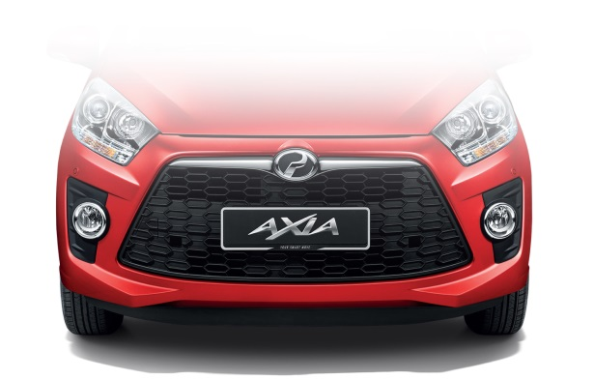
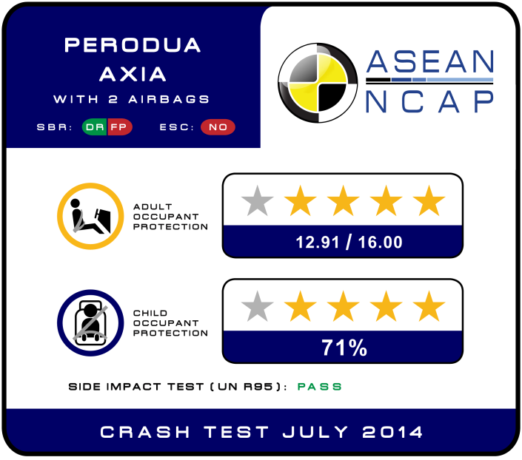
Affordable Safety
During the starting of ASEAN NCAP, many have commented that “safety = expensive”, now we finally can enjoy 4-star car with affordable price.
RM24,900 / THB 250K / IDR 92M /SGD 9800 / USD 8000 / EU 6000 / YEN 800K

Slide 19
Assessed by ASEAN NCAP
Type | Phase 1 | Phase 2 | Phase 3 | Phase 3+
Pick Up |  |  | Chevrolet Colorado [5,4]
 |  |  | Isuzu DMax [4]
Sedan | Ford Fiesta [5] | Nissan Almera [4] | Proton Preve’ [5] | New Honda City [5,4]
 | Honda City [5] | Mazda 2 [4] | Toyota Corolla Altis [5,4] | Nissan Teana [5]
 | Toyota Vios [4] | Honda Civic [5,4] | VW Polo Sedan [4]
 | Proton Saga [3] | Toyota Prius [5] | Chevrolet Sonic [4]
Small Car | Nissan March [4] | Mitsubishi Mirage [4] | Peugeot 208 [4] | New Jazz [5,4]
 | Hyundai i10 [2] | Suzuki Swift [4] | Kia Picanto [4,0] | Perodua AXIA [4]
 | Perodua MyVi [3] |  |  | New Proton [5]
 |  |  |  | Tata Vista [3]
MPV |  | Toyota Avanza [4] |  | New MyVi [4]
 |  | Daihatsu Xenia [4]
 |  | Perodua Alza [4]
SUV |  | Mitsubishi Pajero Sport [4] | Honda CR-V [5,4]
 |  | Subaru XV [5]

Slide 20
Removal of non safer car in the system
Pre-ASEAN vehicles on the road
Some old cars are not crashworthiness and roadworthiness – mainly for mobility needs.
ASEAN NCAP is exploring for methods to discourage the usage of such.

Slide 21
Crash Compatibility
Pick Up is the most selling vehicle in the region.
Thus crash compatibility between Pick Up versus another vehicle has to be explored.

Slide 22
From current to 2016
To stabilize the rating and maturing the development of new vehicle, ASEAN NCAP will maintained its current protocol until end of 2016 except for Side Impact R95 requirements.
Starting 2015, Side Impact R95 is mandatory for 3-star car and above.
For option test with launching, R95 certificate is acceptable.
Other than above, test need to be conducted at ASEAN NCAP official laboratory.

Slide 23
From current to 2016
To ensure the repeatability and quality, ASEAN NCAP is undertaking reassessment or audit test at the moment.
Priority to the car that has extended their ratings for example MIRAGE to ATTRAGE.
Deviation of safety items for example the introduction of new variant without top tether where else it was tested with it before.
Working on New Rating and possible testing protocol. Technical Committee will announce by January 2016.

Slide 24
Development of new testing regime 2016 ~ 2020
ASEAN NCAP wish to focus on developing new testing regime as below;
New combined rating system
Frontal Occupant Protection
Lateral Occupant Protection
Child Occupant Protection
Safety Assist Technology

Slide 25
Current Plate

Slide 26
New Rating
Although 5-star+ is not introduced; the new rating will separate higher achievers from the ordinary 5-star.
Also to ensure the proper distribution of weightage for each star ratings.
Previously, difference between 5 & 4-star is by ESC & SBR. 4-star doesn’t need to have any SBR, ESC or even ABS.

Slide 27
New Rating
ASEAN NCAP has witnessed many miss use of dual ratings.
Usually display higher variant.
This is not effective for ASEAN as a region
4-star label may be display in country where only 0-star variant is available.
ASEAN NCAP notes of the recent development of Euro NCAP – from single to dual star rating.
ASEAN NCAP understands the move is to promote more safety assist technology in a mature market.
Hence, for ASEAN NCAP foresee that single rating is more effective for the region to promote safer vehicle.

Slide 28
New Rating
New Rating would be separated in 3 categories;
Adult Occupant Protection (AOP)
Child Occupant Protection (COP)
Safety Assist Technology (SAT)
The new rating may be as the followings:
AOP (50%) [ current ]
COP & SAT (25%+25%=50%) [future]

Slide 29
Draft Combined Rating
ASEAN NCAP: Safer cars for today and future

Slide 30
Frontal Occupant Protection
Development of new test protocols i.e. full frontal etc.
Minimum points for 5-star, will current 14 points good enough or too stringent.
Will further analyze by considering compatibility study, pre-NCAP vehicle real world crashworthiness study.
The main debate will be portion of frontal in combined rating, thus detail study need to be done.
Additional test protocols will be explored. ASEAN NCAP will also refer to the Euro NCAP latest plan on offset front impact protection (to improve structural engagement for a broad range of vehicles)

Slide 31
Lateral Occupant Protection
Portion of combined ratings need to be developed based on real world crash study.
New NCAP side impact test will be considered together with Q1.5 & Q3 dummy.
Development of Curtain Airbag Evaluation to replace pole test.

Slide 32
Child Occupant Protection
Q1.5 & Q3 expected to be delivered to MIROS PC3 by End of 2015.
Development test will start by 2016.
New point system will be introduced.
Why not having our own ASEAN NCAP Child Seat? Possible solution for safer, affordable and practical CRS.

Slide 33
Safety Assist Technology
Protocols for SBR and ESC need to be developed within 2015.
Will be follow closely the Euro NCAP case study on PTW 2017/2018, especially on AEB development for Motorcycle
Shall prioritize on SATs that suitable to save motorcyclist in ASEAN region.
Suitability of the system/device in the region has to be explored together with OEM.

Slide 34
Thank you for your attention

Slide 35
Copyright Statement
This work is the intellectual property of ASEAN NCAP. Permission is granted for this material to be shared for non-commercial, educational purposes, provided that this copyright statement appears on the reproduced materials and notice is given that the copying is by permission of ASEAN NCAP. To disseminate otherwise or to republish requires written permission from ASEAN NCAP.

