Slide 1

How innovation enables to answer the main challenges of the port industry
- Focus on intermodality -
(WP.24) Workshop on "Intermodality leads to sustainability"
Dr. Christa Sys

Slide 2
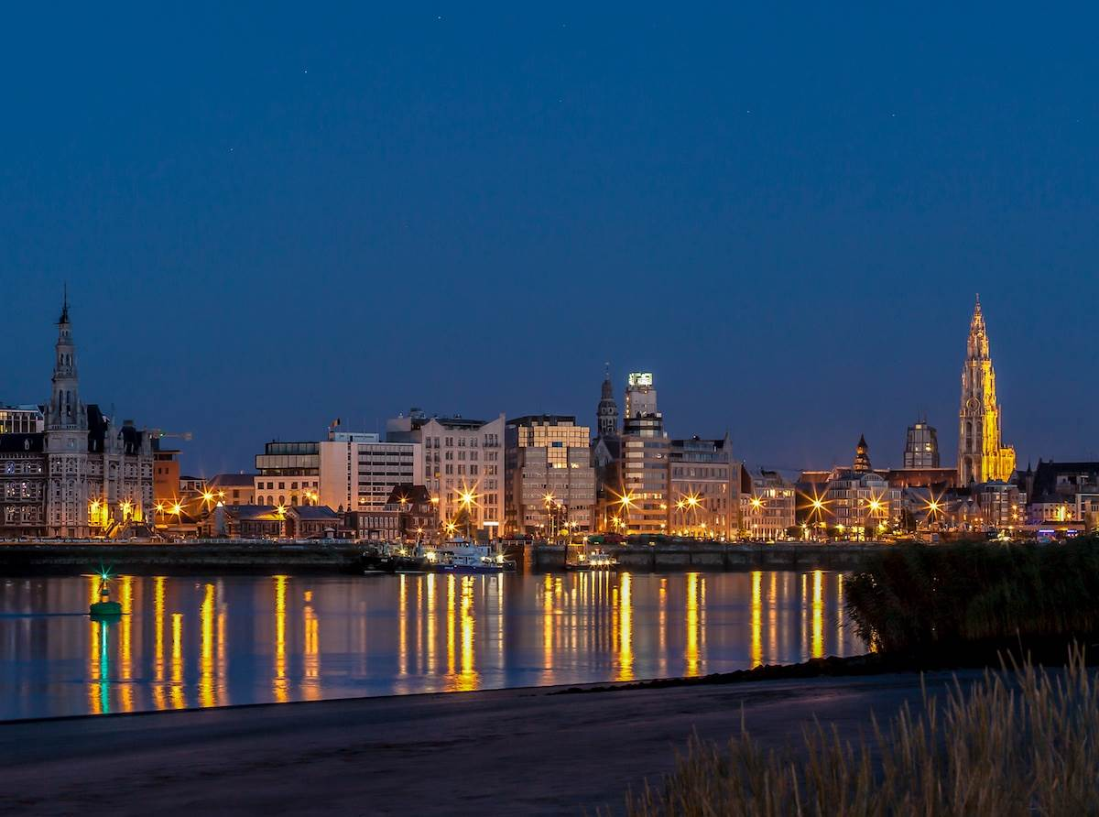
CONTEXT
Notes:
Expediteur
Scheepsagent
Bevrachtingsmakelaar
scheepsmakelaar

Slide 3
Innovation, a driver of economic growth
  A technological or organizational (including cultural as a separate sub-set) change to the product (or service) or production process that either lowers the cost of product (or service) or production process or increases the quality of the product (or service) to the consumer.” (Arduino et al., 2013)
Cost
Quality
Delivery
Flexibility/Customization
Service
Sustainability
INNOVATION
1950s
1990s
2000s
2015

Slide 4
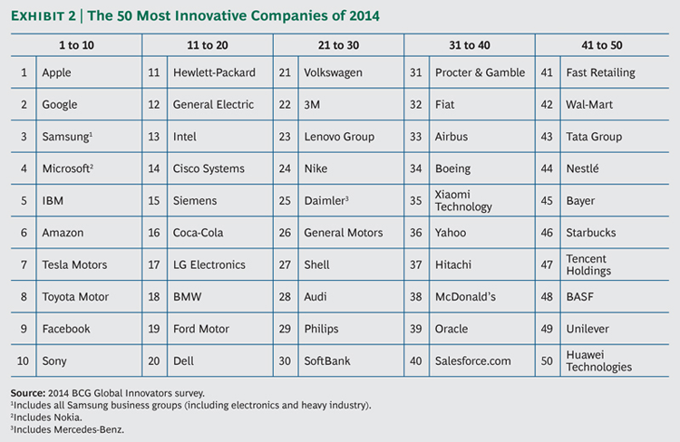
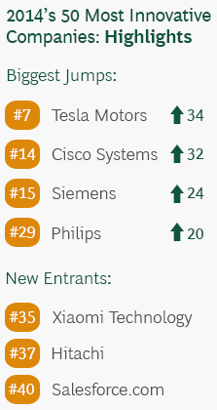
BCG perspectives – Innovation in 2014
Notes:
https://www.bcgperspectives.com/content/articles/innovation_growth_digital_economy_innovation_in_2014/

Slide 5
“the transport sector generally displays poor innovative strength”
International forum on Transport (2010). Transport and Innovation: Unleashing the Potential. Paris: OECD

Slide 6
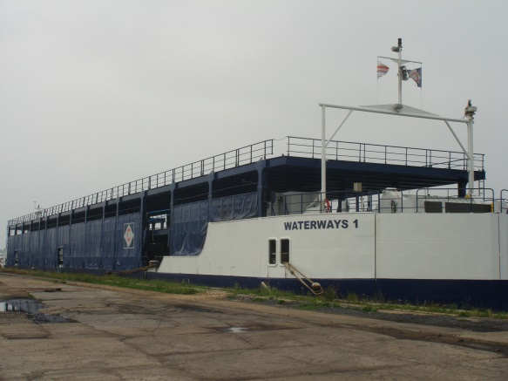
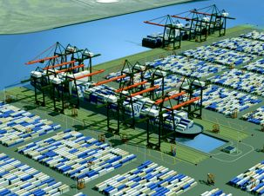
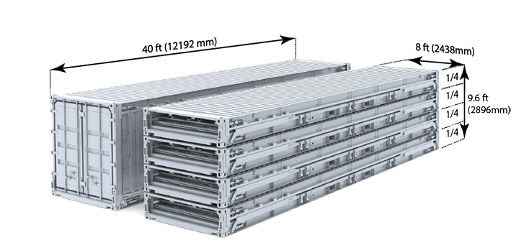
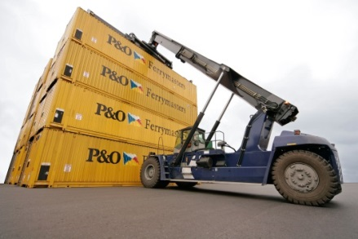
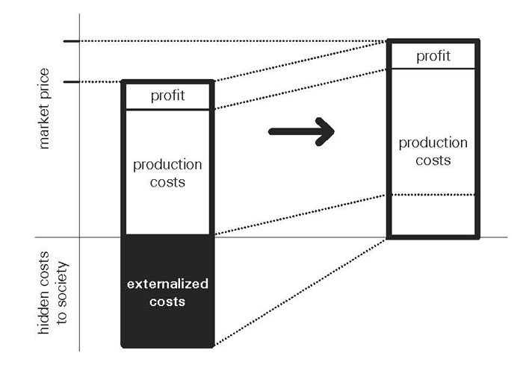
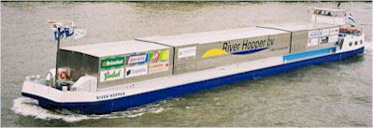
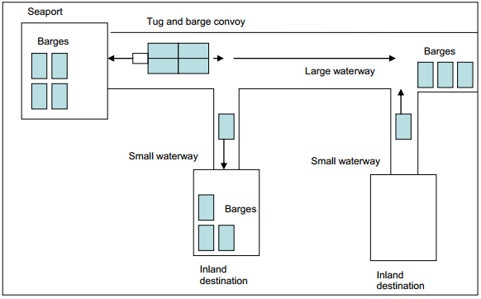
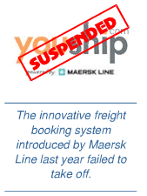
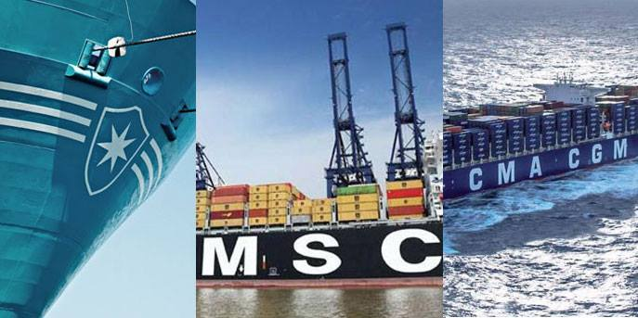
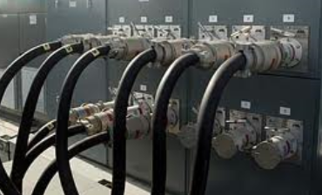
Technology, managerial,
organizational, cultural - business change
Technology
Technology, managerial, organizational,
cultural – market change
Policy initiatives
(yet) FAILED
Managerial, organizational, cultural
Maersk Line cancels Daily Maersk
(March, 10th, 2015)
Alphaliner Newsletter no 42 - 2009
Notes:
International Transport Forum (2010) has shown the transport sector to score less than the average for the economy as a whole when it comes to innovation
perception: maritime and port sector: poor innovative strenght
The following collection of innovation initiatives in the maritime and port sector: proof otherwise
However: failed
Technology:
-inland ship with double deck for transport of cars (in the meantime: other destination)
-Indented Berth, allowing (un)loading operations on both sides of the ship, at the Ceres Paragon Terminal in Amsterdam was not successful
-First prototypes of the foldable container
Managerial, orangisational, cultural
the innovative airline-style online box-booking ‘youship.com’ of Maersk Line failed
P3
Daily maersk
Technology, managerial, organisation, cultural
Floating distribution center
Policy initiatives
Harmonization of intermodal containers
Internalisation of external costs
Small barges
- Cold ironing
Failed or not yet success(for now): why?

Slide 7
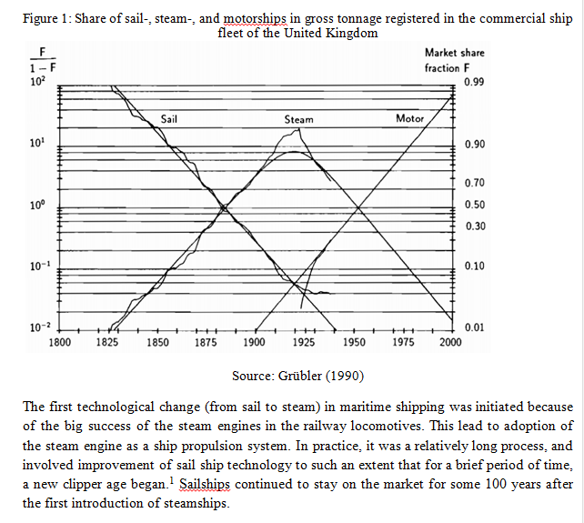
Aronietis, et al., 2015

Slide 8

SUCCESS & FAILURE
Joint international research with Thierry Vanelslander, Valentin Carlan, Athena Roumboutsos, Michele Acciaro, Claudio Ferrari, Alessio Tei, Genevieve Giuliano, Geraldine Knatz, Rosário Macário, Vasco Reis and Jasmine Siu Lee Lam
Notes:
Expediteur
Scheepsagent
Bevrachtingsmakelaar
scheepsmakelaar

Slide 9
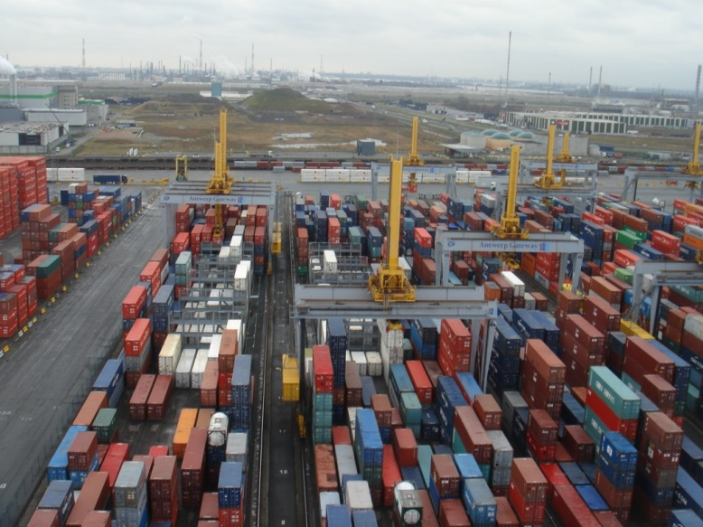
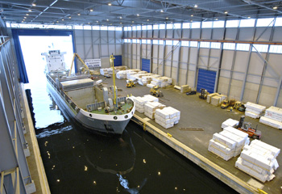
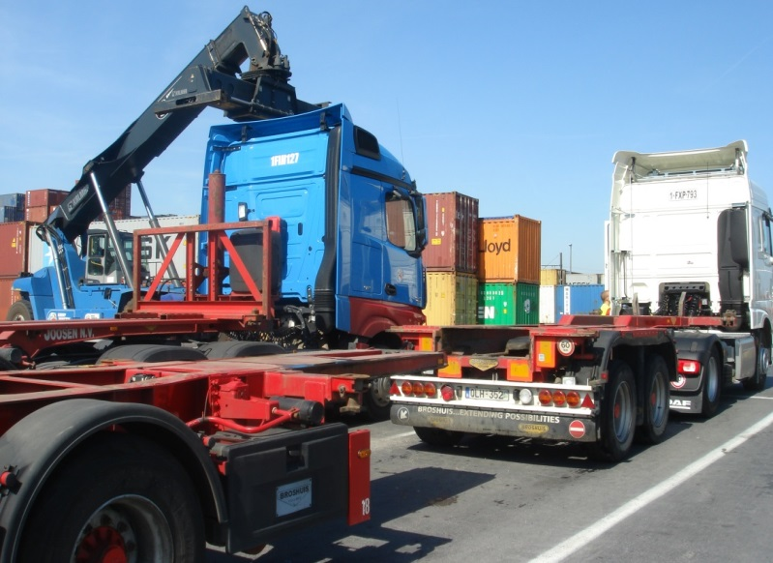
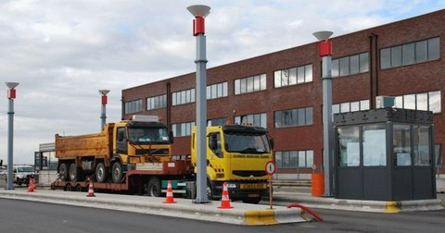
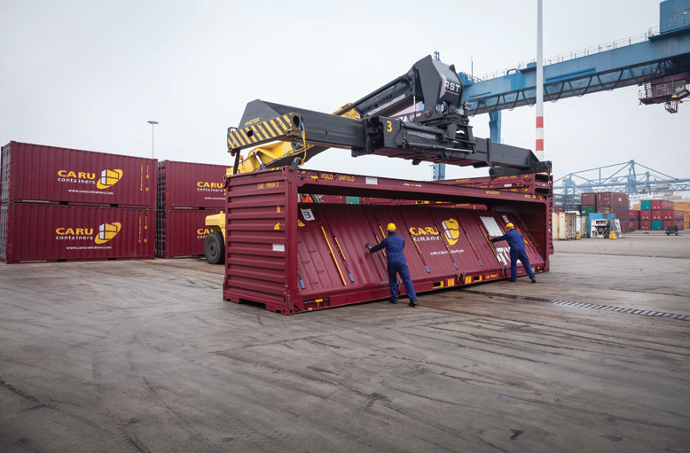
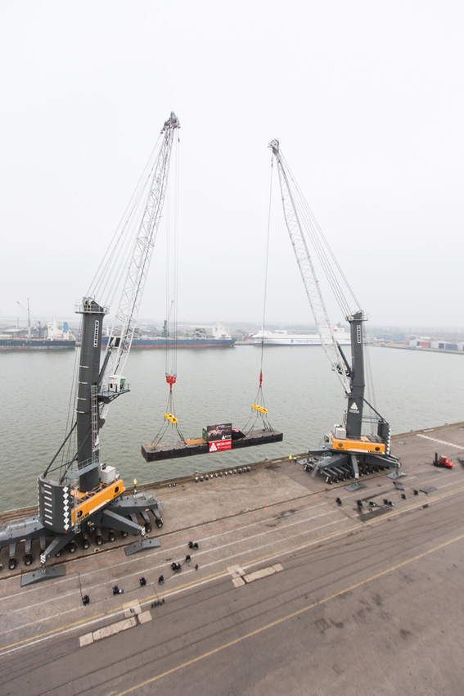
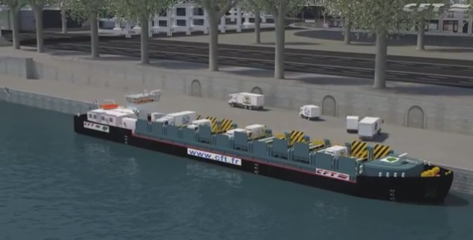
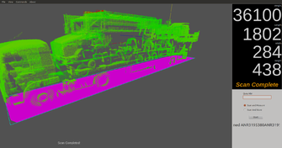
RESEARCH
75 | 30 | 10 | 7 | 4
85%, a mix of technological, administrative, organizational and cultural nature
innovation that relates to the cargo flow and ICT are high on the agenda.
the majority of initiatives are instances of private commercial innovations.
the mainstream of the cases are examples of ‘incremental’ innovations
Notes:
75 innovation cases collected over the period autumn 2013-spring2015
30 private port operators located in 10 different countries
7 universties

Slide 10
OBSERVATIONS FROM THE SET OF INNOVATION CASES
  Innovation initiatives allow responding to
  Economic challenges
  Innovations are profit-driven
  Innovation is a tool that can improve the competitive advantage of port-related stakeholders
  Actor co-operation also seems an important trend
    Note: sample = large companies with resources (fin./people)
  Environmental and social challenges
  If a company is involved in many innovation cases, CO2-emissions reductions are obtained more incidentally
  All innovations comply with social and labour regulations
Notes:
The use of multiple methods and sources of data collection (indepth and focus (group) interview) allow to answer How innovation enables to RESPOND the main challenges of the port industry
Profit
Incidental challenges planet/people
Alternative approach
Opting for the real option approach is however advisable
Wait for new technology (cloud application)
Legislation/intervention → role for Government

Slide 11
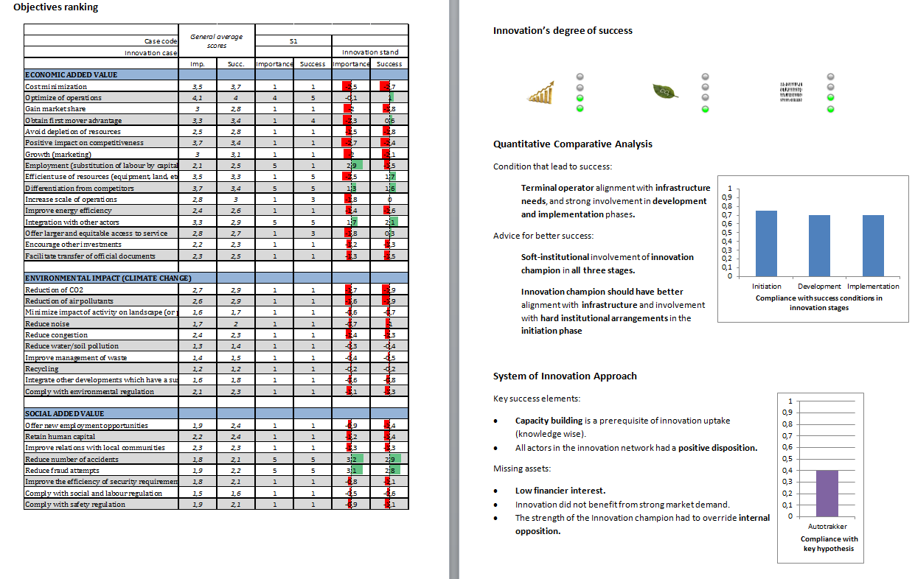
EXAMPLE OF THE INNOVATION MONITOR

Slide 12
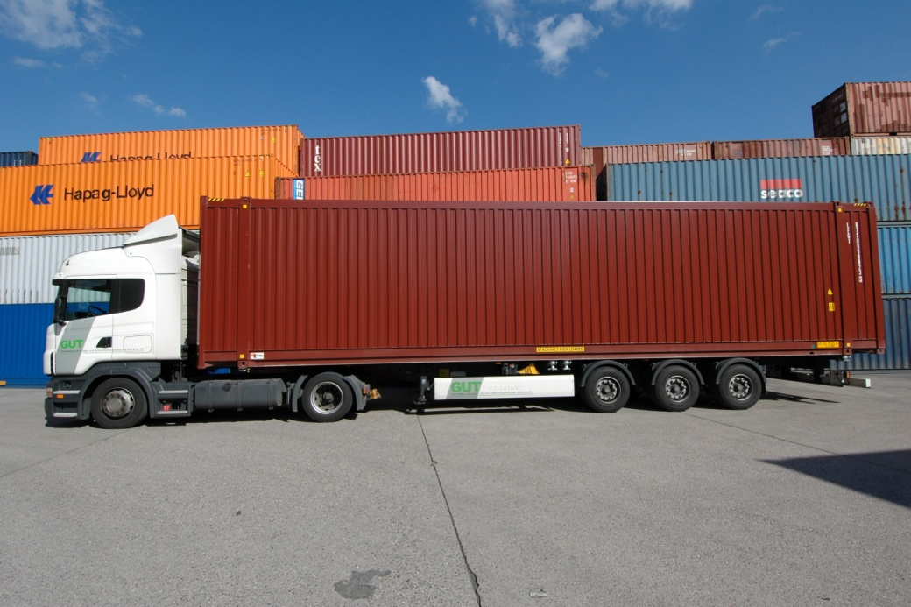
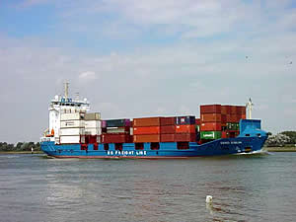
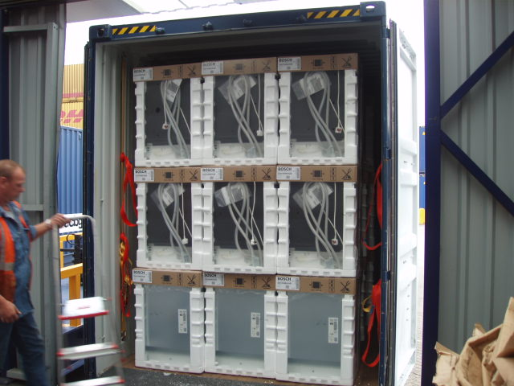
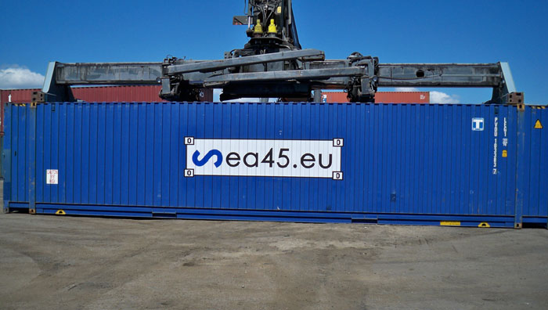
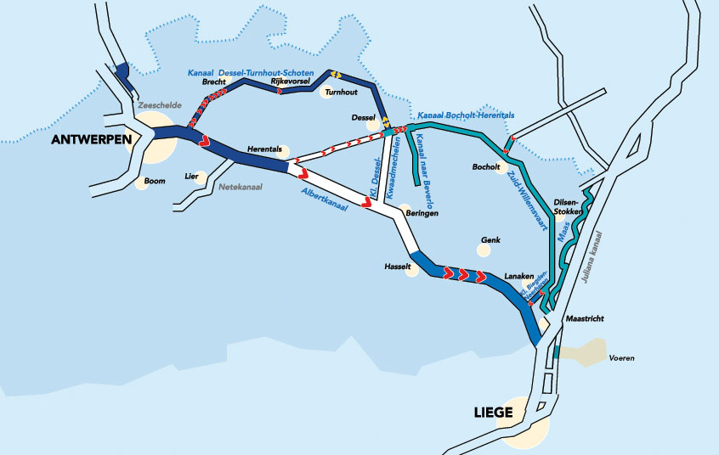


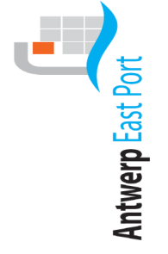

Case 1: 10’6” container
Technological, Managerial, Organisational, Cultural – Business Change
Case 2: SEA45
Technological, Managerial, Organisational, Cultural – Business Change
Case 3: Modal shift
Managerial, Organisation, Cultural - Market Change
Case 4: Foldable container
Technological – Business Change
Notes:
Light blue: Strategic internal decision, external incentives or disincentives, no public subsidies or regulation

Slide 13
NO UNIQUE RECIPE
Substantial misalignments exist between company strategies and degrees of success
  Combinations of variables increasing the likelihood of success:
Terminal operator alignment with infrastructure needs in initiation, development and implementation phases.
Shipping line alignment with infrastructure, both in development and implementation stages.
Notes:
For this set of cases, the development and implementation stages turn out to be crucial, and in particular the infrastructure alignment of both terminals and shipping companies.

Slide 14
MISSING ELEMENTS TOWARDS SUCCESS
Innovation could benefit from stronger market demand.
Not all actors of the innovation network hold a positive attitude.
The strength of the Innovation champion had to over-ride internal opposition.
HIGHLIGHTS
Market push
Collaboration of all actors in the supply chain (e.g. ICT)
Notes:
No positive disposition = innovation not adapted

Slide 15
WHAT ARE THE BOTTLENECKS?
Balance between benefits and costs
Sharing logistical data (volumes, container availability, e-documents, etc.) – phased approach
Container free time
Updating of customs legislation
Notes:
BENEFITS/ NOT SEEN
COSTS WILLINGNESS TO PAY LOW
Regulation, technology, language (edifact?) risk analysis

Slide 16
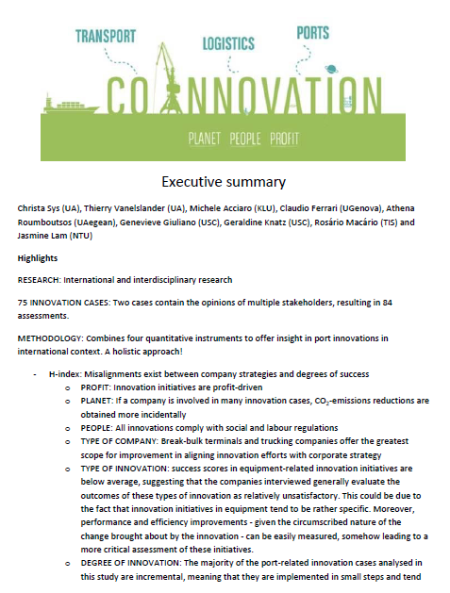
Thank you for your attention
Dr. Christa Sys
BNP Paribas Fortis Chair Transport, Logistics and Ports
Prinsstraat 13, 2000 Antwerpen
@ www.uantwerpen.be/tpr > BNP Paribas Chair > BNPPF innovation event
 christa.sys@uantwerpen.be
Notes:
BNP Paribas Fortis Leerstoel Transport, Logistiek en Havens

