Slide 1
Rail Safety: Trends and Challenges
Safety and security of signalling systems
Dr. Marc ANTONI
UIC
Director of Rail System Department
Geneva, 24 November 2015

Slide 2
CONTENT
1 – Digital word and cyber threats
2 – What does it have to do with us?
3 – Security-is-Safety & Safety-is-Security / risk assessment
4 – Some reduction and mitigation measures
5 – Perspectives
UIC – Rail System Department – Dr. Marc ANTONI – 24 November 2015

Slide 3
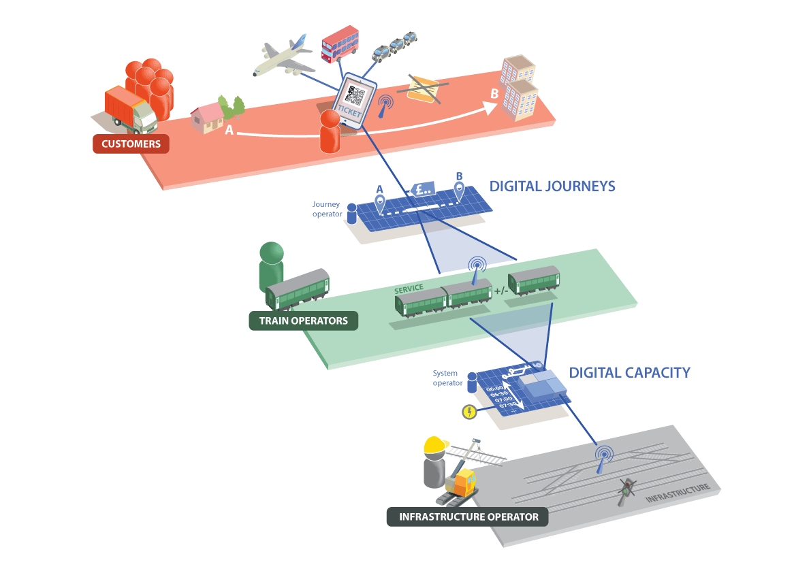
We live in a connected and open world…
FIXED TRANSMISSION INFRASTRUCTURE
WIRELESS COMMUNICATIONS
Especially for signalling critical systems!
UIC – Rail System Department – Dr. Marc ANTONI – 24 November 2015

Slide 4

Cyber Security or Cyber Threat?
The UIC point of view:
Our increasing dependence on cyberspace has brought new risks, risks that key data, critical functions and systems on which we now rely can be compromised or damaged, in ways that are hard to detect or defend against
The safety and security of railways - which is part of the critical national infrastructures - is essential in supporting the Governmental National Security Strategies
Railway safety and security are dependant:
one can only be demonstrate considering the other
Security has to be considered as one of the key elements needed to deliver the railway Digitalisation railway programs
UIC – Rail System Department – Dr. Marc ANTONI – 24 November 2015

Slide 5
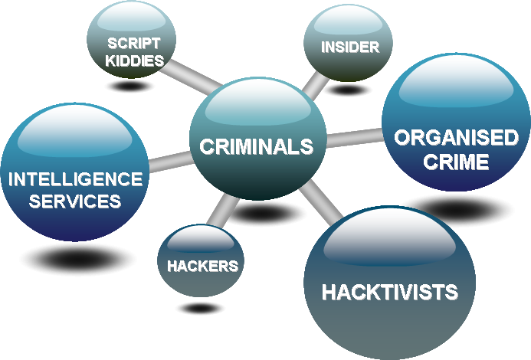
The Bigger Picture
There is an increased need to ensure that systems, assets, services, functions and data are protected appropriately and this is becoming increasingly harder as we become more connected.
Challenges that will present themselves from a security perspective include:
    Traditional rail systems are moving towards open communications protocols that require connectivity of systems and services from all parts of the business
    Convergence of open networks - security must be applied end to end and on all layers → with the railway particularity that the deny of
    service leads to a unsafe operation situation!
    Physical security - is just as important
    Threats (human and technology based) - are adapting
    quicker that traditional security detection methods
    Technology deployment makes this harder to control and
    boundaries are becoming blurred. Abnormal behaviour
    detection in real-time is becoming harder to detect
UIC – Rail System Department – Dr. Marc ANTONI – 24 November 2015

Slide 6
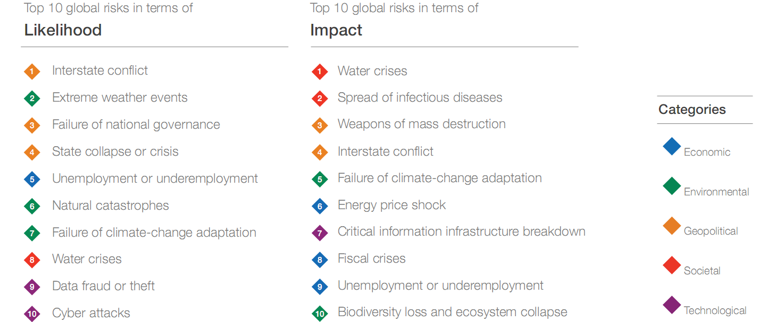
Cyber involvement in many risks
Cyber risk has also been identified at a global level (Davos 2015)
Source: World Economic Forum
UIC – Rail System Department – Dr. Marc ANTONI – 24 November 2015

Slide 7
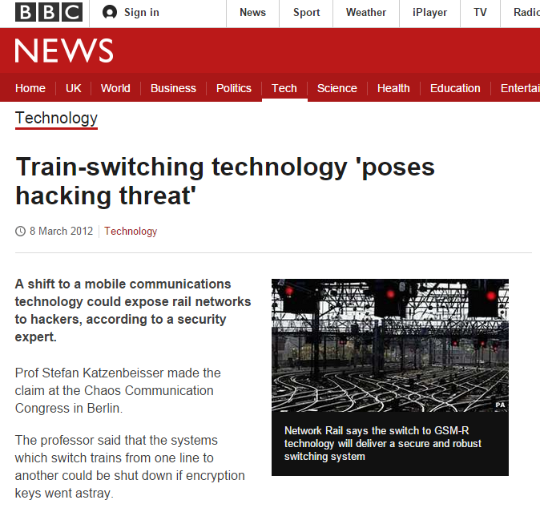
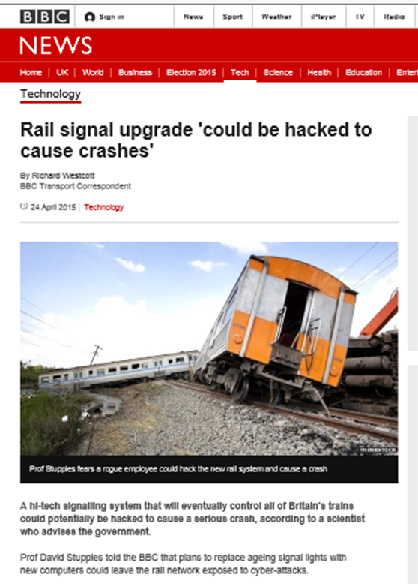
What does it have to do with me?
Surely it won’t happen to us
UIC – Rail System Department – Dr. Marc ANTONI – 24 November 2015

Slide 8
What does it have to do with me?
Surely it won’t happen to us
JAN 2008
Teenage boy hacks
Polish Tram system
DEC 2011
DDoS attack on US Rail Signalling System
And a lots of non official events, behaviours, intrusions tests and results…
Leading to think that some improvement have quickly to be done on existing and forecasted modern signalling and traffic control systems
JUN 2010
Used it like ‘a giant train set’, causing chaos and derailing four vehicles.
Denial of Service (DDoS) attack against train track control point switch gear. Primary routers/servers controlling track signals could not be deemed 100% reliable and commuter train service held to 15 mph.
AUG 2012
Network Rail Station Status
Stuxnet Worm Targets Industrial Control System
DEC 2011
Computer Hackers
‘Could bring rail network to a standstill’
Station status report application affected by Distributed Denial of Service attack causing a 6 hour outage
A worm targeting the types of industrial control
systems (ICS) that are commonly used in
infrastructure supporting facilities. “Crafted and
targeted attack carried out by a well funded threat
source, as part of its mode of operation jumped
the air gap and penetrated a ‘closed’ system.
New switching systems are vulnerable to attack. Simplest form of cyber attack could paralyse network.
UIC – Rail System Department – Dr. Marc ANTONI – 24 November 2015
Notes:
US RAIL
Denial of Service (DDoS) attack against train track control point switch gear
Primary routers/servers controlling track signals could not be deemed 100% reliable and commuter train service held to 15 mph.

Slide 9
‘’Security-is-Safety & Safety-is-Security’’
RESILIENCE
SAFETY
Convergence
CYBER SECURITY
PHYSICAL SECURITY
→ Need to be considered on the railway system point of view
UIC – Rail System Department – Dr. Marc ANTONI – 24 November 2015

Slide 10
What does that mean to us?
Delivering a Cyber-Safe Service
ICT is now vital to enable each level to operate
Passenger Info & Hospitality
Stations & Trains
Track & Communications
Property inc. Land & Depots
… and to make ICT work effectively the business needs each use of a digital system at each level to interconnect seamlessly within and across the levels
Risk Appears Everywhere
UIC – Rail System Department – Dr. Marc ANTONI – 24 November 2015

Slide 11

What does that mean to us?
Considering railway as a system
The railway system is in “stable imbalance”
→An evolution of one dimension has an impact on the others
Men – Human capital (organisation, skills, education, culture…)
Environment by sub network (economical and safety targets, traffic, track ownership policy…)
Operation principles - Rules (operation rules, laws, technical directives, track ownership management…)
G
x
Infrastructure (track, signalling, traffic management, overhead lines, monitoring…)
Rolling stock (signalling systems, speed, load, aerodynamics, acceleration, monitoring…)
UIC – Rail System Department – Dr. Marc ANTONI – 24 November 2015

Slide 12

What does that mean to us?
Considering first the severity level
The “acceptable” and “unacceptable” consequences have to be considered indifferently
→The unacceptable consequences have to be eradicated by design
Severity
NOT Acceptable area
  Is the approach
  “Risk = Frequency x Severity” acceptable pour security threats? NOT ALWAYS
  How to estimate the “Frequency” ?
  An attack can be to much!
(1)Unacceptable border depending of the sub-network
(2)Risks have to be mitigated
Risk = frequency x severity
(3) Rare events who have to be “eradicated” by design
Acceptable and assumed Risks
Frequency (exposition to cyber attacks)
UIC – Rail System Department – Dr. Marc ANTONI – 24 November 2015

Slide 13
→ Risks cartography of a
IP signalling network
What does that mean to us?
Considering first the severity level
Probability (Frequency)
R1 : [Network] Paralysis of the railway traffic during many days following a human mistake leading to a virus dissemination on the operational network
R2 : [Network] Paralysis of the railway traffic following the unavailability of the operational network
R3 : [Computerized system] Paralysis of the railway traffic following a human mistake and virus infection of the remote control centre…
R4 : [Computerized system/Network] Paralysis of the railway traffic following an internal or external malicious attack
R5 : [Computerized system/Network] Paralysis of the railway traffic during many days following the unavailability of the remote control centre (disaster, strike)
R6 : [Computerized] Incapacity to use the remote monitoring of the infrastructure assets and local remote control modules following a cyber attack (from Internet)
For each identified category of systems, networks, sub-networks, functions (security level 1 to 4)
→ Leads to different packages of coherent solutions on different axles on the Supplier and railway sides
→ The battle of the safety is win or loosen at the first design stages
Very High
R2
R1
4
High
R6
R3
3
Medium
2
Low
R4
R5
1
« UNACCEPTABLE »
1
2
3
4
Impact (Severity)
Low
Medium
High
Very High
Low risk, no disposition necessary
Can a scenario reducing the railway safety be identified ?
The regularity / availability of the railway traffic can be significantly reduced by any scenarios ?
Medium risk, to verify the necessity to reduce them
High risk, necessary dispositions to reduce them
Non acceptable risk, priority action to be launched
UIC – Rail System Department – Dr. Marc ANTONI – 24 November 2015

Slide 14



What does that mean to us?
Package of coherent solutions
Railways - - Suppliers
Functional level
(coherence between the context and the input data… formal proof, detection system (IDS), functional automatic detection and commutation…)
IP level Mitigation measures (firewall; Privacy of data collected; Integrity of data collected; VPN; Events monitoring; Intrusion detection system (IDS); DMZ, network segmentation)
Organisation and architecture system
  (Security and safety management system, skill, education, confinement
  of the accesses, authorizations…)
IT level
  (Safe operating system vs. specific real time operating system not known, distinction between HW + basic SW and Functional SW...)
CONVERGENCE: Reduce the possibility to go through (how to control the four dimensions?)
UIC – Rail System Department – Dr. Marc ANTONI – 24 November 2015

Slide 15

What does that mean to us?
Any propositions from the UIC ARGUS project
→ International Railway Standard end 2015
1) Yesterday
Signalling functions are independent of the telecom link
SAFETY Signalling System
SIL0 Closed Telecoms
Links
SAFETY Signalling System
Tomorrow
And/Or
SAFETY Signalling System
SAFETY Signalling System
SAFETY Signalling System
SIL0 Closed Network
15
Open Network
with security function
(e.g. VLAN)
SAFETY
Signalling System
SIL4 functions independent of the Network type
Security barrier
SIL4 functions dependent of the Network type
Security barrier?
Security Platform Steering Committee - 10 June 2013 Paris
UIC – Rail System Department – Dr. Marc ANTONI – 24 November 2015

Slide 16
What does that mean to us?
Any propositions from the UIC ARGUS project
→ International Railway Standard end 2015
2) - Global network unavailability → Indirect safety risk for operation
Safety is security and security s safety
System Available
λ _{Wrong side failure}
λ _{Safe failure}
Unsafe state of the system
State Hacking
μ _{Reparation}
System unavailable
λ _{Operation wrong side failure}
_{Degraded mode}
Corruption of local critical computerized signalling systems
→ Direct safety risk for operation
UIC – Rail System Department – Dr. Marc ANTONI – 24 November 2015

Slide 17
What does that mean to us?
Any propositions from the UIC ARGUS project
→ International Railway Standard end 2015
3) – Generic design choices or mitigation measures
    → Protection in deepness on independent layers requiring different types of competence to go trough: Protections on the physic and telecoms layer + Protection on the real time signalling modules + Protection on the functional level of the real time signalling modules (especially formal proofs and open functional white boxes) + Protection on the human and organisational level
    → Generic design and build of signalling and networks in a common multi-technical team: Operation, Telecom, Signalling, Safety...
    → Implementing measures or solutions for a "business continuity“ likely to ensure a reduced service after a massive attack (architectural choices, pre positioning means, "business continuity plan“, transmission by track circuit instead radio link...)
UIC – Rail System Department – Dr. Marc ANTONI – 24 November 2015

Slide 18
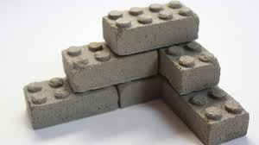
What does that mean to us?
Any propositions from the UIC ARGUS project
→ International Railway Standard end 2015
3) – Generic design choices or mitigation measures
    Implementing means for “functional surveillance and control activities on the networks" beyond simple operational control - Establishment of security accreditation means of authorized operators to act on all or part of sensitive networks...
    Distinction (physical independence) between signalling close network and the other intranet or internet operation & services networks
    Distinction between the signalling sub-network level and real signalling local level network: interlocking unit realize a barrier between the two level of network = confinement - Distinction (independence)
    between Telephone and signalling links - Automatic
    intrusion detection of the sub-network networks
UIC – Rail System Department – Dr. Marc ANTONI – 24 November 2015

Slide 19
What does that mean to us?
Any propositions from the UIC ARGUS project
→ International Railway Standard end 2015
3) – Generic design choices or mitigation measures
    Cryptography protection: in coherence with the signalling modules: at telecom format level and at functional level
    “VPN and more” (weak) services of the sub-network networks.
    In the frame work of a “Security Management System” regular use of in house hackers making intrusions tests.
    Reduce in critical systems the usage of radio communication links and satellite localisation systems too easy to perturbate, to intrude, to modify the safe behaviours of the safety functions...
UIC – Rail System Department – Dr. Marc ANTONI – 24 November 2015

Slide 20
Perspectives
Major consequences of cyber attacks are a reality for all the railways
Need of continuous exchanges of best practices in order to manage the risks with a system point of view (security ←contribute→ safety)
Necessity of best understanding (risks / targets) between Signalling, Operation and Telecoms actors for digital critical applications
Railway IM’s need several and specific set of mitigation measures depending of the criticity of the traffic, the acceptability of the consequences.
The railway domain is especially critical for national economic and military reasons... We are at the beginning of the story.
➔ UIC will published beginning 2016 a specific IRS (International Railway Standard) on this topic
UIC – Rail System Department – Dr. Marc ANTONI – 24 November 2015
Notes:
Demonstration of Safety/Security targets for the all life cycle
30 years versus 6 month
Standards for industrial activities / public activites
Malicious risk management (durability of technical solution like encryption versus time)
Performances / cost
Maximum System time versus average system time via the network
Common modes
Transparence
No ambiguity

Slide 21
Thank you for your kind attention
Dr. Marc ANTONI
FIRSE
UIC - Director of the Rail System Department
antoni@uic.org
UIC – Rail System Department – Dr. Marc ANTONI – 24 November 2015

