Slide 1
SAFETY MANAGEMENT SYSTEM
IN TURKISH STATE RAILWAYS (TCDD)
Mr. İbrahim Halil Çevik
Head of Foreign Relations Department

Slide 2
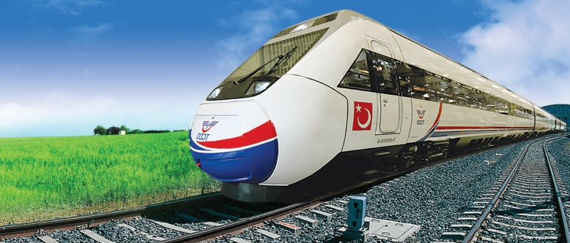
CONTENTS
1. Safety Management System (SMS) in EU
2. SMS in Turkish State Railways (TCDD)
3. SMS ……
4. Risk Assessment

Slide 3
SAFETY MANAGEMENT SYSTEM IN EU
The Safety Management System (SMS) plays a central role in the EU safety regulatory framework and is a cornerstone of the safety of the railway system in the European Union (EU).
SMS in EU was established by
Safety Directive
2004/49/EC

Slide 4
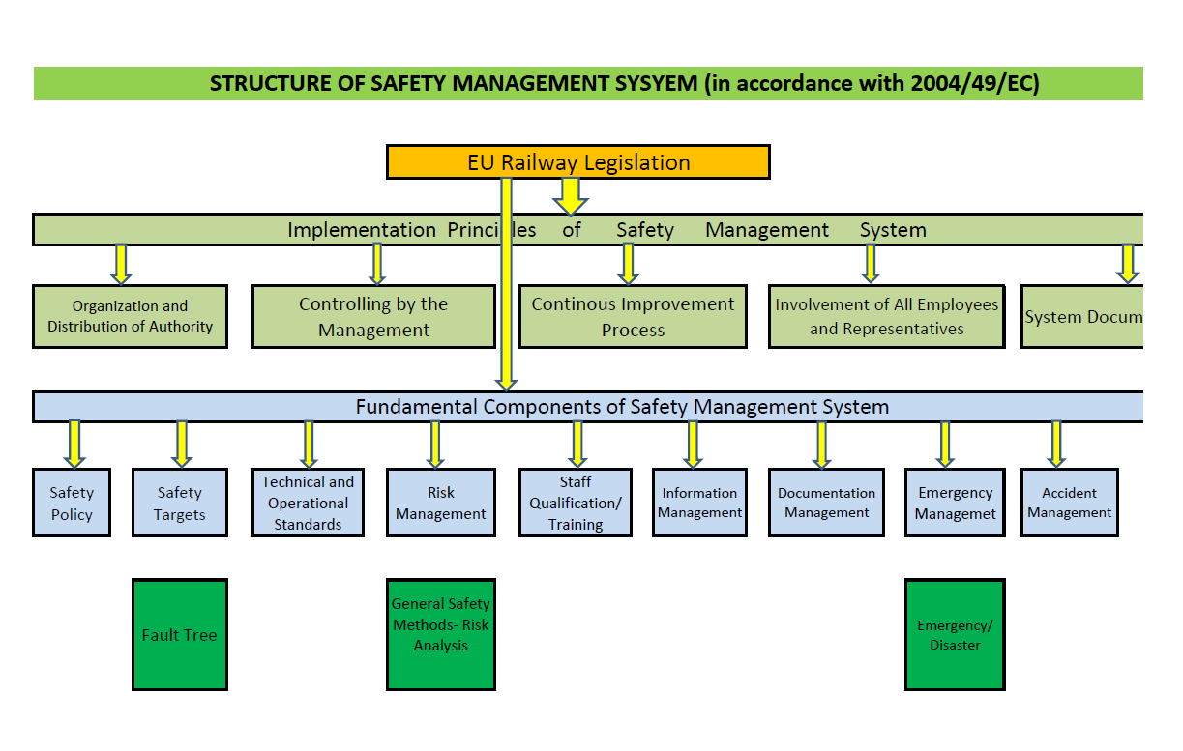
SAFETY MANAGEMENT SYSTEM IN EU

Slide 5
BACKGROUND OF ESTABLISHMENT OF SMS IN TCDD
The drives for the establishment of
a Safety Management in TCDD are:
1- Inauguration of High Speed Operations in 2009
2- Turkish Railway Reform in 2013

Slide 6
BACKGROUND OF ESTABLISHMENT OF SMS IN TCDD
3 basic
requirements
Elaboration of a strategy and action plan
Turkish Railway Reform Project
financed by EU
completed in January 2013
Developing a system for infrastructure allocation and pricing and a network statement
Developing an SMS for infrastructure management and railway operations

Slide 7
ESTABLISHMENT OF SMS DIRECTORATES IN TCDD
Pursuant to the Decision of Board of Directors
dated 06 December 2012
SMS Directorates were established
in the General Directorate
and in each of the Regional Directorates

Slide 8
OBJECTIVES FOR THE ESTABLISHMENT OF
SMS DIRECTORATES
SMS Directorate was established in TCDD in order to:
ensure safe transportation of freight and passengers
develop good relations between the infrastructure manager and the third parties, after the liberalization of TCDD

Slide 9
MISSION OF SMS DIRECTORATES
The mission of the SMS units is:
to establish SMS in accordance with Safety Directive 2004/49/EC on the network of TCDD and
to follow its implementation as well as
to reduce the number of incidents and accidents to an acceptable level by popularising a safety culture.

Slide 10
ESTABLISHMENT OF SMS DIRECTORATES IN TCDD
SMS Directorates are
directly under the Director General
at the Headquarters
and
the Regional Directors
in the Regions

Slide 11
TCDD ORGANIZATION CHART

Slide 12
ACTIVITIES FOR THE ESTABLISHMENT OF SMS
For the establishment of SMS in TCDD:
All SMS experts were trained on specific fields such as ISO 9001, OHSAS 18001, Risk Analysis, Hazard Assessment, Problem Solving Techniques, etc.
Approximately 2000 employees were trained on SMS by local and foreign experts.

Slide 13
ACTIVITIES FOR THE ESTABLISHMENT OF SMS
Visits were paid to Germany, Spain, Switzerland and Austria to examine their safety management systems on site.
Following the establishment of SMS in 2012, a 3-year project was initiated to facilitate adoption of SMS, improve its efficiency and spread the safety culture in TCDD. This project is underway.
In order to develop a corporate safety policy Safety Councils and Committees where employees can submit their problems on safety and proposals for improvements were established.

Slide 14
SAFETY COUNCIL AND SAFETY COMMITTEE
Members of the Safety Council are
Heads of Departments at the headquarters and Service Managers in the regions who are engaged in operating activities
Members of the Safety Committee are
Experts from departments and services engaged in operating activities

Slide 15
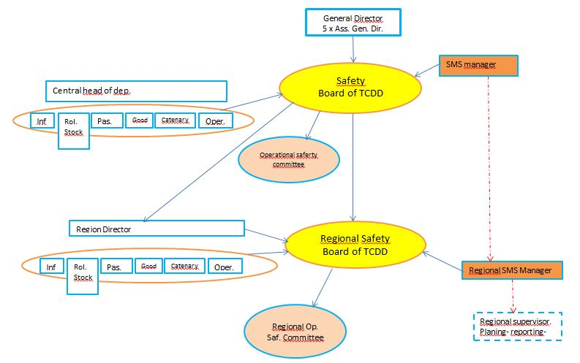
SMS ORGANIZATION CHART

Slide 16
ACTIVITIES FOR THE ESTABLISHMENT OF SMS
As a result of a joint study with the Directorate General for Regulation of Railways, regulations were prepared and put into practice at national level on the following subjects:
Level Crossing
Rail Network Access and Capacity Allocation
Rolling Stock Registration
Directive on Accident Search and Investigation was published.
Contributions were made to the preparation of Directive on Emergency Management.

Slide 17
Ensuring safety is the most important target of our Enterprise. In order to improve safety, qualitative and quantitative targets are defined and the plans and methods are developed to achieve these targets. After the defined targets are discussed by the Safety Council and Committee, they are put into practice.
CORPORATE SAFETY TARGETS
Input Events
Identification of Safety Targets
Safety Targets
Resource Availability
Old
Safety Reports
Environmental Changes

Slide 18
Safety policy expresses and reflects an organization’s commitment, obligation (mission) and strategic view (vision) on railway safety. TCDD Safety Policy in compliance with Directive 2004/49/EC was published on 15 July 2015 with the approval of the Board of Directors. All staff were informed about it and the Safety Policy was put on the official website of TCDD.
SAFETY POLICY
Notes:
Board of Directors?

Slide 19
CONTINUOUS IMPROVEMENT PROCESS (CIP)
CIP
Information from Public and Employees
Learning from Mistakes
Internal/ External Audits
Evaluation of Management
Safety Targets
Standards/ Laws

Slide 20
SMS AND RISK MANAGEMENT
- SMS Directorate started implementing Risk Management and Assessment Process in TCDD.
- Risk Matrix of TSE-EN-50126 was adopted by TCDD.
Why was Risk Matrix of TSE-EN-50126 chosen?
- Easy to use
- Easily comprehensible by staff
- Training on Risk Assessment and Risk Management Tools is underway.
- In the future, complex risk management tools like FMEA (Failure Mode Effects Analysis) and FTA (Fault Tree Analysis) will be used.

Slide 21
RISK MANAGEMENT
Railway companies need to set up a framework to systematically analyze all risks directly arising from work activities, job design or workload and implement appropriate controls to protect the safety of those undertaking and/or affected by the tasks.
Pursuant to the decision of the Board of Directors dated 18 April 2015, SMS Directorate uses hazard tree method and risk matrix to identify risks arising from railway operations.

Slide 22
Risk Analysis Process
RISK MANAGEMENT
Defining System
Identifying Hazards
Assessing Hazards
Identifying Measures
Risk management is conducted through:
1. compilation of various events by means of:
event analysis
monitoring
early warning indicators
2. identification of hazards
3. assessment of risk potential of hazards
4. development of countermeasures

Slide 23
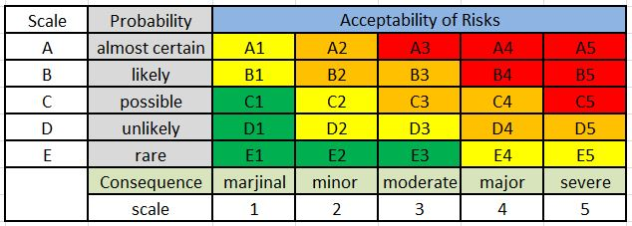
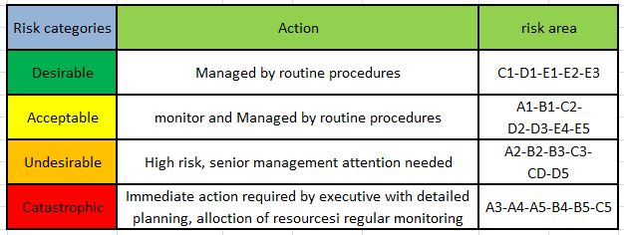
TCDD Risk Matrix
RISK MANAGEMENT

Slide 24
RISK MANAGEMENT
PROBABILITY OF OCCURRENCE OF ACCIDENT/INCIDENT IN THE TCDD RISK MATRIX
SCALE | PROBABILITY OF OCCURRENCE | DEFINITION | TIME INTERVAL
A | Very Likely | Event can occur at any moment. | Daily
B | Likely | Event may occur frequently. | Between 2 Days and 1 Month (included)
C | Possible | Event may occur occasionally. | Between 1 Month and 1 Year (included)
D | Unlikely | Event may occur rarely. | Between 1 Year and 10 Years (included)
E | Very unlikely | Event may occur very rarely. | More than 10 Years
SEVERITY OF ACCIDENT/INCIDENT IN THE TCDD RISK MATRIX
SCALE | SEVERITY | DEFINITION OF POTENTIAL LOSS | FINANCIAL LOSS ASSESSMENT
5 | Catastrophic | Many Fatalities/Catastrophic Environmental Loss/Catastrophic Financial Loss | Above 5.000.000 TL
4 | Significant | Single Fatality/Significant Environmental Loss/Significant Financial Loss | Between 1.000.000 TL (included) and 5.000.000 TL
3 | Moderate | Multiple Severe Injuries/Moderate Environmental Loss/Moderate Financial Loss | Between 350.000 TL (included) and 1.000.000 TL
2 | Low | Single Severe Injury/Low Environmental Loss/Low Financial Loss | Between 100.000 TL (included) and 350.000 TL
1 | Negligible | Minor Injuries/ Negligible Financial and Environmental Loss | Below 100.000 TL

Slide 25
STAFF QUALIFICATION MANAGEMENT AND TRAINING
- Staff assigned to safety-critical activities should be well-qualified for the job.
- To ensure fulfillment of responsibilities, sufficient resources should be allocated and staff should be authorized.
- As a result of joint studies with Vocational Qualifications Authority, National Vocational Standards and National Vocational Qualifications were defined for 16 and 8 professions, respectively.
Notes:
6 YOK!

Slide 26
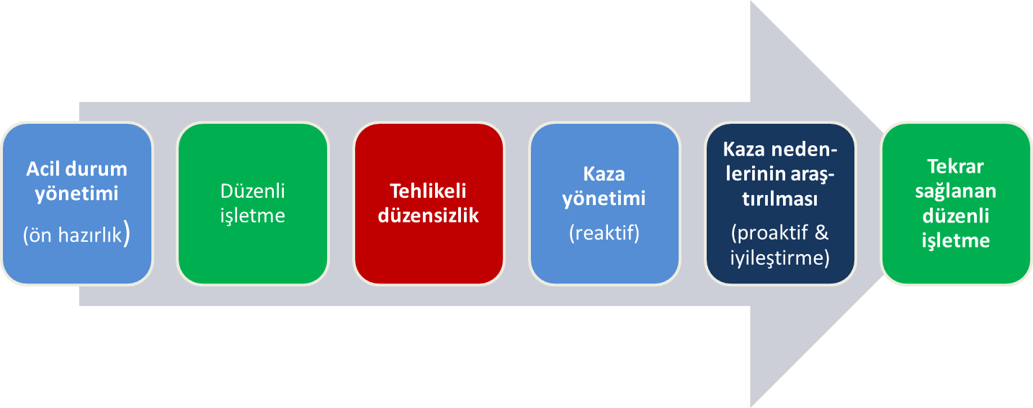
EMERGENCY MANAGEMENT
Within the framework of railway emergency management, safety rules and recommendations focus on risk management, establishing systems (procedures, protocols, technical means, communication and information systems, others) to avoid incidents.
However, accidents and crises are not likely to be stopped, but managed and settled in the most efficient and effective way using the available resources in the minimum time.
TCDD Directive on Emergency Management, which came into force on 10 December 2012, has been implemented.
Emergency Management
(Preliminary activities)
Investigation of Causes of Accidents
(Proactive&
Rehabilitation)
Regular Operation
Regained
Regular operation
Dangerous irregularities
Accident Management
(Reactive)

Slide 27
ACCIDENT MANAGEMENT
Methods should be devised to ensure that:
- accidents, incidents, near-misses and other dangerous events are reported and analyzed,
- preventive measures are taken.
Directive on Accident Search and Investigation was prepared and training activities are underway.

Slide 28
AUDITS
Safety-critical processes managed by our Enterprise are controlled by independent safety experts.
SMS experts in TCDD aim to control and supervise all safety-critical processes on a regular basis.

Slide 29
DEFINING PROCEDURES TO MEET TECHNICAL AND OPERATIONAL STANDARDS
All railway operating processes must comply with legal and technical standards, national rules, etc.
Railway operating processes should be checked and updated on a regular basis.
To enable monitoring the safety-related standards, all departments should work in coordination.

Slide 30
DEFINING PROCEDURES TO MEET TECHNICAL AND OPERATIONAL STANDARDS (EXAMPLES)
Internal (TCDD) | External
➢ Operating Regulations | ➢ Railway Law
➢ Working Time Regulations | ➢ Laws (e.g. Occupational Health and Safety Law)
➢ Maintenance Processes | ➢ Standards
SMS (all processes included) | ➢ TSI
➢ Internal Regulations | International Regulations (2004/49/EC, VO 1169-2010, etc.)
 | ➢ SMS of Third Parties

Slide 31
Thank you for your kind attention.
İbrahim Halil ÇEVİK
Head of Foreign Relations Department

