Slide 1
Human Factors and Signals Passed at Danger
Dr Huw Gibson
Dr Ann Mills
RSSB

Slide 2
Presentation Overview
GB Rail and Signals Passed at Danger (SPADs)
Summary of Investigation in to Human Factors and Signals Passed at Danger
Proposed industry changes

Slide 3
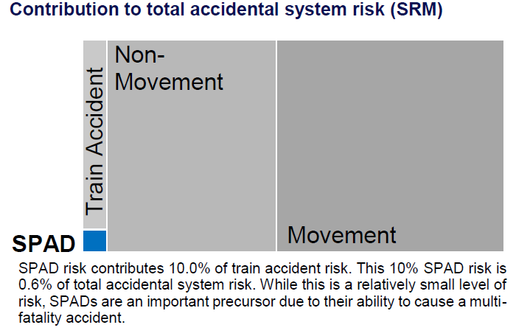
SPADS in context of total accidental system risk

Slide 4
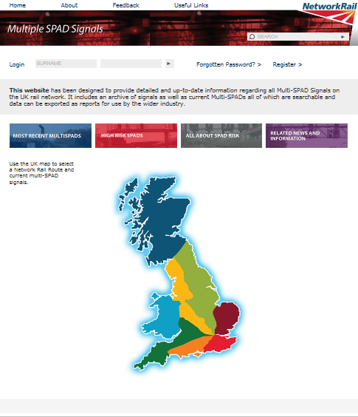
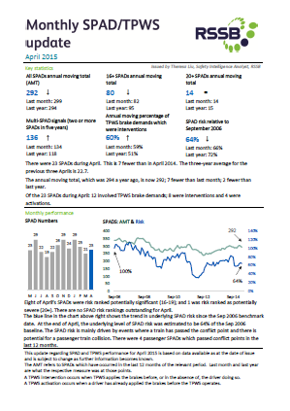
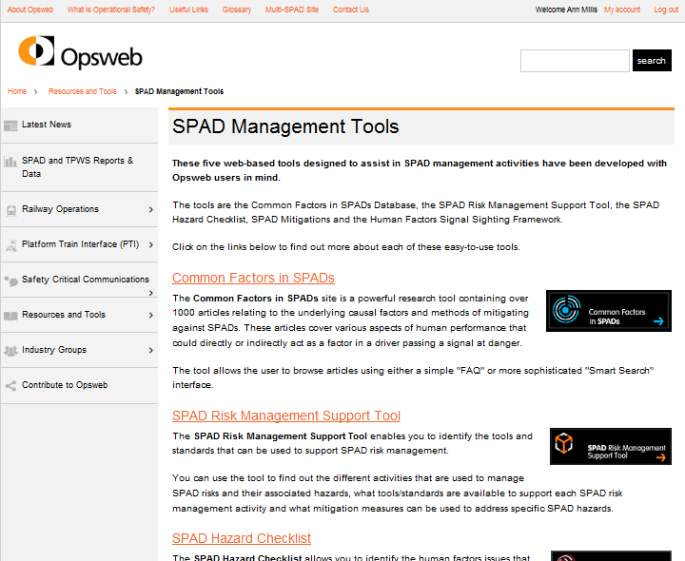


GB reporting, resources and research

Slide 5
Industry Human Factors SPAD Review

Slide 6
Project Objectives
Develop new and fuller insights in to the human factors issues associated with SPAD incidents
Work with industry to identify the strengths and any potential weaknesses in SPAD management processes
Help to assure that human factors associated with SPADs are effectively managed
Notes:
Bullet 1: We have an opportunity to understand better because we now have a growing database called the Incident Factor Classification System which captures human factors issues related to incidents.
Bullet 2: Working with industry to look at both proactive management through training and briefing and reactive management of incidents.
Bullet 3: Is what is being done already sufficient, what more can the human factors specialists do for you as support, what are good practices in the industry.

Slide 7
How do we manage SPADs better?
Identify the underlying causes of SPAD incidents
  Reviewing SPAD investigation reports
  Looking at how investigations could be improved
Communicating the underlying cause information to all staff and implementing improvements in SPAD management processes
  Workshops with industry: drivers, managers for railway undertakings, signallers, managers for the infrastructure manager (Network Rail)
  Challenging individual companies to do steps one and two

Slide 8
How to communicate underlying causes

Slide 9

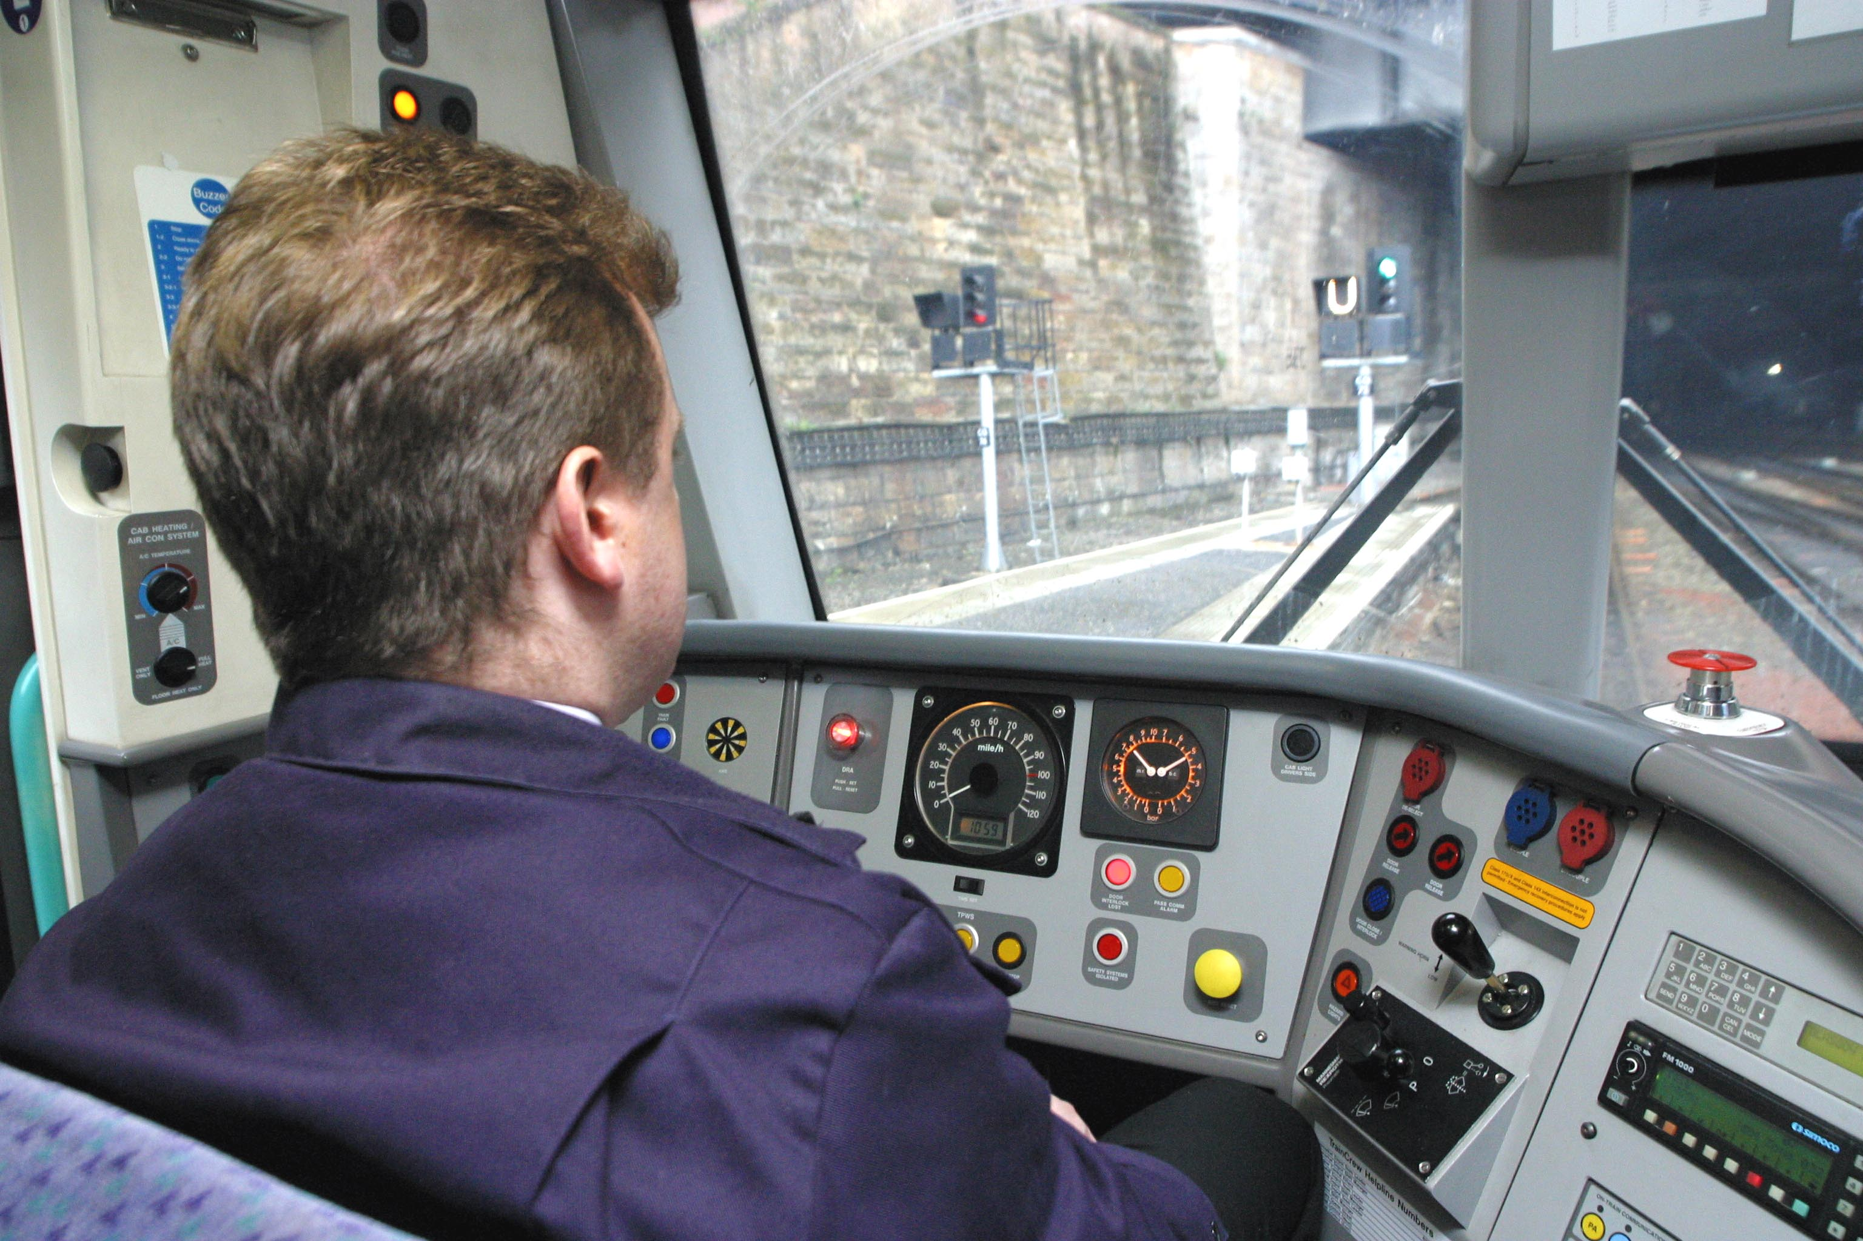
Knowledge, skills and experience
Environment
Communication
Equipment

Slide 10


Teamwork
Workload
Personal Factors
Information
Supervision and Management
Practices and Processes

Slide 11
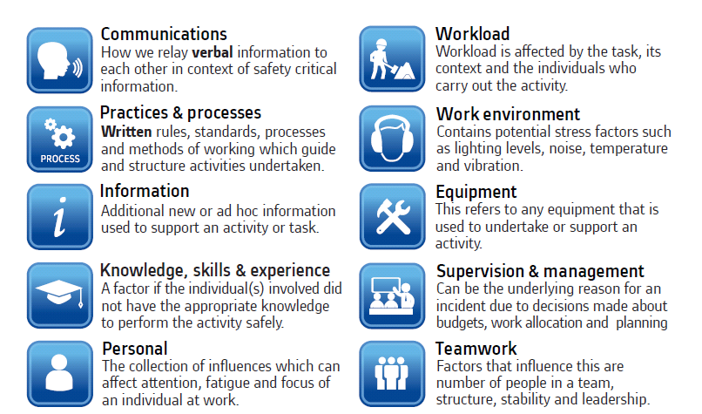
Ten Incident Factors – Alstom Prompt Card
The 10 incident factors

Slide 12
What are the underlying causes?

Slide 13
SPAD Data Collected
257 SPAD Incident Investigation Reports Reviewed
924 Causal/Contributory Factors, average four per incident
197 Passenger, 54 Freight, 184 Network Rail
By Year:
2011 | 2012 | 2013 | 2014
70 | 62 | 116 | 9

Slide 14
SPAD 10 Incident Factor causes

Slide 15
Conclusions

Slide 16
Key Challenge to Industry

Slide 17
Conclusions
Identifying underlying causes profiles is the first step in understanding the human factors associated with SPADs
Need to focus on the safety management system, not the train driver
By involving drivers, managers and company directors in reviewing underlying causes and identifying improvements we can:
  Fix recurrent issues across SPAD incidents
  Support the development of a Just Culture around SPADs

Slide 18
Thank you

