Slide 1
Submitted by the experts from CLEPA
Informal document GRRF-78-44
78th GRRF, 16-19 September 2014
Agenda item 9(a)
Explanation to GRRF-78-27

Slide 2
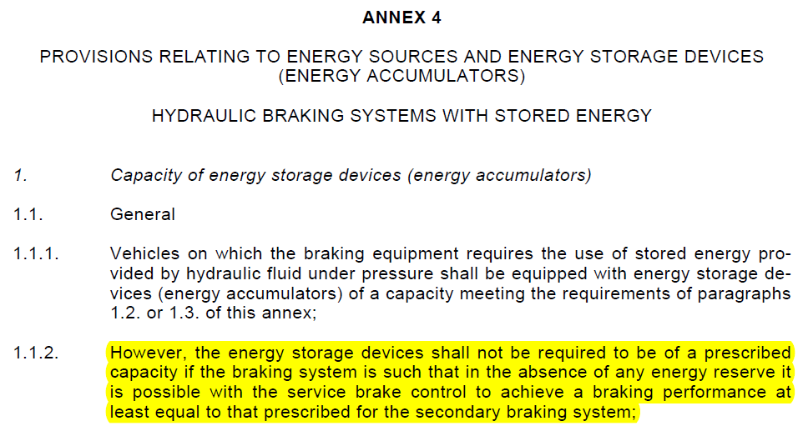
ECE-R 13H

Slide 3
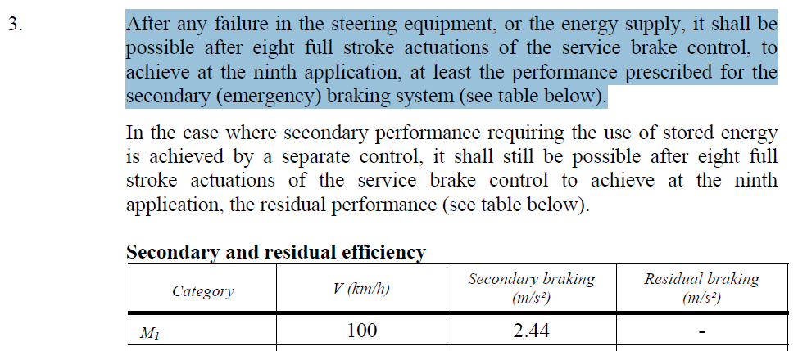
ECE-R 79 – Annex 3 (Excerpt only!)
E/ECE/324/Rev.1/Add.78/Rev.2/Amend.1−E/ECE/TRANS/505/Rev.1/Add.78/Rev.2/Amend.1

Slide 4
ECE-R 79
5.3.1.4. In the case where the braking system of the vehicle shares the same energy source as the steering system and this energy source fails, the steering system shall have priority and shall be capable of meeting the requirements of paragraphs 5.3.2. and 5.3.3. as applicable. In addition the braking performance on the first subsequent application, shall not drop below the prescribed service brake performance, as given in paragraph 2. of Annex 3 of this Regulation.
5.3.1.5. In the case where the braking system of the vehicle shares the same energy supply as the steering system and there is a failure in the energy supply, the steering system shall have priority and shall be capable of meeting the requirements of paragraphs 5.3.2. and 5.3.3. as applicable. In addition the braking performance on the first subsequent application shall comply with the prescriptions of paragraph 3. of Annex 3 of this Regulation.
"5.3.1.6. The requirements for the braking performance in paragraphs 5.3.1.4. and 5.3.1.5. above shall not apply when the prescribed secondary braking performance defined in paragraph 3 of Annex 3 of this Regulation can be achieved by the use of muscular energy alone."

