Slide 1
Railway competitiveness
Hinne Groot, Netherlands ministry
25th November 2014
UN ECE SC.2 workshop

Slide 2
NL key figures (2013) railways
Rail passenger km:
17.669 (-0.5%)
906 international
17.018 under public service contract
8% market share
94% of trains punctuality (5 min)
Average passenger journey journey app. 49km
Important market segments:
Commuters to urban areas;
Students travel;
Intercity cross-country services;

Slide 3
NL key figures (2013) railways
Freight
App 90% is international transport
Most competitive for distancs 300-1500km
Tonkm: - 1 %
Border crossing trains on Rhine Alpine corridor +3%;
Border crossing trains on North Sea Mediterranean corridor +4%
Market share new railway undertakings: 41% tonkm
6% market share
Market segments:
Maritime cargo / continental cargo;
Bulk / intermodal container / single wagon load;

Slide 4
NL key figures (2013) railways
State aid:
€1.4bln to Infrastructure Manager for maintenance / renewal
investments 0.8bln
App -40mln to incumbent railway undertaking NS
mln to regional passenger railway undertakings

Slide 5
Railway competitiveness
Competitiveness, contribution to sector railways:
Intermodal competition;
Intramodal competition;
Efficiency of the railway system;
Innovation of the railway system;
Reliability of transport system;
Safety and security of the transport system;

Slide 6
Railway competitiveness
Competitiveness contribution to overall economic development:
Freight:
accessibility of the mainports Rotterdam and Amsterdam;
efficiency of logistics systems;
Passengers transport:
Accessible cities, spatial planning;
Environmental impact;
Accessibility of transport;

Slide 7
How to deliver competitivenes: NL institutional setting
Separated infrastructure manager ProRail is state owned public company;
Open market rail freight, no railway freight undertaking is owned by Dutch government;
Passenger transport from 2015 onwards:
Integrated public service contract main railway network for 2015 – 2014 period directly awarded to NS;
Up to 20% of railway passenger trainkilometers part of regional public service contracs, tendered out:
National Safety authority as part of Government regulatory agency on transport and environment (ILT);
Railway regulatory body as part of national competition authority (ACM)

Slide 8
1.3 Key players in railway sector
National
Safety Authority (ILT)
Regulatory Body, ACM
Freight RU’s
contracts
Infrastructure manager ProRail
Infracapacity, infracharges, quality
Passenger RU’s
NS
Regional RU’s
Multi-annual contract
PSO contract
PSO contracts
Ministry of infrastructure
Regional government

Slide 9
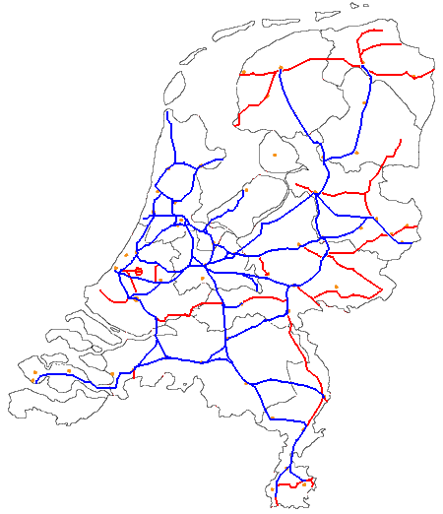
1.1 Information on Dutch passenger railway network
Blue lines: national
Red Lines: regional
+ dedicated freight line
(Betuwe Route) from
Rotterdam to German
border at
Zevenaar-Emmerich
350 km
Germany
Belgium

Slide 10
Long term rail strategy, challenges
Railway services, general
Improve reliability of railway services; coping with mayor disturbances, including wheather;
Railway passenger services:
Coherence of the network for passengers with main railway network versus decentralised lines; OV chipcard, travel information, connections, passenger rights;
Efficiency commitment: from 2015 onwards NS will pay €180mln for the exclusive right annexed to the PSO contract for the main railway network;

Slide 11
Long term rail strategy, challenges
Railway freight services:
Rail freight corridors key element for Logistics and ports strategy;
Infrastructure management
Capacity allocation: support optimal use of scarce capacity;
Network wide implementation of ERTMS in planning phase;
Infrastructure investment program to facilitate high frequency rail passenger services;
ProRail multiannual contract includes efficiency target
Environmental: control noise impact to citizens

Slide 12
Contact details:
hinne.groot@minienm.nl
+31.70.4561678

