Slide 1
Proposal for Amendment to UN Regulation No. 46
(Devices for indirect vision)
Submitted by the expert from Japan
Informal document GRSG-105-25
(105th GRSG, 8-11 October 2013,
agenda item 6.)

Slide 2
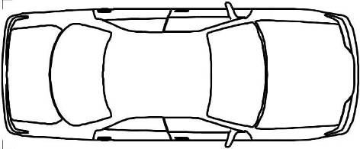
1-1. Overview
R46 (Devices for indirect vision) ECE-TRANS-WP.29-GRSG-2013-5
Our new proposal:
GRSG/2013/5 (From Japan) |  | New Japanese proposal
(1) “CP Optional” requirements |  | Mandatory ・From the standpoint of mutual recognition of approvals, we changed the proposed applicability from “CP Optional” to “Mandatory”.
(2)The provision to ensure the vehicle’s close-proximity field of vision |  | Continues to be proposed for M1 * We would like to continue to propose this amendment, as it is highly effective at improving safety. * However, for the provision on the exclusion of the A-pillar blind area as seen from the eye-point, the method using a formula that we proposed at the 104th GRSG is complicated, we will consider a simpler method.
 |  | ・In narrow streets or streets with no sidewalk, pedestrians/bicycles and vehicles are not sufficiently separated, and the risk for accidents between them is high. It is therefore extremely important, from the standpoint of safety, to ensure the field of vision for the drivers starting the vehicle so that they can notice pedestrians/bicycles.
0.3m
0.3m
Proposal for Amendment to UN Regulation No. 46 (Devices for indirect vision)
(To be continued on the next page)

Slide 3
1-2. Overview (continued)
GRSG/2013/5 (From Japan) |  | New Japanese proposal
(3) Mirror surface curvature (6.1.2.2.4.2.) |  | Withdrawn for M1
(4) Mirror impact absorption test (6.1.3.4.) |  | Withdrawn for M1
Categories other than M1:
For the categories other than M1, due to the differences not only in the mirror surface curvature and impact absorption test but also in traffic environment, there exist large differences among CPs in their requirements, etc. to ensure the field of vision necessary for driving the vehicles; thus, we would like to propose to separate M1 from the other categories in R46.

Slide 4
2. Effects and Evaluation Relating to the Motor Vehicle Close-Proximity Field of Vision Regulation
-- Changes in the Numbers of Accidents Involving Pedestrians at the Start of the Vehicle (Japan） --
Background * The changes in the numbers of accidents involving pedestrians at the start of the vehicle were investigated based on the year when the regulation to ensure the vehicle’s close-proximity field of vision applied in Japan, and its effects were studied. * The subjects of the current study were limited to SUVs and minivans as they are the primary vehicles of category M1 for which measures need to be taken to comply with the new regulation. Data * Accidents of SUVs and minivans involving pedestrians (infants to 10-year-olds) at the start of the vehicle. | Effects of introduction of the regulation: * Fatal accidents: Reduced by about 46% from 24 accidents in 2002 to 13 accidents in 2010. * Serious injury accidents: Reduced by about 49% from 215 accidents in 2002 to 110 accidents in 2010. * Minor injury accidents: Reduced by about 31% from 1158 accidents in 2002 to 800 accidents in 2010.
Accidents reduced overall by about 34%
Conclusion:
It was found that the regulation to ensure the close-proximity field of vision is effective to a certain extent for accidents involving children at the start of the vehicle.

Slide 5

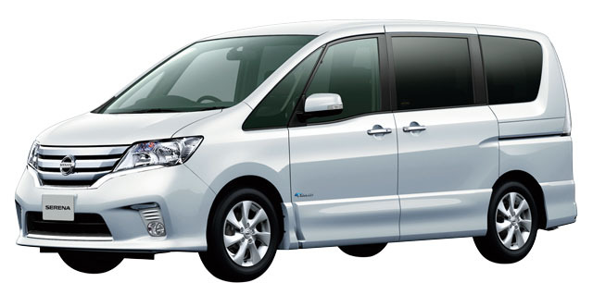
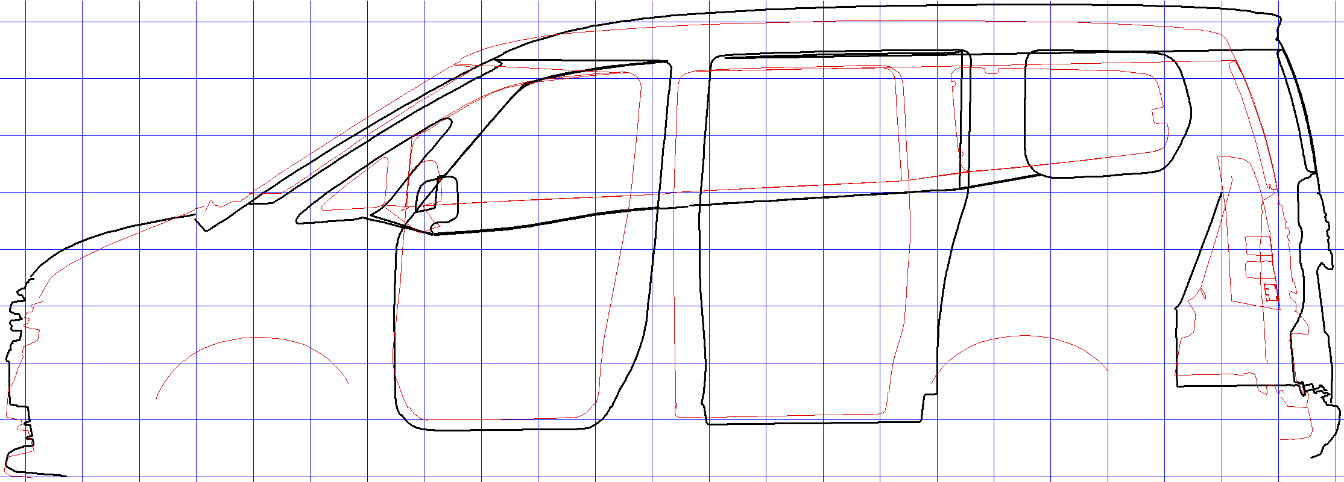
３． An Example where the Close-Proximity Field of Vision Was Improved through Introduction of the Regulation
NISSAN SERENA
2010-
1999-2005
This windows area expanded
* The close-proximity field of vision requirement may be met using either the indirect or direct field of vision. To comply with this requirement, some manufacturers improved the direct field of vision for minivans, in which the close-proximity field of vision is generally more limited than sedans.

Slide 6
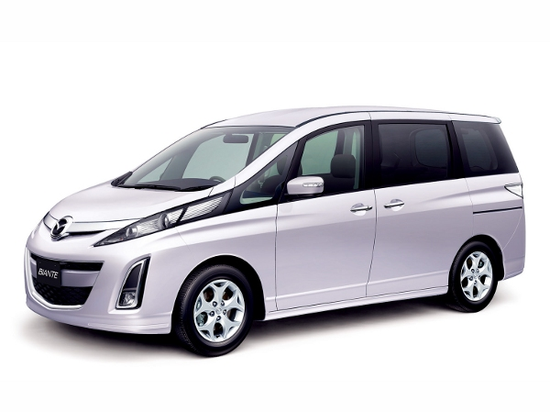
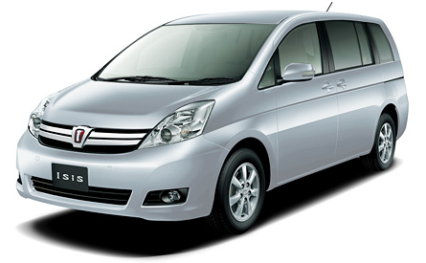
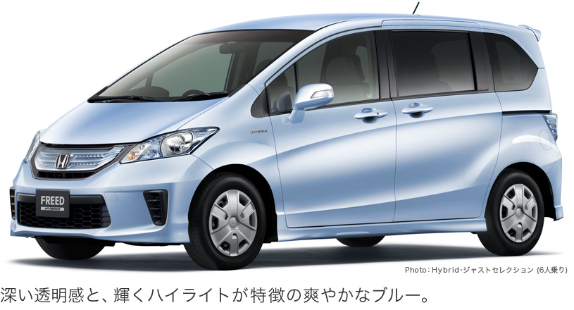
４． Examples where the Direct Field of Vision Was Ensured and the close-proximity mirrors Were Not Required
MAZDA BIANTE
NISSAN SERENA
4715(L)×1770(W)×1835(H)
4685(L)×1695(W)×1865(H)
TOYOTA ISIS
HONDA FREED
4215(L)×1695(W)×1715(H)
4640(L)×1710(W)×1640(H)

Slide 7
5-1. Why It Is Necessary to Separate M1 from the Other Categories in R46
Main differences between R46 and the Japanese regulation include:
* The vehicle’s close-proximity field of vision is slightly different.
* R46 requires the ground to be visible while the Japanese regulation assumes a part of the child body (height) as the target of visibility.
* R46 prohibits installation of mirrors at a height of not more than 2.0 m.
 | Mirrors | Object of vision | Positioning
R46 | Class V Class VI | Ground | Installation at a height of not more than 2.0 m prohibited
Japan | Front mirror, side mirror * In the case of right-hand drive | A pole with dia. of 30 cm and height of 1.0 m | Anywhere, as long as the impact absorption tests are met.
(Excerpt from GRSG-103-23)

Slide 8
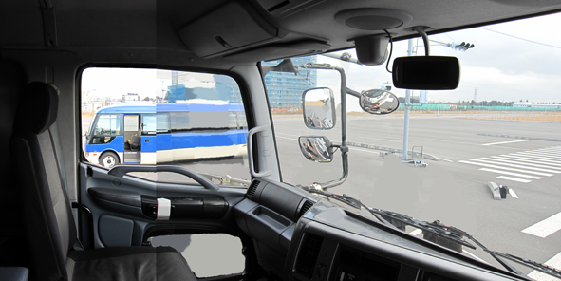
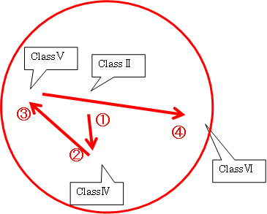
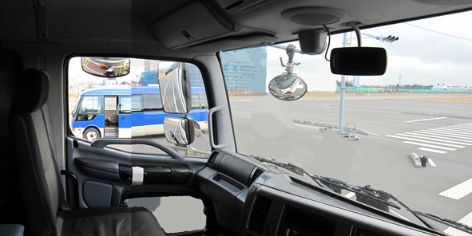
5-2. Why It Is Necessary to Separate M1 from the Other Categories in R46
♦Examples where the Japanese mirror and the R46 mirror are installed in the same vehicle (N3)
* Concept of installing mirrors differs between Japan and R46.
Japanese mirror
R46 mirror
Main mirror
①
③
* It is important to be able to quickly check the vehicle’s close-proximity surroundings when turning left at narrow intersections. Thus, on many vehicles in Japan, 3 mirrors are installed in close-proximity to ensure the field of vision with little movement of line of sight.
Front under mirror
②
Side under mirror
Difficult to harmonize the Japanese regulation with R46 for large vehicles

Slide 9
6. Summary
● The close-proximity field of vision requirement is effective in reducing the blind area for obstacles, in narrow streets, in the field of vision immediately forward of the vehicle and adjacent to the side of the front passenger seat.
→ We would like to consider permitting the perception or detection method using a sensor, sonar, etc. in addition to the perception method using a mirror or camera that we proposed at the 104th GRSG, if the GRSG-related parties so desire. In this case, consideration will require time (see the schedule below).
● Due to the differences in traffic environment, there exist considerably large differences among CPs in their requirements to ensure the field of vision necessary for driving vehicles, giving us many issues to address.
Nevertheless, from the standpoint of promoting the IWVTA, we would like to adopt R46 including
the requirement of the close-proximity field of vision.
We therefore propose to separate M1 from R46.
● We believe that this proposal will be beneficial, in view of safety, for CPs with road conditions similar to Japan’s.
Schedule (draft)
Reg. No. | 2013 |  | 2014 |  | 2015 |  | 2016
 |  | GRSG 105th session | GRSG 106th session | GRSG 107th session | WP.29 | Amendment of R46 | Establishment of IWVTA (target)
R46 Rear-view mirror
Development of new technical requirements related to the close-proximity field of vision
Discussion at GRSG
Approval of WP.29

