Slide 1

PROPOSAL FOR AN NEW REGULATION FOR VEHICLE INDOOR AIR QUALITY (VIAQ)
Informal document GRPE-66-40
66th GRPE, June 7th 2013
Agenda item 18(a)
Jongsoon Lim
(jongsoon@ts2020.kr)
KATRI(Korea Automobile Testing & research Institute)

Slide 2

Contents
1.Background
2. Korea Case study
3. International Status
4. Conclusion
Notes:
2

Slide 3


Background
Consumers are increasingly concerned about indoor air quality from
household, workplace and vehicle
Various chemical materials are emitted from vehicle interiors
VOCs and Aldehydes are included in the vehicle indoor air
Chemical materials are harmful to human body
Causes symptoms such as headaches, eye irritation, sneeze, and so on
Such symptoms may not only affect drivers' health but also safe driving.
Discussions on vehicle indoor air quality is necessary
to protect driver’s health and safe driving

Slide 4
Background
Harmful Substances & Its Effect on Human Body
Item | IARC | Effect on Human Body
Formaldehyde | 1 | As colorless liquid with strong stimulating smell, it causes skin infections and invades the mucosa
Benzene | 1 | Causes skin and eye irritation, is extremely dangerous when inhaled, and in serious cases, causes leukemia and increases the occurrence rate of lymph cancer and blood cancer
Ethyl benzene | 2B | Affects internal organs, lungs, central nervous system
Styrene | 2B | Stimulates eyes, skin, nose, respiratory system, causes sleepiness or unconsciousness
Toluene | 3 | Stimulates central nervous system, causing nausea, and abnormalities in stomach and nerve system
Xylene | 3 | Causes nerve stimulation, skin infection, cornea damage and so on, damages kidney and reproductive functions
Carcinogenic Classification Standard of International Agency for research on Cancer
Group 1 : Carcinogenic to humans
Group 2A : Probably carcinogenic to humans
Group 2B : Possibly carcinogenic to humans
Group 3 : Not classifiable as to its carcinogenicity to humans

Slide 5

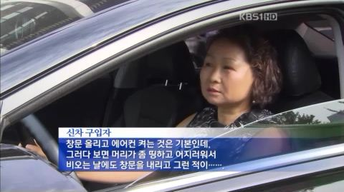
Introducing of Korea Case
    Sick House Syndrome & Sick Car Syndrome : became a social issue
    New car driver feel a headache, eye irritation, sneeze and so on
    The main cause is the chemical materials that emitted from vehicle interiors
<KBS news “Hazardous substances in new car interiors”>
Interview : I feel slight headache and dizzy…
Notes:
5

Slide 6


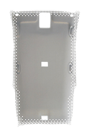
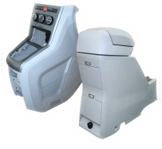
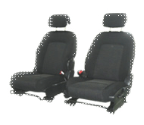
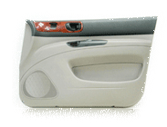






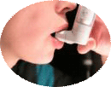



New car consumer survey
    Surveyed 800 people who purchased a new car
    Feeling the physical symptoms under driving : 51.5%,
    Headache 31.5%, Eyes irritation 31%, Sneeze 15.8%, Fatigue11.1%...
Vehicle interior materials
SEAT
DOOR TRIM
CARPET
IP
HEADLINING
BACK SHELF
PANEL
CONSOLE
Formaldehyde
Toluene
VOCs
Amines
phthalate
PAHs
Headache
Dizzy
Sneeze
Dyspnoea
Sleepiness
Allergy
Smell
Notes:
6

Slide 7
The progress of rule making
    2005 Research on new car Indoor Air Quality basic investigation
    2006 Research on Driver Risk Assessment of new car
    2007 Private and Public Conference, Public Hearing, Seminar
    Public Announcement of 「Management Guideline of Vehicle Indoor Air Quality」
    2010 Checkout test on 9 new vehicle model released in 2009
    2011 Checkout test on 9 new vehicle model released in 2010
Notes:
7

Slide 8
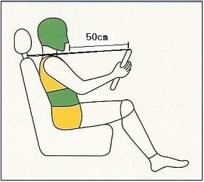
The main contents of VIAQ Guideline
    Establish a VIAQ guideline on harmful substances
    reflecting the new vehicle’s IAQ risk evaluation and the characteristics of the vehicle
Vehicle’s indoor air quality measurement method
Time
Temp stabilize
Min. 12hr
Ventilation
30min
Close door
Sealing
2hr
sampling
15min
Cabin
Temp
25℃
25℃
25℃
25℃
Harmful substance limit
Item (㎍/㎥) | Formaldehyde | Benzene | Toluene | Xylene | Ethyl benzene | Styrene
Limit | 250 | 30 | 1,000 | 870 | 1,600 | 300
Notes:
8

Slide 9

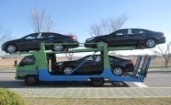
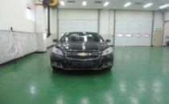
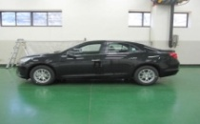
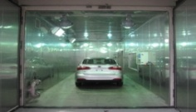
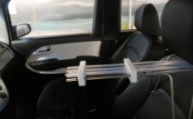
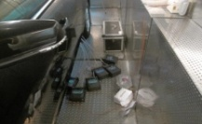
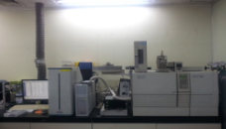
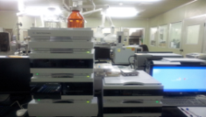
Checkout Test
    Checkout whether automobile manufactures comply with guideline
14days
28days
Car Preparation
2 hours
Room Temperature Stabilizing
Sampling
Temp. Stabilizing
Sampling
Sample
Analysis
  9
GC/MS
HPLC
Content Analysis
Notes:
9

Slide 10
Test Results
    The result of checkout test
Year | Item | Formaldehyde | Toluene | Ethyl benzene | Styrene | Benzene | Xylene
 | Limit | 250 | 1,000 | 1,600 | 300 | 30 | 870
2011 | Avg | 35 | 1,046 | 102 | 14 | - | -
 | Min | 8 | 108 | 20 | 7 | - | -
 | Max | 56 | 2,846 | 470 | 25 | - | -
2012 | Avg | 20 | 328 | 66 | 33 | 7 | 199
 | Min | 4 | 85 | 18 | 4 | 5 | 45
 | Max | 29 | 753 | 131 | 136 | 13 | 379
Notes:
10

Slide 11







International VIAQ Status
1970
1980
1990
2005
2007
2012
ㆍGermany
VW(1978)
Car cabin
air quality
study
ㆍGermany
(1981)
VOCs Report
ㆍTOYOTA
(1991)
ㆍChina
(2007)
VOC
ㆍChina
(2012)
Guideline
ㆍKorea(2005)
VOC study
ㆍCARB (1998,2003)
VOCs Report
ㆍJAMA
(2005)
VOC
Report
No.98
ㆍGermany
DIN(2007)
ISO standard
Proposal
ㆍISO
Standard
(2012)
ㆍKorea(2010)
Guideline

Slide 12
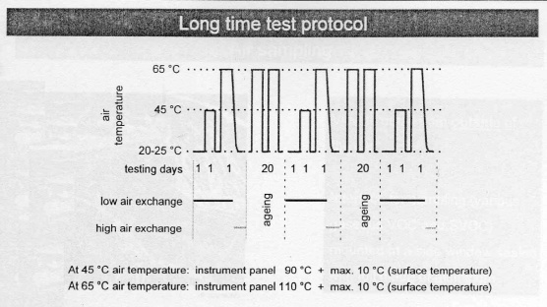
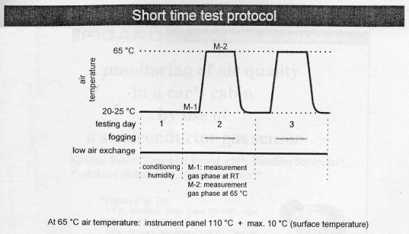
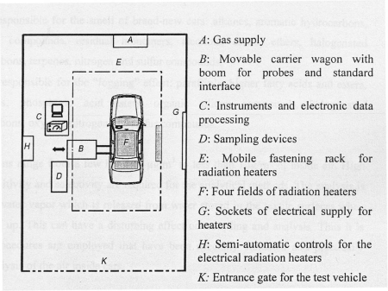
International Status(Europe)
    VOCs related research began since 1970
    Netherlands, France, Sweden and other countries conducted researches
    Germany conducted researches from a long time ago related to the smell suppression of new cars
    From the beginning of 1990s, research on VOSc evaluation method of a new car’s indoor space was conducted, led by TṺV NORD , TṺV (Technology Inspection Association)
    In TṺV Rheinland, TOXPROOF certification system on new car’s indoor air quality is operated
< Composition of TṺV NORD Vehicle Indoor air Quality Measuring System>
Notes:
12

Slide 13
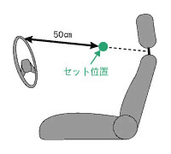
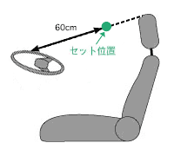
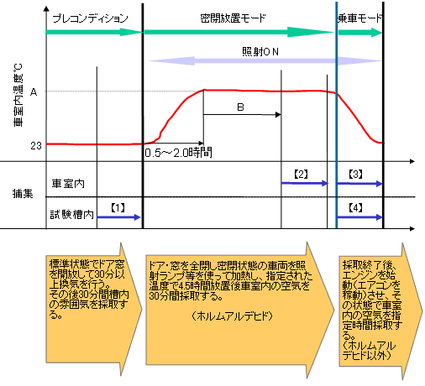
International Status(Japan)
    Japan Automobile Manufacturers Association (JAMA) leads IAQ Research
    In February 2005, led by JAMA, “Countermeasure Guidance on the Reduction of vehicle Indoor VOCs” is announced
    In March 2006, trucks and buses are added and the guideline is amended
    In case of sedans, in 2007 and in case of commercial vehicles such as trucks and buses, in 2008, new cars sold within Japan is recommended to meet the guidelines
< JAMA Sampling Location and Experiment Mode >
Notes:
13

Slide 14
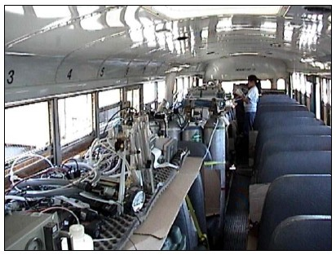
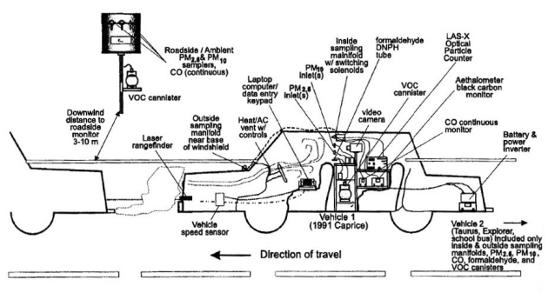
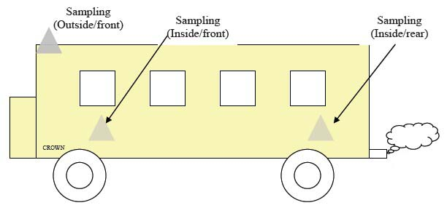
International Status(USA)
    VOCs related researches began from the end of 1990s
    In case of CARB(California Air Resources Board ), indoor air quality research result on 2 sedans, 1 SUV and 1 school bus in 1998 and 7 school buses in 2003 was announced
    EPA (Environmental Protection Agency) Report on the necessity of indoor air quality research
    “Journal of Exposure Analysis and Environmental Epidemiology” 2003
    SAE Technical PAPER 2010-36-0390 “New Vehicles Cabin Indoor Air Quality”
<Composition of CARB Indoor Air Quality Measuring System>
<CARB Bus Indoor Air Quality Measuring System>
<CARB Bus Indoor Air quality Measuring System>
Notes:
14

Slide 15
International Status(China)
    IAQ Research by China’s Indoor Decoration Association Indoor Air Reduction Center & Guangzhou Environment Inspection Center
    Conducted indoor air quality situation investigation on vehicles respectively (in 2007)
    Announcement of IAQ Regulation by Chinese Environment Protection Agency (2012)
    Enactment of relevant Acts of national level based on situation investigation and research results
    HJ/T 400-07 December 2007 "Determination of Volatile Organic Compounds and Carbonyl Compounds in Cabins of Vehicles“
    GB/T 27630-2011 01 March 2012 “Guideline for air quality assessment of Passenger car”
Notes:
15

Slide 16

International Standard and Regulation
ISO 12219-1:2012 "Interior air of road vehicles -- Part 1:Whole vehicle test chamber – Specification and method for the determination of volatile organic compounds in cabin interiors
Automobile Management Act Article 33-3, 18 Dec. 2012
(Newly Manufactured Vehicle Indoor Air Quality Management)
Ministry of Land, Infrastructure and Transportation Notification No. 2007-539, 5 June 2007)
“Newly Manufactured Vehicle Indoor Air Quality Management Standard”
HJ/T 400-07 December 2007 "Determination of Volatile Organic Compounds and
Carbonyl Compounds in Cabins of Vehicles“
GB/T 27630-2011 01 March 2012 “Guideline for air quality assessment of Passenger car”

Slide 17
Comparison of VIAQ Limit
    Comparison of vehicle indoor air quality limit
Harmful Substances | Korea | China | ISO
Formaldehyde | 250 | 100 | -
Benzene | 30 | 110 | -
Toluene | 1,000 | 1,100 | -
Ethyl Benzene | 1,600 | 1,500 | -
Xylene | 870 | 1,500 | -
Styrene | 300 | 260 | -
Acetaldehyde | - | 50 | -
Acrolein | - | 50 | -
Total | 6 types | 8 types | -

Slide 18
Manufacturers Status
    Management status of manufacturers
Manufacturers | Management Status
GM | VOC management based on GM standard
FORD | VOC management based on FORD standard
VOLVO | Management based on Chinese regulations
Nissan, Honda, Toyota | Management based on Japanese Automobile Manufacturers Association (JAMA) guideline
Porsche | Management based on German Automobile Industrial Association VDA 270 (smell test) , VDA 275 (measurement of formaldehyde emission), VDA 278 (volatile organic compound) regulations
Jaguar Land-rover | Applies Japanese and Chinese regulations
Hyundai, Kia | Management based on Korean regulations
Notes:
18

Slide 19
Conclusion
To protect driver and passenger‘s health and safe driving, discussions
are needed for Vehicle indoor air quality
Need for discussion on a unified standard before more standards
per country are enacted
New regulation proposal on vehicle’s indoor air quality
Harmful substance permissible limit emitted from vehicle’s interior materials
Vehicle’s indoor air quality measurement method

Slide 20
Thank you
Senior Reseacher
Jongson Lim
jongsoon@ts2020.kr
Chief Reseacher
Hyunwoo Lee
peterlee@ts2020.kr
Notes:
20

