Slide 1
Comments on GRE/2012/27(Lighting & Signalling WG)
Informal document No. GRE-68-20 (68th GRE, 15-18 October 2012,
agenda item 4(c)(i))
Headlamp Initial Aiming
October 2012

Slide 2
GRE/2012/27 proposes changes to ECE R48 to improve the minimum range of visibility, and to replace the artificial 2000lm limit for automatic levelling with more appropriate glare control.
Notes:
Note: proposal is for a Supplement: should be a new series of amendments since some currently acceptable systems would be rendered unapprovable

Slide 3
Proposed changes:
To redefine the initial aim and static load-levelling requirements of dip beam cut-off in terms of theoretical range on the road rather than the current % downward inclination.
Notes:
Summary of content
First para 6.2.6.1.2

Slide 4
Proposed changes:
To redefine the initial aim and static load-levelling requirements of dip beam cut-off in terms of theoretical range on the road rather than the current % downward inclination.
To reduce aiming tolerance, and delete the additional aiming tolerance in CoP, aligning it with the approval requirement.
Notes:
Summary of content
First para is 6.2.6.1.2,
second para Annex 9 1.3.2

Slide 5
Proposed changes:
To redefine the initial aim and static load-levelling requirements of dip beam cut-off in terms of theoretical range on the road rather than the current % downward inclination.
To reduce aiming tolerance, and delete the additional aiming tolerance in CoP, aligning it with the approval requirement.
To add a requirement to measure glare values in loaded conditions as part of both Type Approval and CoP, if the resultant aim falls outside permitted tolerance.
Notes:
Summary of content
First para is 6.2.6.1.2,
second para Annex 9 1.3.2,
third para 6.2.6.1.3

Slide 6
Proposed changes:
To redefine the initial aim and static load-levelling requirements of dip beam cut-off in terms of theoretical range on the road rather than the current % downward inclination.
To reduce aiming tolerance, and delete the additional aiming tolerance in CoP, aligning it with the approval requirement.
To add a requirement to measure glare values in loaded conditions as part of both Type Approval and CoP, if the resultant aim falls outside permitted tolerance.
To delete the reference to 2000lm as a threshold for automatic levelling.
Notes:
Summary of content
First para is 6.2.6.1.2,
second para Annex 9 1.3.2,
third para 6.2.6.1.3,
fourth para 6.2.9,

Slide 7
Proposed changes:
To redefine the initial aim and static load-levelling requirements of dip beam cut-off in terms of theoretical range on the road rather than the current % downward inclination.
To reduce aiming tolerance, and delete the additional aiming tolerance in CoP, aligning it with the approval requirement.
To add a requirement to measure glare values in loaded conditions as part of both Type Approval and CoP, if the resultant aim falls outside permitted tolerance.
To delete the reference to 2000lm as a threshold for automatic levelling.
To add a visible warning to the driver, defining what is the minimum visibility distance, if theoretical range is less than 50m.
Notes:
Summary of content
First para 6.2.6.1.2
second para Annex 9 1.3.2,
third para 6.2.6.1.3,
fourth para 6.2.9,
fifth para is 6.2.6.1.2

Slide 8
Proposed Initial nominal aim to correspond to 75m theoretical range
Specified % inclination is ( Headlamp height / 75 ) as a %, rounded to nearest 0.1%.
Notes:
Theoretical Range is Headlamp height / %inclination

Slide 9
Proposed Initial nominal aim to correspond to 75m theoretical range
Currently: initial aim is specified by the manufacturer, within permitted limits dependent on lamp height. Height bands overlap for tolerance.
min height | max height | %down
500 | 1000 | 1.0% to 1.5%
800 | 1200 | 1.5% to 2.0%
Notes:
Current: Between 800 and 1000, manufacturer can choose which values to apply

Slide 10
Proposed Initial nominal aim to correspond to 75m theoretical range
Under proposal,
No overlap between height bands
Most headlamps would be aimed higher than at present
Risks increased glare.
<sports car
< normal family car
< van/SUV
Notes:
Proposed: No band overlap: e.g 712 must be 0.9%, 714 must be 1.0%.

Slide 11
Theoretical Range vs real visibility
Is Theoretical Range a good measure of real visibility range?:
CIE TC4-45 generated a way to measure visibility range: it is significantly more complicated than simply the cut-off intersection, but correlates well with human perception.
Notes:
If cut-off intersection were a good measure of real-world visibility range, CIE TC4-45 would not have needed to generate a more complicated method!

Slide 12
Theoretical Range vs. real visibility
Is Theoretical Range a good measure of real visibility range?:
CIE TC4-45 generated a way to measure visibility range: it is significantly more complicated than simply the cut-off intersection, but correlates well with human perception.
The following examples are taken from the CIE TC4-45 report
Two similar R98 headlamps, with similar mounting heights (715mm, 717mm)
Both are aimed at 1.0% down. This is the same value of aim that would apply under the proposal for these headlamp heights.
Ranges are calculated according to TC4-45 method.
Notes:
If cut-off intersection were a good measure of real-world visibility range, CIE TC4-45 would not have needed to generate a more complicated method!

Slide 13
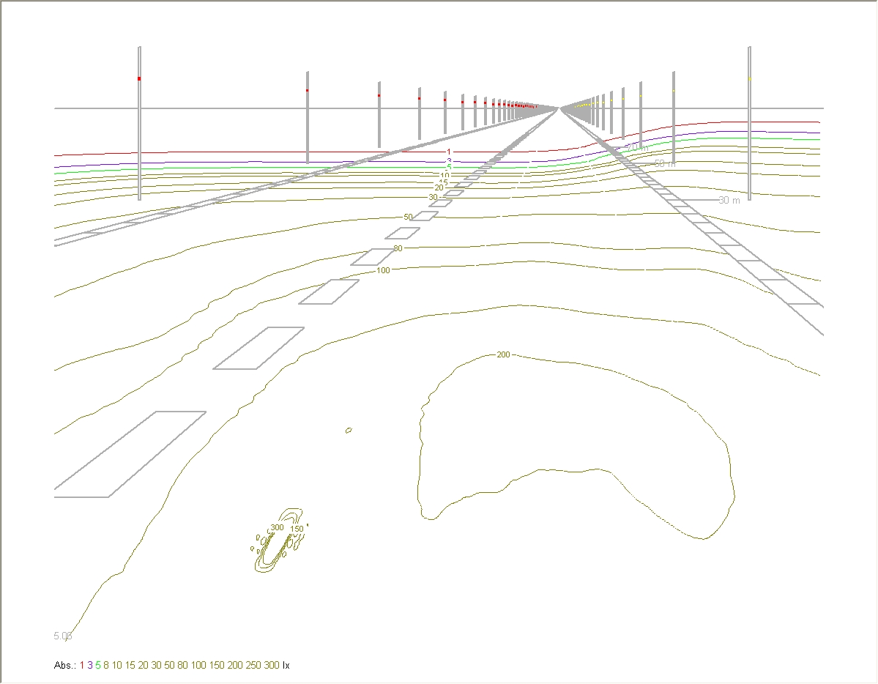
Glare intensities plotted on screen located at 50m from Car
75m
Illuminance values plotted on screen at 25m (0,0 is the Headlamp Optical Axis)
Illuminance values plotted on road surface
Notes:
Reproduced from CIE report with 75m line added
Headlamp 11: shallow gradient

Slide 14
Glare intensities plotted on screen located at 50m from Car
60m
forward Visibility
75m
Low gradient through the cutoff = less glare sensitivity to initial aiming tolerances
Illuminance values plotted on screen at 25m (0,0 is the Headlamp Optical Axis)
Illuminance values plotted on road surface
Notes:
Headlamp 11: shallow gradient

Slide 15
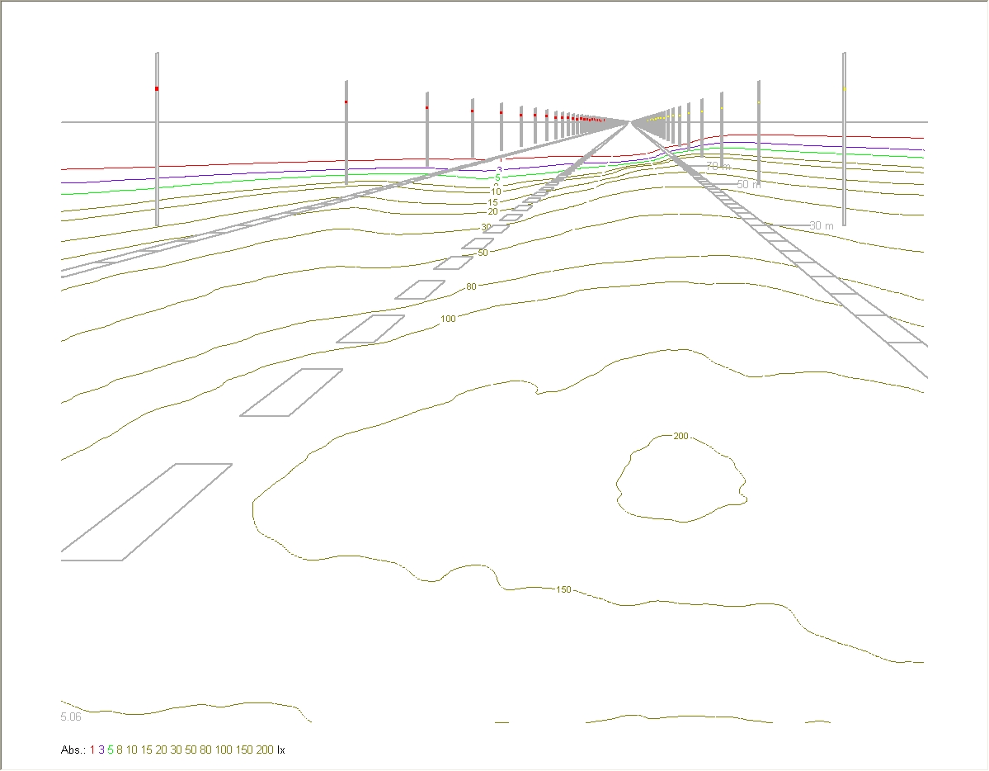
Glare intensities plotted on screen located at 50m from Car
75m
Illuminance values plotted on screen at 25m (0,0 is the Headlamp Optical Axis)
Illuminance values plotted on road surface
Notes:
Headlamp 5 steep gradient

Slide 16
Glare intensities plotted on screen located at 50m from Car
85m
forward Visibility
75m
High gradient through the cutoff = more glare sensitivity to initial aiming tolerances
Illuminance values plotted on screen at 25m (0,0 is the Headlamp Optical Axis)
Illuminance values plotted on road surface
Notes:
Headlamp 5 steep gradient

Slide 17
Theoretical Range vs. real visibility
Both lamps have a theoretical range of 75m
Sample 11 has TC4-45 visibility range of 60m
Sample 5 has TC4-45 visibility range of 85m
Notes:
To recap up to here: proposal increases glare risk without guaranteeing improved visibility.

Slide 18
Theoretical Range vs. real visibility
Both lamps have a theoretical range of 75m
Sample 11 has TC4-45 visibility range of 60m
Sample 5 has TC4-45 visibility range of 85m
Conclusion: theoretical range is a poor measure of real-world visibility
Notes:
To recap up to here: proposal increases glare risk without guaranteeing improved visibility.

Slide 19
Tolerance with load levelling to be 50m to 100m theoretical range (6.2.6.1.2) for both approval and CoP
Currently total load levelling tolerance is 2.0% approval, 2.6% CoP
Manufacturer may define initial aim to optimise levelling results
Notes:
Lower table also shows what will need to be met for annual inspections

Slide 20
Tolerance with load levelling to be 50m to 100m theoretical range (6.2.6.1.2) for both approval and CoP
Proposal is shown expressed as %.
Initial aim is defined by regulation
Highest permitted aim with levelling unchanged at -0.5%
Corresponds to a reduction in load levelling tolerance for most cars of 60-75%
Notes:
table also shows what will need to be met for annual inspections

Slide 21
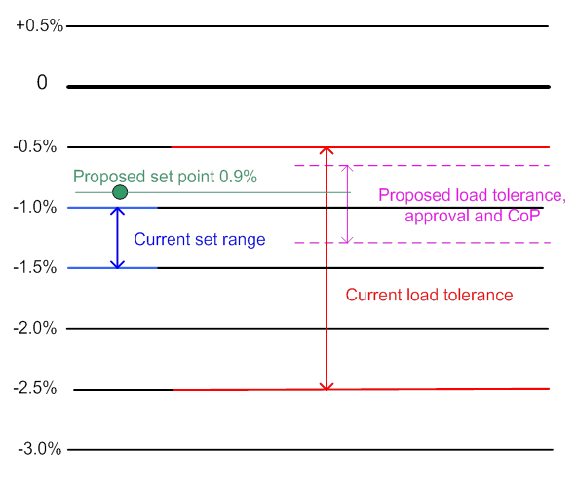
Tolerance with load levelling
Example for 650mm high passenger car headlamp
To consistently meet CoP requirements, initial aim and levelling system need to be repeatable with a standard deviation of better than 0.1%. Repeatability of suspension system alone is not this good.
Notes:
Chart shows current and proposed set aim and load tolerance (Type Approval) limits.
Proposed Set point -0.9%
Proposed Tolerance allows deviation of 0.25% upwards, 0.4% downwards. 0.65% total.
Current (with 1.0% set aim) allows 0.5% upwards, 1.5% downwards
You would be lucky to get initial aiming repeatable to 0.1% s.d.

Slide 22
6.2.6.1.3 requires that if, under loading conditions of Annex 5, aim falls above the 100m range, glare must be measured
This is assessing the glare with the headlamp aimed as it would be under Annex 5 load conditions. Measurement to take place during headlamp type approval.
But at time of headlamp Type Approval, R48 inspection has not taken place, so the aim of the headlamp under Annex 5 conditions is not known.
Notes:
Not clear that 6.2.6.1.2 permits aim to fall outside tolerance limits, but assume it does.

Slide 23
Deletion of 2000lm requirement
Current regulation para 6.2.9 prohibits the use of para 6.2.2.2 manual levelling option with LED or >2000lm light sources
Proposal deletes this prohibition
Provided that 50-100m theoretical range can be achieved by manual levelling, manual levelling would be permissible for any headlamp.
GTB working group is currently reviewing visibility and glare: it would be better to await their outcome.
Notes:
Not clear whether this is the intention, but it would be unwise to anticipate GTB group findings.

Slide 24
Warning message
If theoretical range under Annex 5 loading conditions falls below 50m but above 25m, a warning notice is to be placed in the car, declaring the minimum theoretical range as a minimum ”visibility distance”
Visibility distance does not correlate directly with theoretical range (see above).
Notes:
In practice, for commercial reasons, this is an option that no manufacturer could use.

Slide 25
GRE/2012/21 proposed changes to ECE R48 (1 of 3):
To redefine the initial aim and static load-levelling requirements of dip beam headlamps in terms of theoretical range on the road rather than the current % downward inclination.
Conclusion:
Redefining the aim point will raise the aim for most passenger cars This may not give the desired visibility range
To prevent this causing increased glare, aiming and levelling tolerances must be tightened
Industry needs aiming and levelling capability data to identify if this tolerance tightening is practicable.

Slide 26
Thank You

