Slide 1
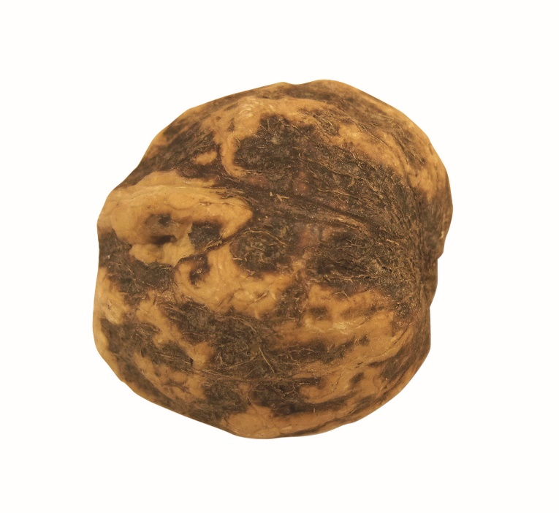
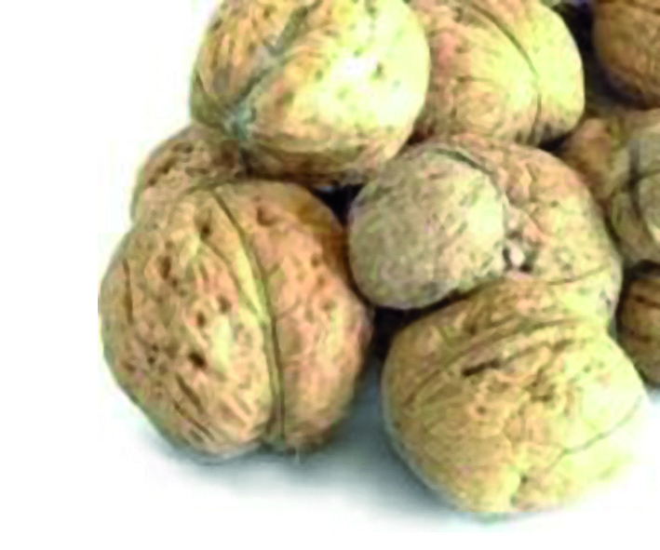
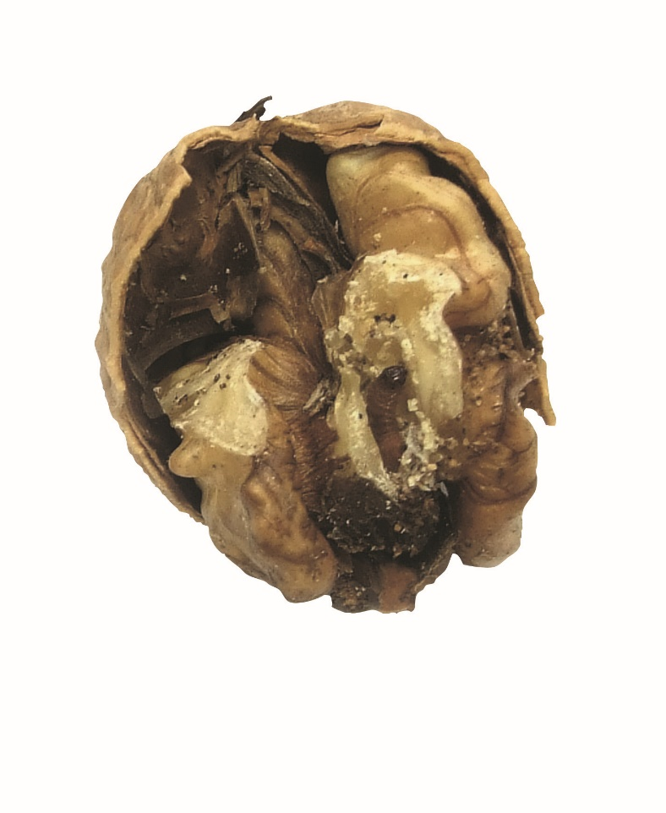
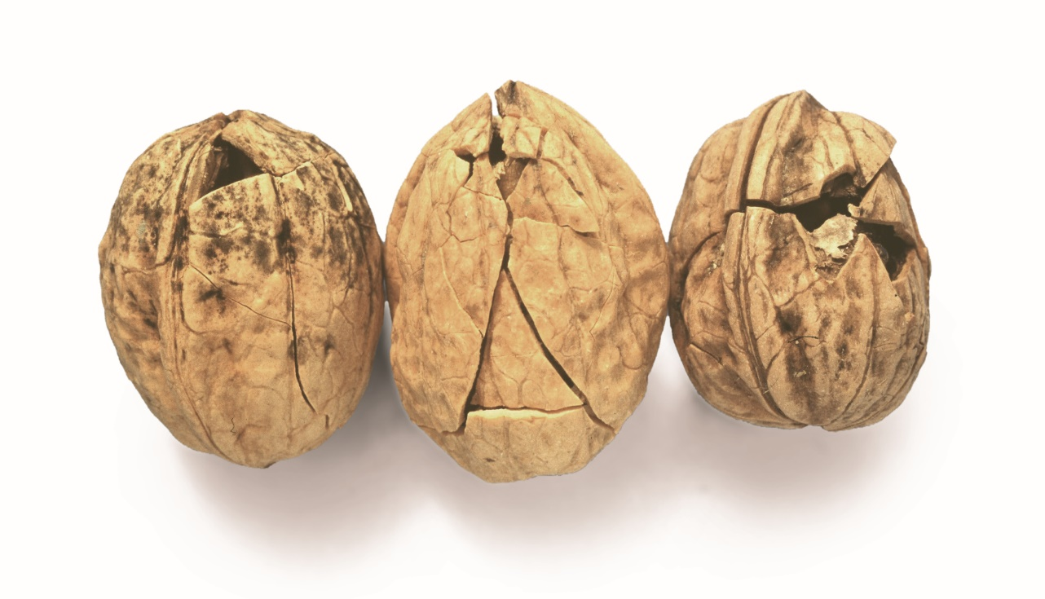
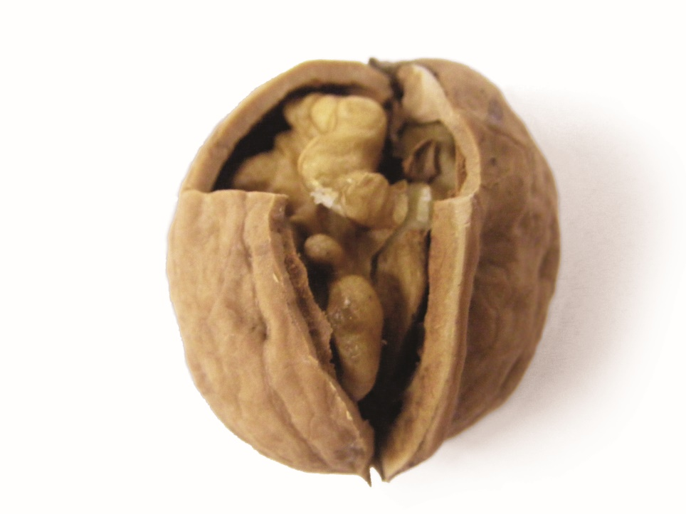
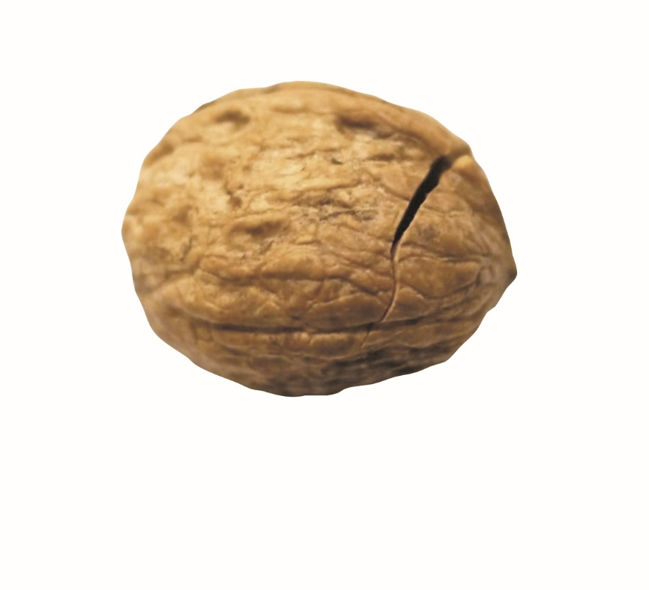
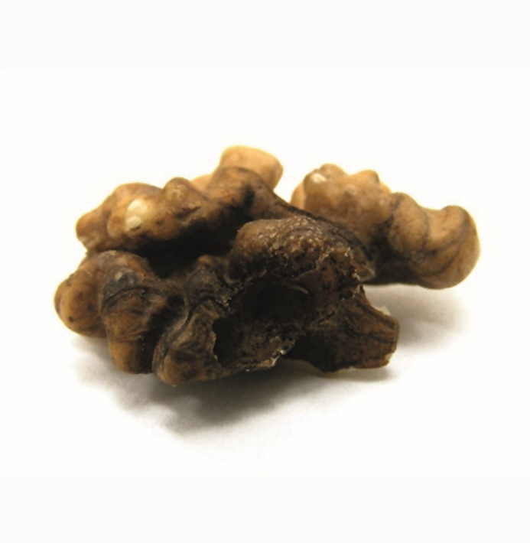
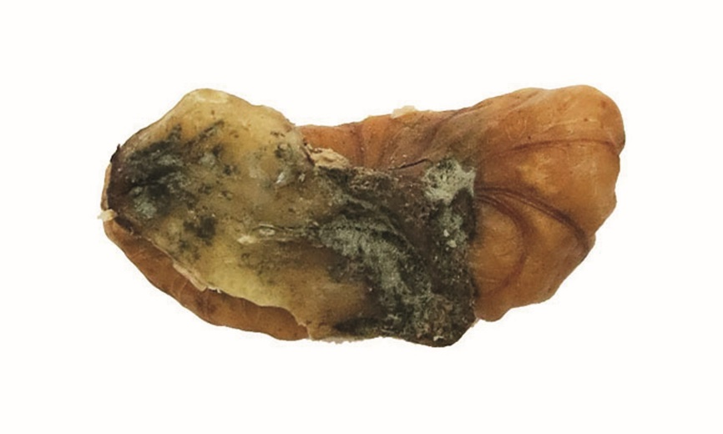
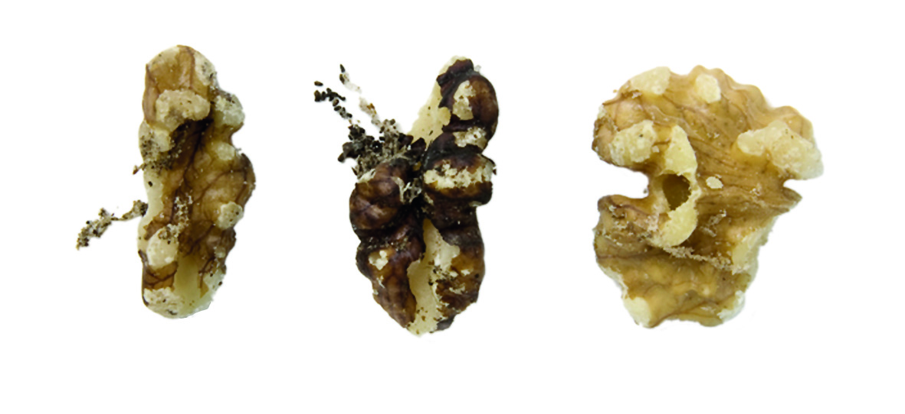
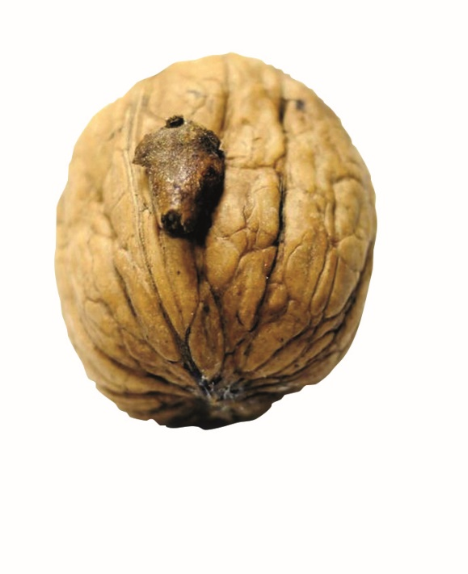
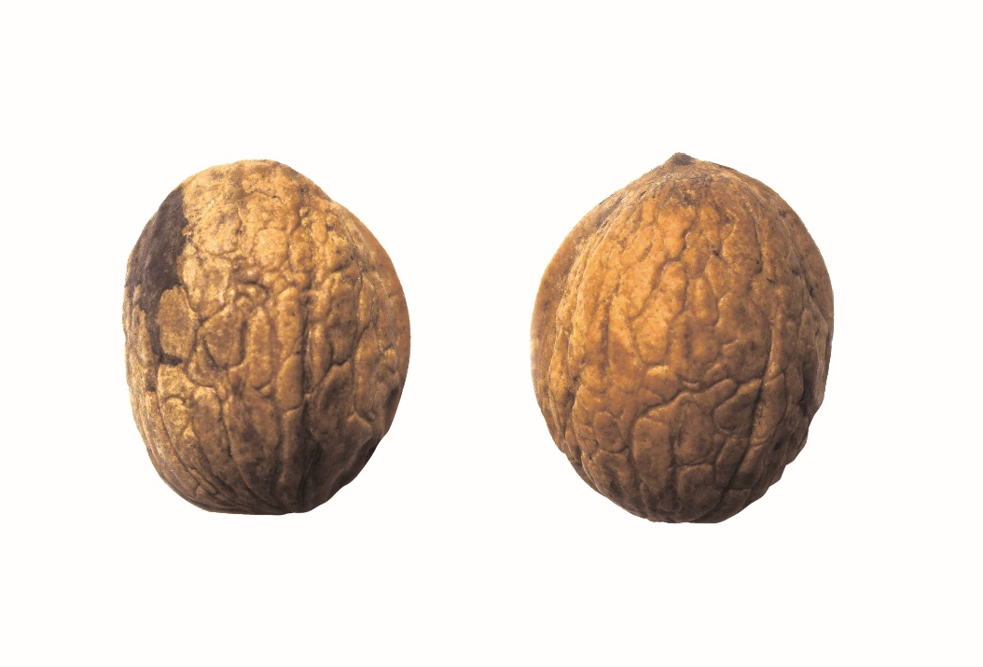
COMMERCIAL AND MARKETING QUALITY OF
INSHELL WALNUTS
*
DEFINITION & CLASSIFICATION
The UNECE standard applies to inshell walnuts* free from outer husks, of varieties (cultivars) grown from Juglans regia L., intended for direct consumption or for food when intended to be mixed with other products for direct consumption without further processing.
It does not apply to inshell walnuts that are processed by salting, sugaring, flavouring, roasting or for industrial processing.
Inshell walnuts are classified into the following three classes: Extra Class, Class I and Class II. The classification is determined in accordance with the defects allowed in the Standard's section "IV, Provisions concerning tolerances“.
QUALITY DEFECTS
Explanatory Brochure UNECE Standard on the marketing and commercial quality control of INSHELL WALNUTS, Photo 11
Explanatory Brochure UNECE Standard on the marketing and commercial quality control of INSHELL WALNUTS, Photo 15
Explanatory Brochure UNECE Standard on the marketing and commercial quality control of INSHELL WALNUTS, Photo 17
FREE OF BLEMISHES
MOULD ON SHELL
DAMAGED BY PESTS
Explanatory Brochure UNECE Standard on the marketing and commercial quality control of INSHELL WALNUTS, Photo 3
Explanatory Brochure UNECE Standard on the marketing and commercial quality control of INSHELL WALNUTS, Photo 4
Explanatory Brochure UNECE Standard on the marketing and commercial quality control of INSHELL WALNUTS, Photo 13 ( The two in the middle)
DAMAGE ON SHELL
DAMAGED SHELL, EXPOSED KERNEL
NOT SUFFICIENTLY DEVELOPED
Explanatory Brochure UNECE Standard on the marketing and commercial quality control of INSHELL WALNUTS, Photo 2
Explanatory Brochure UNECE Standard on the marketing and commercial quality control of WALNUT KERNELS, Photo 6
Explanatory Brochure UNECE Standard on the marketing and commercial quality control of INSHELL WALNUTS, Photo 16
INTACT SHELL
BLEMISHES AND DISCOLOURATION
MOULD ON KERNEL
Explanatory Brochure UNECE Standard on the marketing and commercial quality control of INSHELL WALNUTS, Photo 18 (One in the middle + right)
Explanatory Brochure UNECE Standard on the marketing and commercial quality control of INSHELL WALNUTS, Photo 6
Explanatory Brochure UNECE Standard on the marketing and commercial quality control of INSHELL WALNUTS, Photo 10
INSECT DAMAGE
ADHERING HULL / HUSK
MEASURING STAINS
The UNECE standard for inshell walnuts and an electronic version of this poster can be retreived from the following addresses. Standard: https://www.unece.org/trade/agr/standard/dry/DDP-Standards.html Poster: https://www.unece.org/publications/oes/welcome.html

