Slide 1
Fresh fruit and vegetable exports from Greece: solutions
Towards solutions

Slide 2
Programme of the day
Time | Subject
09:00-09:15 | Welcome - Representative UN ECE Presentation of participants
09:15-09:30 | Purpose and scope of the meeting Dr Heiner Lehr
09:30-10:00 | Summary of initial workshop and identified challenges Dr Heiner Lehr
10:00-11:00 | International good practice as benchmarks for Greece Part I EXPORT PROMOTION BOARDS COOPERATIVES as models to get economies of scale Dr Heiner Lehr
11:00-11:30 | Coffee break
11:30-13:00 | International good practice as benchmarks for Greece Part II EXTENSION SERVICES ELECTRONIC SUPPY CHAIN TRANSPORT AUTOMATION AND SCHEDULING OF INSPECTIONS Dr Heiner Lehr
14:00-14:30 | Light Lunch
14:30-16:00 | Discussion of solutions Dr Heiner Lehr
16:00-16:20 | The smarter food vision Dr Heiner Lehr
16:20 | Closure Representative UN ECE

Slide 3
List of benchmark items
The following areas were identified as needing a solution:
EXPORT PROMOTION BOARDS
COOPERATIVES as models to get economies of scale
EXTENSION SERVICES
ELECTRONIC SUPPLY CHAIN
TRANSPORT
AUTOMATION AND SCHEDULING OF INSPECTIONS

Slide 4
Export promotion boards
PROBLEM
Since Greece has many smaller food businesses, market intelligence is not generally available in particular when it comes to market needs and preferences, e.g. on social responsibility, carbon footprint, organic food.
There is no common export promotion that provides a marketing platform for Greek agri-food products in the exterior world.
INTERNATIONAL COMPARISON
The world bank has seen a clear connection between export promotion agencies and export volumes (88 countries)
Key to success: private participation, specific markets, “small is beautiful”
Quite a number of countries offer generic or specific labels (Norway, Flanders, Malaysia etc) as a common marketing platform
Key to success: specificity, quality control

Slide 5
Potential solution
Establishment of a privately operated Export Promotion Agency
Operation in specific existing markets, such as Russia, and specific target markets, such as China
Gathering of market information
Appointment of “ambassadors” in the country
Lobbying for specific import agreements
Operation of a specific Greek premium brand
Linked to low production, but high quality
Potential attributes: organic, smallholder, sustainable/traditional production
Elaboration of specific criteria, achievable for producers, yet robust enough to build image of excellence

Slide 6
Funding
Food safety
More trust
Avoidance of animal diseases
Improved market access
Access to high-value markets
Differentiation in the marketplace
Taxes
PUBLIC PRIVATE PARTNERSHIPS
Increased supply chain efficiency
Better sourcing
Levies
Better marketability
Consumer interaction
Direct marketing
Fraud avoidance
Greater total market

Slide 7
Taking action
Establishment of Roundtable for Fruit and Vegetable Exports
Roundtable shall invite stakeholders for discussion
Exporters
Producers
Logistics providers
Ministry for Development, Competitiveness and Shipping
Ministry for Rural Development and Food
Ministry of Finance/Customs
Roundtable has the function to discuss the establishment of an export promotion agency with private character/strong private participation
OSC could be the convener of the Roundtable

Slide 8
Cooperatives as models to get economies of scale
PROBLEM
Greece has many small food businesses
Fragmentation leads to
Higher cost of production
Lower rate of innovation
Lack of understanding of latest changes in local requirements
Lack of understanding of market requirements abroad
INTERNATIONAL COMPARISON
Farmers cooperatives have been successful in a number of countries (B, ES, ZA), especially in conjunction with specific marketing instruments, such as the Dutch auction
Models have been implemented with differentiation between technical cooperatives (sharing resources) and marketing cooperatives (sharing market facing activities)

Slide 9
Potential solution
Ministry of Rural Development and Food to produce trainings on farmers’ cooperatives
Needs assessment: marketing cooperatives, resource cooperatives or both?
Training on establishment of cooperatives, specific functions, governance
MRDF to study registration of cooperatives as approved traders
Specific smallholder section in the export promotion agency to provide assistance to farmer marketing cooperatives

Slide 10
Extension services
PROBLEM
There is very little practical research that smaller producers and exporters can benefit from
Applied research in general lacking; most research activities at universities are of an academic nature
INTERNATIONAL COMPARISON
Some countries operate public research institutes (NO, ES, …) as a source for innovation
Some countries operate extension services (ES, AUS, …) as knowledge distributors
Some countries have implemented innovation promotion programmes or agencies in agriculture (UK, AUS, …)
Funding is either public or mixed levy/tax based

Slide 11
Potential solution
Privately run Service Centres are an interesting option (see South Africa), especially when operating smallholder development programmes
Such Service Centres should in the longer term be accredited by MRDF
In order to facilitate creation of such Service Centres, establishment of a training programme should be studied
Objectives of the Service Centres
Technical assistance to farmers, in particular smallholders
Distribution of knowledge from research
Dissemination of knowledge with respect to latest legal requirements
Assistance with 3rd party certification schemes and their implementation
Link to agricultural universities and research centres to promote applied research
MRDF to invite large exporters to promote the idea of Service Centres
Funds could come from levies raised by Export Promotion Agency

Slide 12
Electronic supply chain
PROBLEM
The electronic supply chain has shown in several places its use in assuring compliance, providing marketing information and supporting claims such as organic, sustainable etc
Linked with public systems, the electronic supply chain also increases the efficiency of e.g. the export process
The backbone of such an electronic supply chain are food information management systems
INTERNATIONAL COMPARISON
Norway is implementing a fully electronic traceability system, as the basis of an food information management system; other countries are doing the same
Different models have been tried, but a combination of public oversight with private initiative seems to be the most interesting model

Slide 13
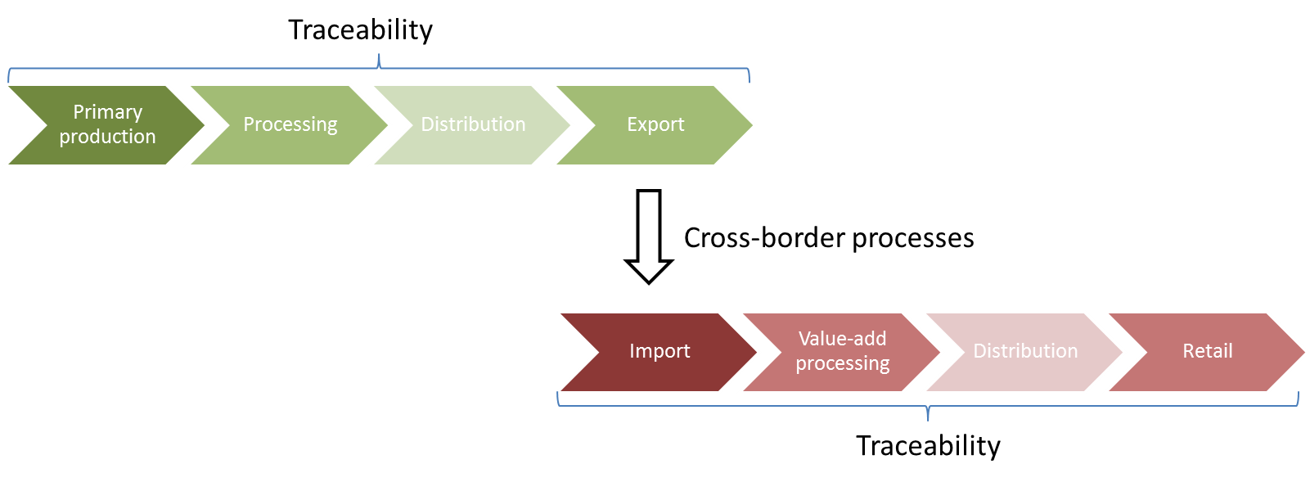
What is a food information management system?
Food information management
differs from traceability in providing models for the implementation of a holistic cross-border chain information management
differs from trade-oriented systems by including traceability processes in the exporting and importing country

Slide 14
Architecture
red light: non-conformance
green light: conformance
Food Safety Agencies
EXPORTING NATION
Export control
Import
control
Food Safety Agencies
IMPORTING NATION
Layer 1: Public sector
Layer 2: Private sector
Primary
production
Processing
Distribution/
Export
Import/
Retail
Consumers
Layer 3: Verification

Slide 15
Advantages
Marketing and
brand assurance
Authenticity
-Claims management
New business
models
Carbon indexed ingredients
Dynamic shelf life
Sustainability
-Stakeholder involvement
-Key indicator calculation
C-FiM
Chain Food Information Managment
Compliance to standards and regulations
Trade and efficiency

Slide 16
Main purposes
Provide marketing opportunities
Provide basis for informed choice by importers, retailers and consumers
Spin marketing stories around origin
Include smallholders in global supply chains
Provide means to find product supply
Provide means to find product demand
Distribute knowledge to smallholders
Build trust through transparency
Support marketing claims by hard data
Ensure food safety and standard compliance
=> Smarter Food Vision

Slide 17
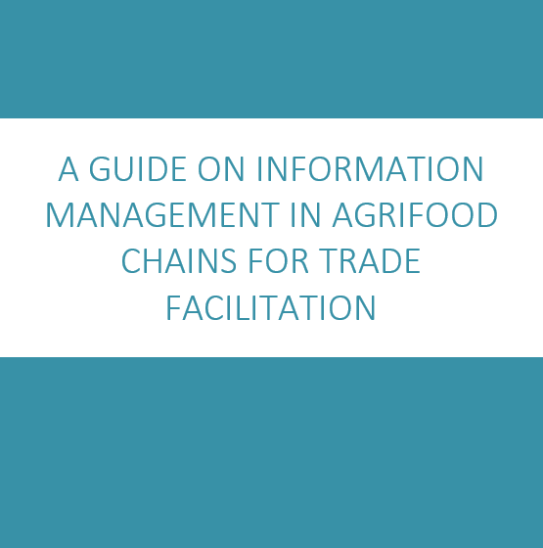
More information
For more details, see UNNExT guide on information management in agrifood chains for trade facilitation
To be published by UN ESCAP/UN ECE Q3 2014

Slide 18
Kickstart actions
Kickstart action 1: Implement electronic agrifood license, permit, certificate and audit system
Kickstart action 2: Establish international cooperation on Single Window for Agrifood Trade and inter-agency information systems
Kickstart action 3: Implementation of an automated risk-based inspection system using cross border electronic information exchange of agrifood permits and certificates
Roundtable on Export Promotion would be a logical forum to discuss this matter

Slide 19
Transport
PROBLEM
Availability of transport – in particular overland transport – is an issue.
For smaller producers it is very difficult to obtain transport in peak season, given that there are only about 2,000 export trucks in Greece. The estimated need (peak season) is about 10,000 trucks.
This also drives the transport cost, in addition to unusually high toll road costs for inner Greek transport
INTERNATIONAL COMPARISON
Logistics costs in Greece seem on higher end in international comparison
Logistic platforms, distribution centres and logistics cooperatives have shown to be successful in DE, B
Flexibility and adaptation to customer requirements are key for successful logistics

Slide 20
Potential solution
The establishment of logistics platforms operating from key distribution centres seem to be an interesting offer
Logistic platform would have the following objectives
Concentration of goods
Cold chain handling of goods
Provision of transport services (by auction?)
Export services
Can work with local inspectors fully employed on site
Local transport to DC
Inspection at DC
Containerisation
Transport to ship/train or international road
One stop centre for logistic and export services

Slide 21
Next steps
Successful implementation of logistic platforms will require
Large and small logistics companies willing to participate
Suitable land
Access to private and perhaps public finance
The public hand (Ministry for Development, Competitiveness and Shipping/Ministry of Rural Development and Food) should convene suitable stakeholders and facilitate the discussion
Local municipalities could contribute land as investment opportunity
As a pilot platform, Thessaloniki appears to be a logical location

Slide 22
Automation and scheduling of inspections
PROBLEM
After finding suitable logistic arrangements, physical inspections are the next most important factor in the export timeline
International agreements, especially on phytosanitary certificates, make it seem unlikely that physical inspections can be subjected to risk managed samples
Inspections and inspection reporting could be made much more efficient
Weekend and after office hour inspections are at time difficult to arrange
INTERNATIONAL COMPARISON
Independent scheduling by experienced dispatchers has proven to reduce waiting time in NL.
Mobile tools for inspectors haven shown to improve productivity in NL
Some countries seem more resource efficient with respect to inspectors (ES, NL, ZA)

Slide 23
Potential solution
Companies should be allowed to submit inspection requests well ahead of time
Mid and larger companies should experiment with fixed inspection times (1 slot per day for example)
Centralised expert dispatching seems a good solution
Requires a mobile scheduling tool for inspectors
Mobile solution should be SMS based for low-tech phones first and then extended to smartphones on a Bring Your Own Device basis (BYOD)
Automation of (over)time recording using mobile phones and geolocalisation
ePayment should be enabled, with accounts and monthly bills
Could existing commercial offers be used?
Information exchange between relevant Ministries should be enabled
Provision of information to importing countries should be studied

Slide 24
VAT refund time
VAT refunds could be paid automatically into ePayment accounts
Notes:
A PWC study called “Paying Taxes” found that, based on a survey, most European companies have to wait 1 to 3 three months for their VAT refunds. The European average time to refund is well below the global average and slightly below the OECD average.

Slide 25
Next steps
MRDF and Customs have embarked already on the path towards the integration of Conformity Certificates/Exemption Certificates with the Single Administrative Document (export declaration)
The establishment of a National Single Window
Next steps should include a fully electronic export workflow
Integration of ePayment
Electronic issuance of Certificate of Origin
Electronic versions of Phytosanitary Certificates (after physical inspection)
Exchange of information with importing countries

Slide 26
Thank you for your attention!
Dr Heiner Lehr
Syntesa Partners & Associates
heiner@syntesa.eu

