Slide 1
Graphs Showing Forecasts made for 70th Timber Committee meeting (supplement) UNECE/FAO Forestry and Timber Section
Geneva, Switzerland
16-19 October 2012

Slide 2
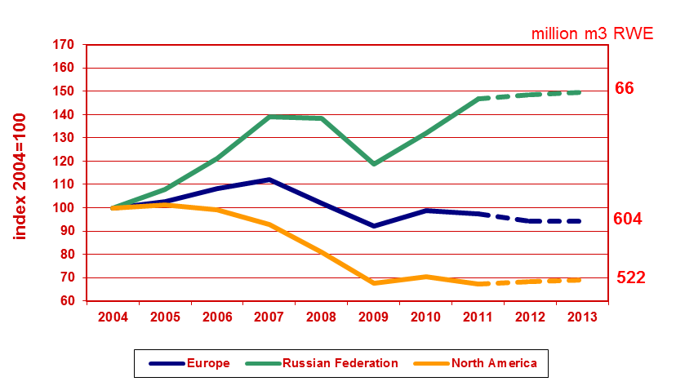
Consumption of Forest Products in UNECE Region
UNECE Timber Committee, October 2012, Geneva

Slide 3
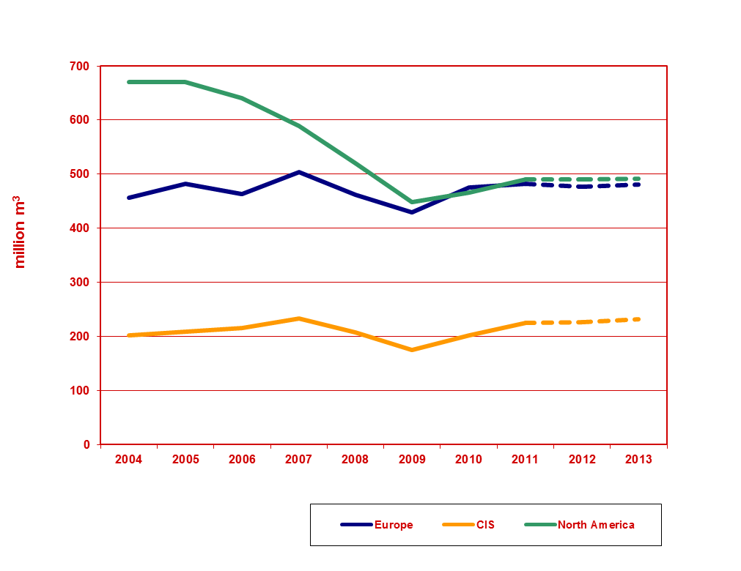
Roundwood (industrial and fuel) Removals in UNECE Region
UNECE Timber Committee, October 2012, Geneva

Slide 4
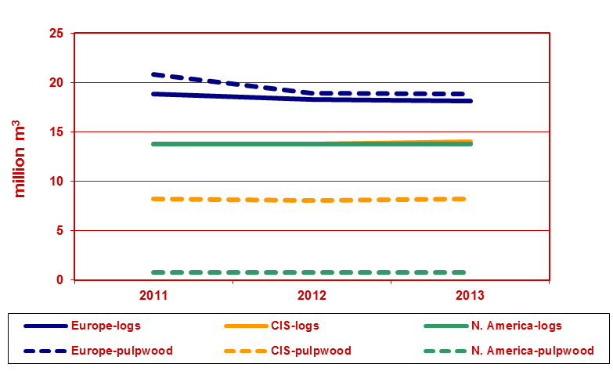
Log and Pulpwood Exports in UNECE Region
UNECE Timber Committee, October 2012, Geneva

Slide 5
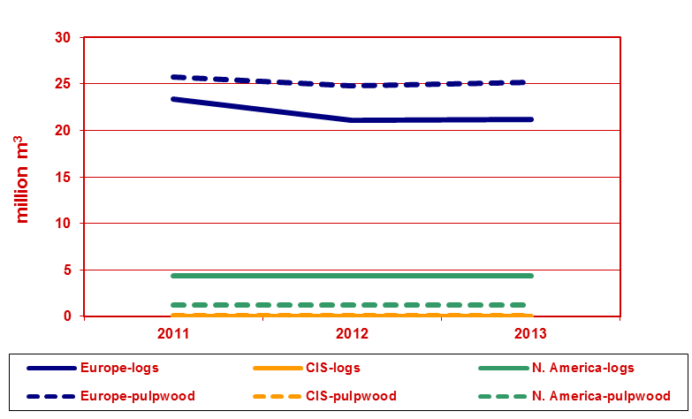
Log and Pulpwood Imports in UNECE Region
UNECE Timber Committee, October 2012, Geneva

Slide 6
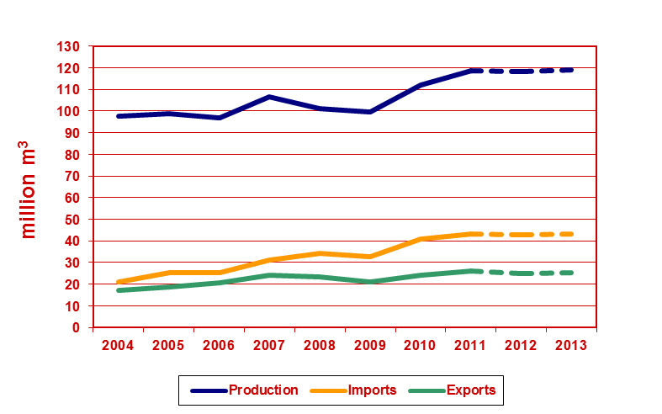
Chips, particles and residues in Europe
UNECE Timber Committee, October 2012, Geneva

Slide 7
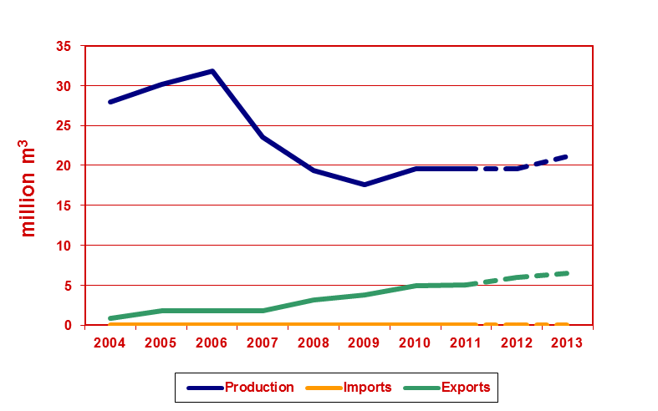
Chips, particles and residues in CIS
UNECE Timber Committee, October 2012, Geneva

Slide 8
Chips, particles and residues in CIS
UNECE Timber Committee, October 2012, Geneva

Slide 9
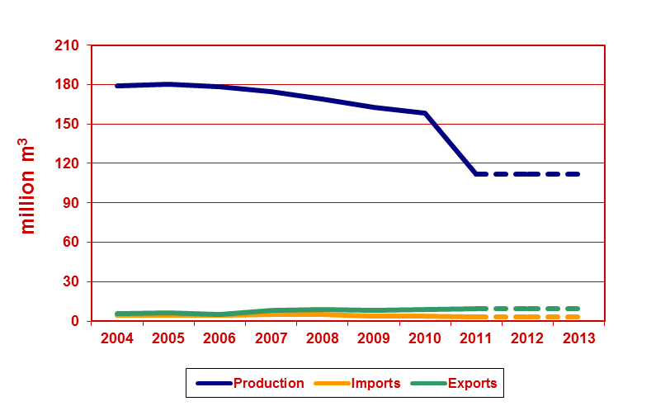
Chips, particles and residues in North America
UNECE Timber Committee, October 2012, Geneva

Slide 10
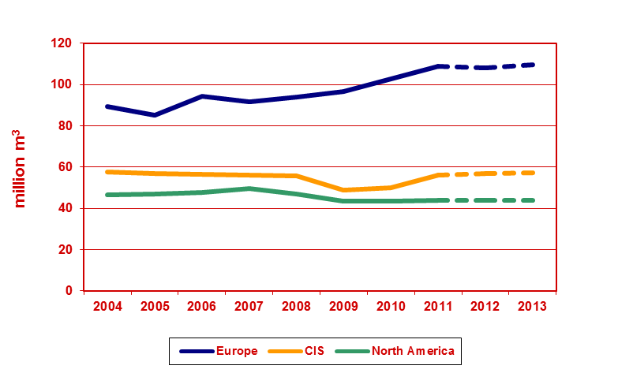
Wood Fuel Removals in UNECE Region
UNECE Timber Committee, October 2012, Geneva

Slide 11
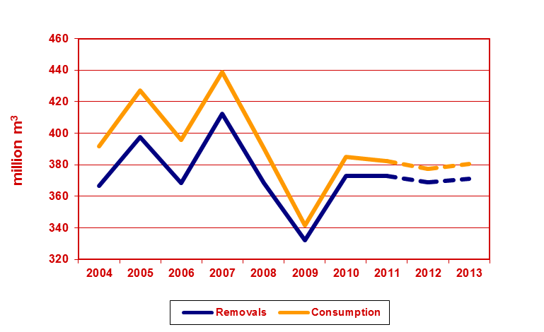
Industrial Roundwood Europe
UNECE Timber Committee, October 2012, Geneva

Slide 12
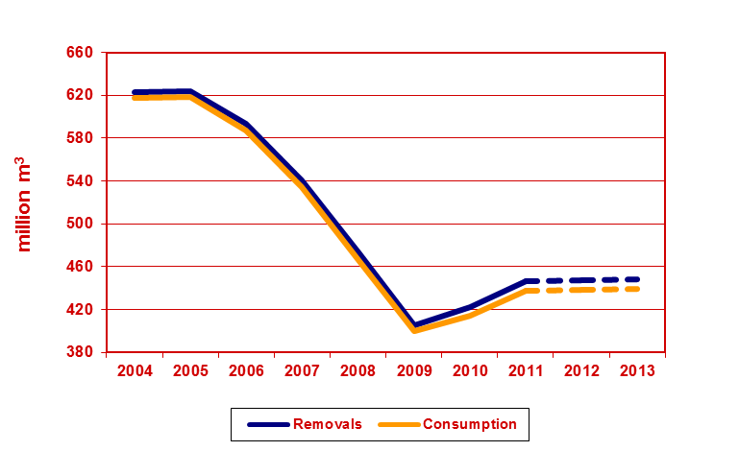
Industrial Roundwood North America
UNECE Timber Committee, October 2012, Geneva

Slide 13
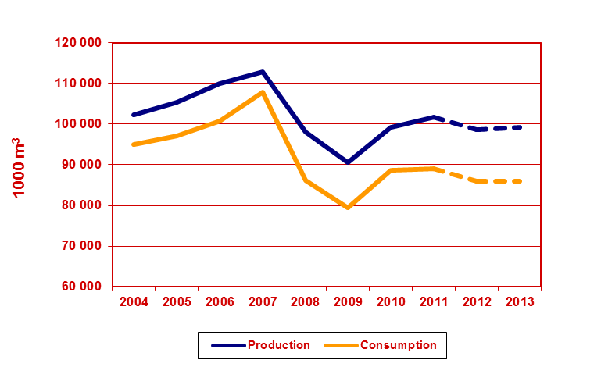
Sawn Softwood – Europe (1)
UNECE Timber Committee, October 2012, Geneva

Slide 14
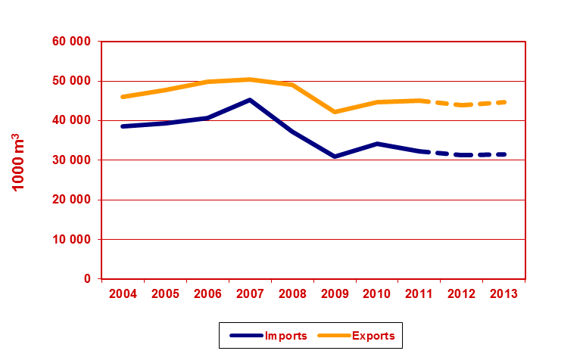
Sawn Softwood – Europe (2)
UNECE Timber Committee, October 2012, Geneva

Slide 15
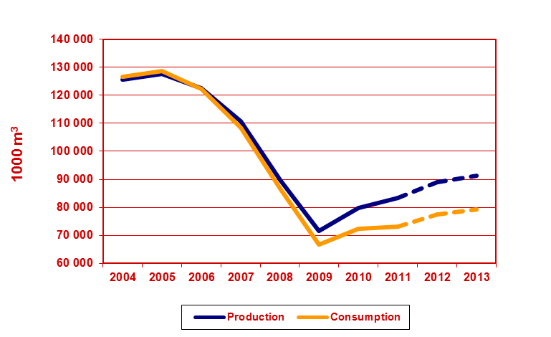
Sawn Softwood – North America (1)
UNECE Timber Committee, October 2012, Geneva

Slide 16
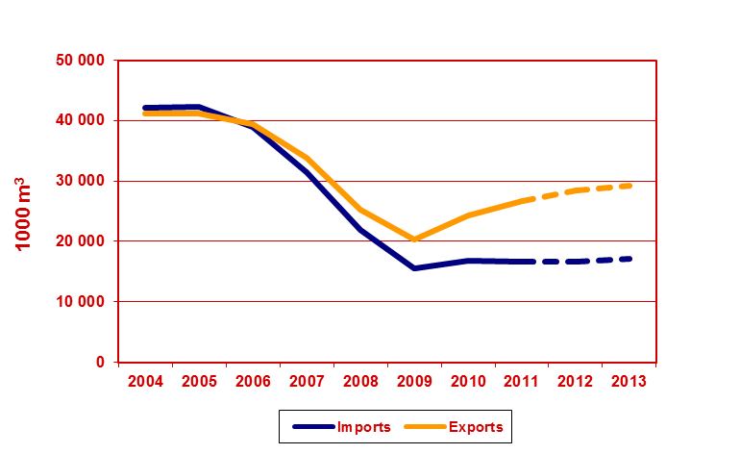
Sawn Softwood – North America (2)
UNECE Timber Committee, October 2012, Geneva

Slide 17
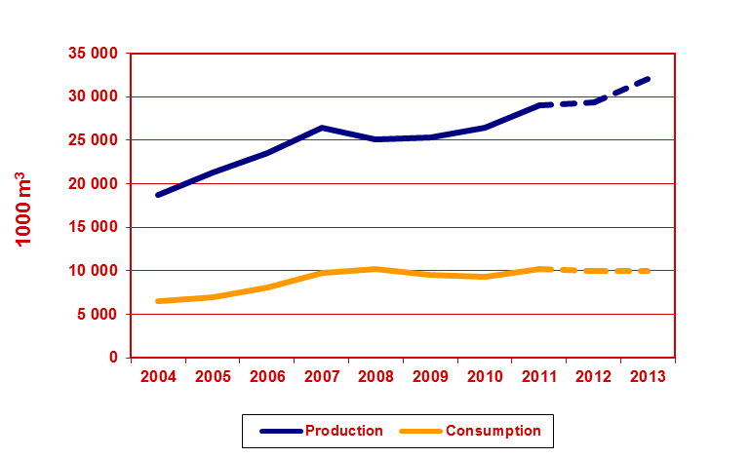
Sawn Softwood – Russian Federation (1)
UNECE Timber Committee, October 2012, Geneva

Slide 18
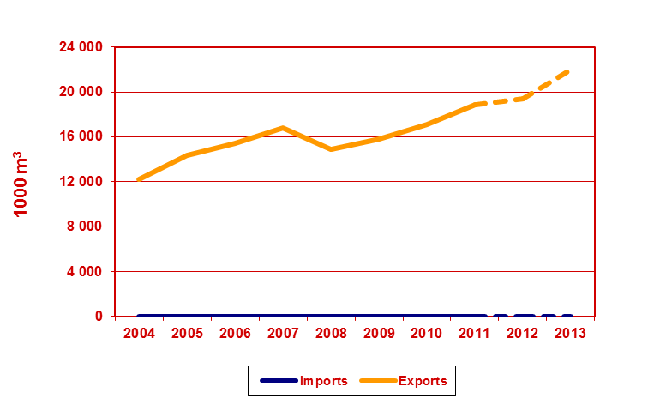
Sawn Softwood – Russian Federation (2)
UNECE Timber Committee, October 2012, Geneva

Slide 19
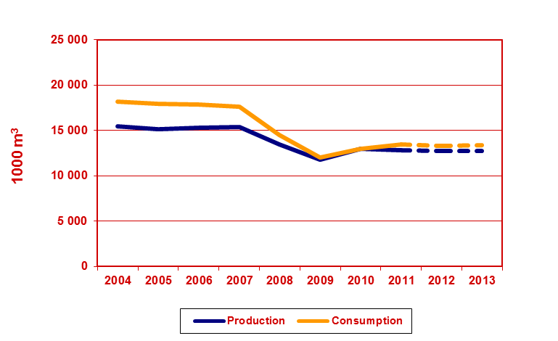
Sawn Hardwood – Europe (1)
UNECE Timber Committee, October 2012, Geneva

Slide 20
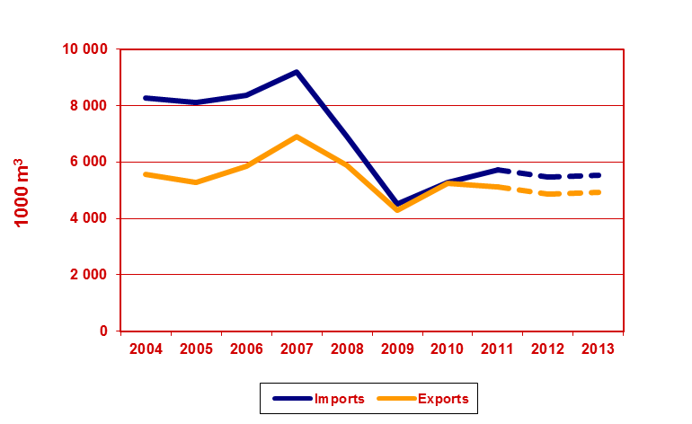
Sawn Hardwood – Europe (2)
UNECE Timber Committee, October 2012, Geneva

Slide 21
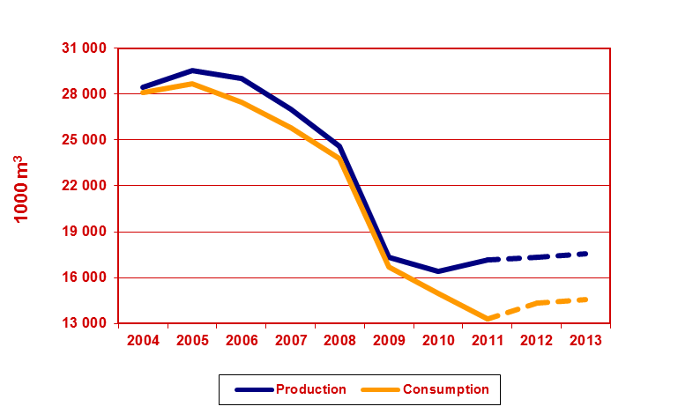
Sawn Hardwood – North America (1)
UNECE Timber Committee, October 2012, Geneva

Slide 22
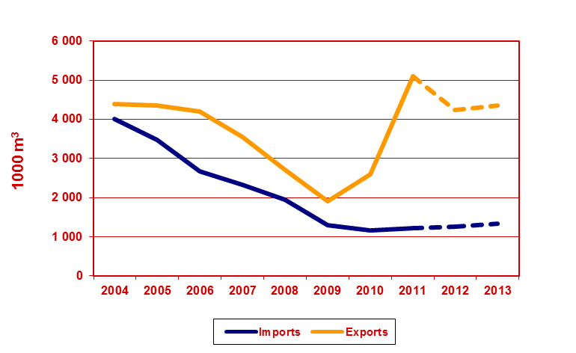
Sawn Hardwood – North America (2)
UNECE Timber Committee, October 2012, Geneva

Slide 23
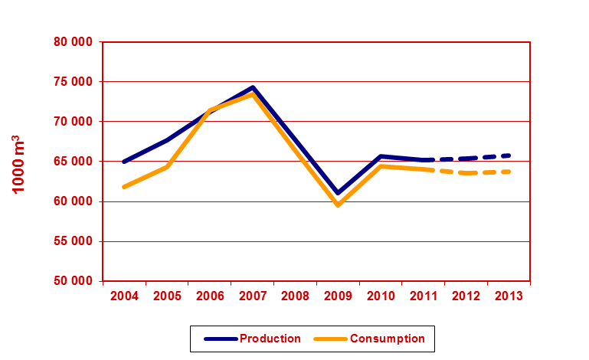
Wood-based Panels - Europe
UNECE Timber Committee, October 2012, Geneva

Slide 24
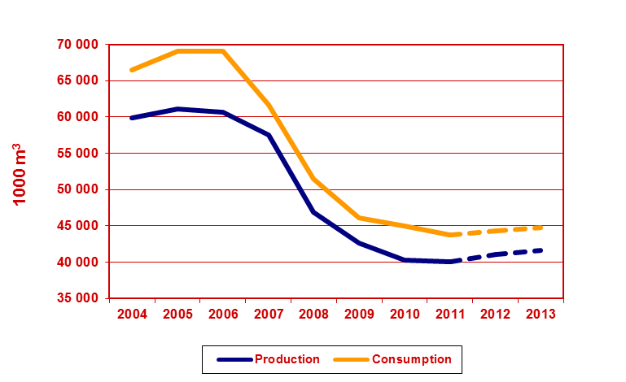
Wood-based Panels – North America
UNECE Timber Committee, October 2012, Geneva

Slide 25
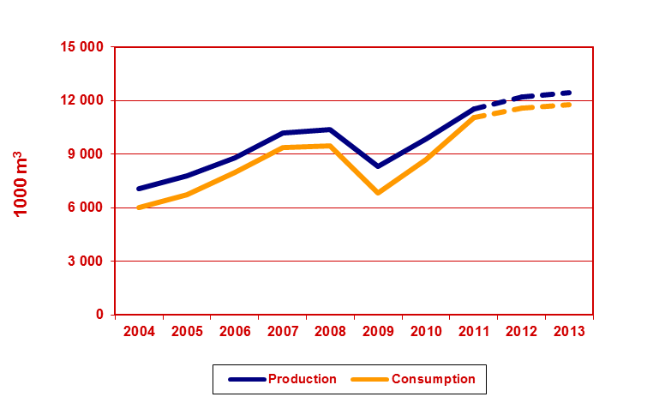
Wood-based Panels – Russian Federation
UNECE Timber Committee, October 2012, Geneva

Slide 26
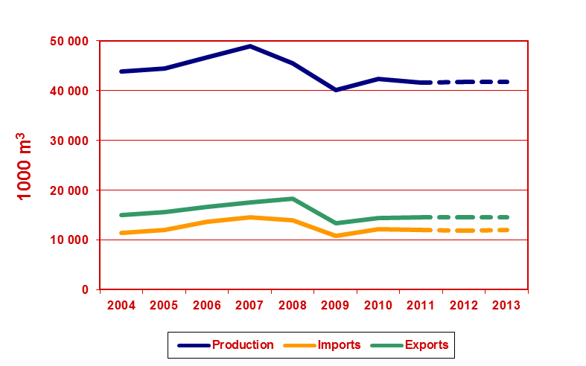
Particle Board (including OSB) – Europe
UNECE Timber Committee, October 2012, Geneva

Slide 27
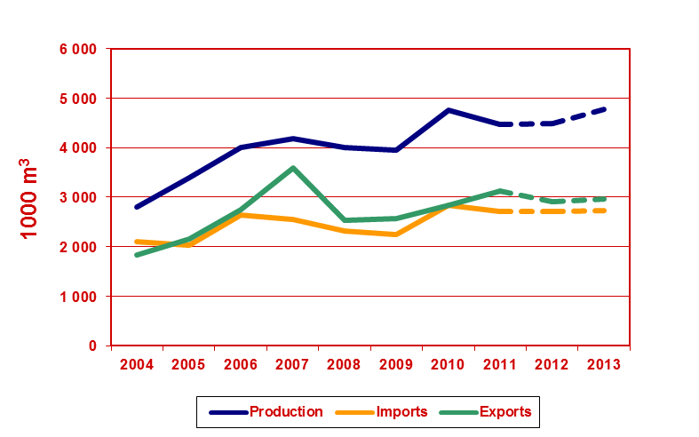
OSB – Europe
UNECE Timber Committee, October 2012, Geneva

Slide 28
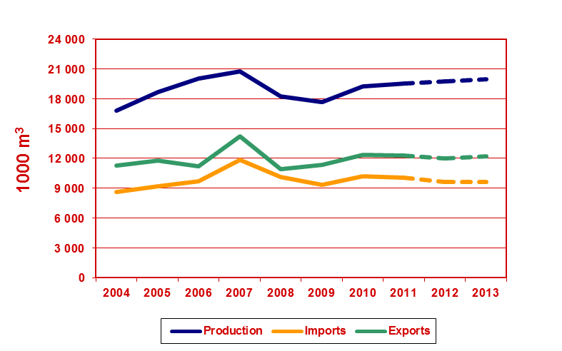
Fibreboard – Europe
UNECE Timber Committee, October 2012, Geneva

Slide 29
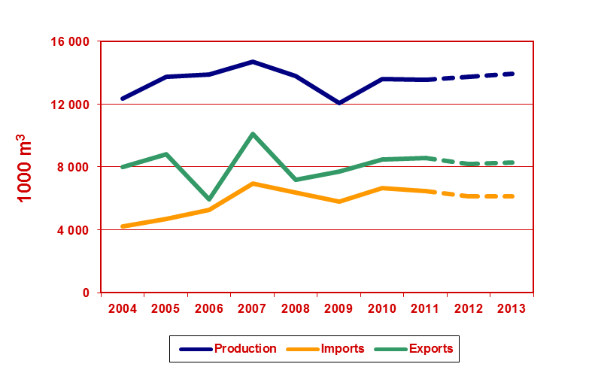
MDF – Europe
UNECE Timber Committee, October 2012, Geneva

Slide 30
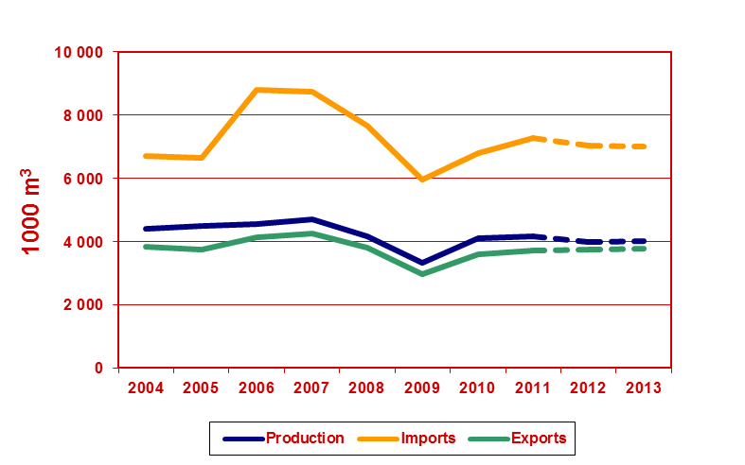
Plywood – Europe
UNECE Timber Committee, October 2012, Geneva

Slide 31
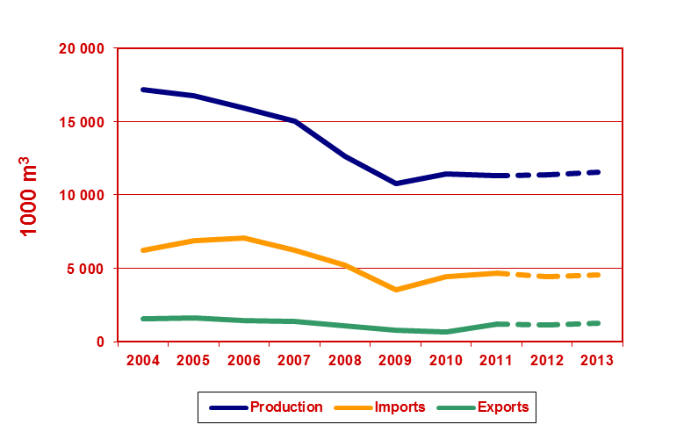
Plywood – North America
UNECE Timber Committee, October 2012, Geneva

Slide 32
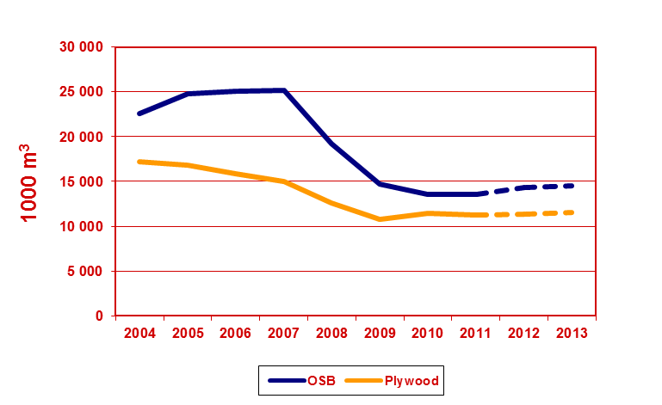
Structural Panel Production – North America
UNECE Timber Committee, October 2012, Geneva

Slide 33
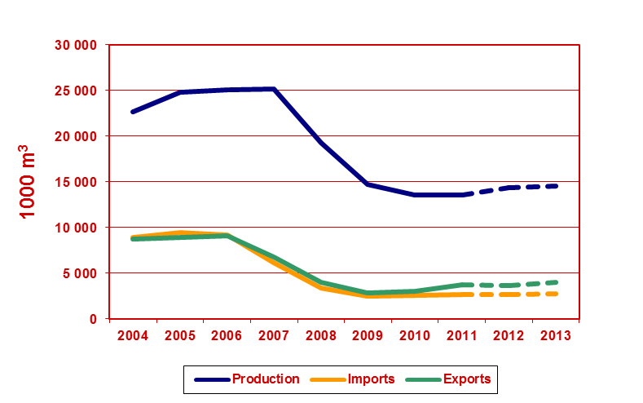
OSB– North America
UNECE Timber Committee, October 2012, Geneva

Slide 34
OSB– North America
UNECE Timber Committee, October 2012, Geneva

Slide 35
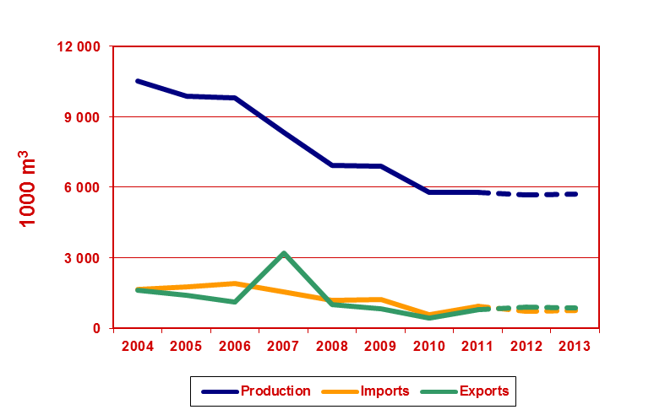
Particle Board (excluding OSB) – North America
UNECE Timber Committee, October 2012, Geneva

Slide 36
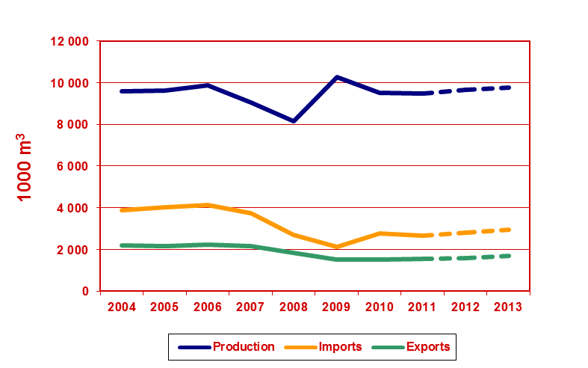
Fibreboard – North America
UNECE Timber Committee, October 2012, Geneva

Slide 37
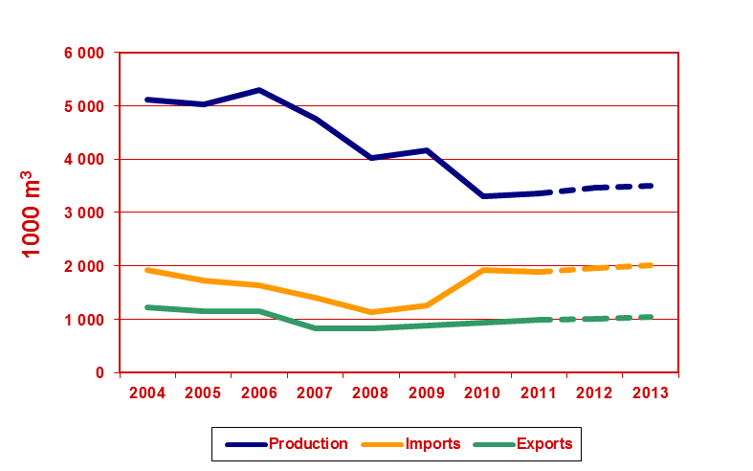
MDF – North America
UNECE Timber Committee, October 2012, Geneva

Slide 38
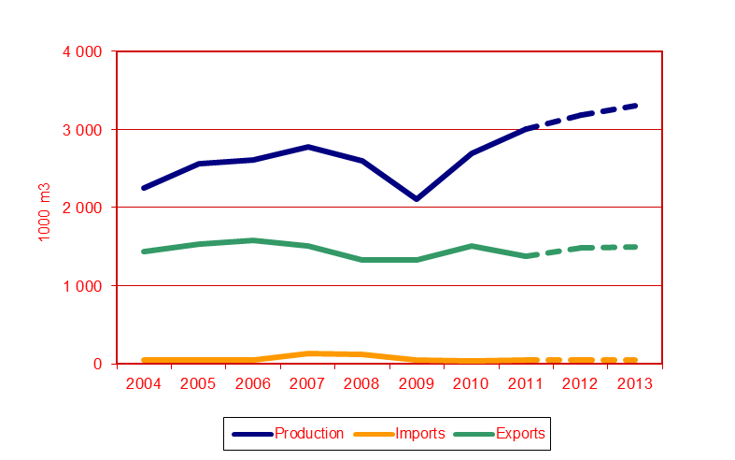
Plywood – Russian Federation
UNECE Timber Committee, October 2012, Geneva

Slide 39
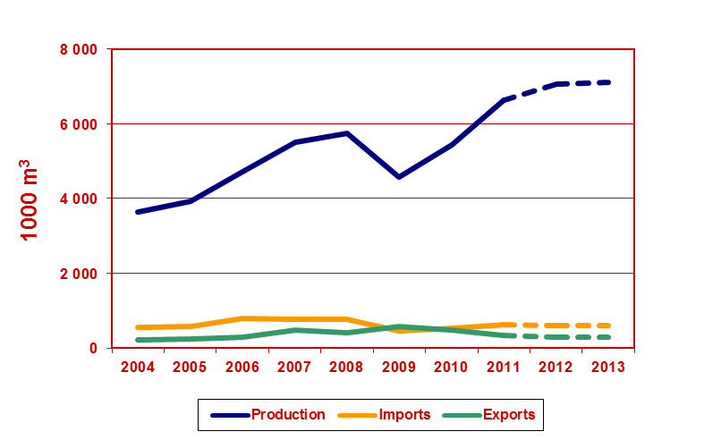
Particle Board – Russian Federation
UNECE Timber Committee, October 2012, Geneva

Slide 40
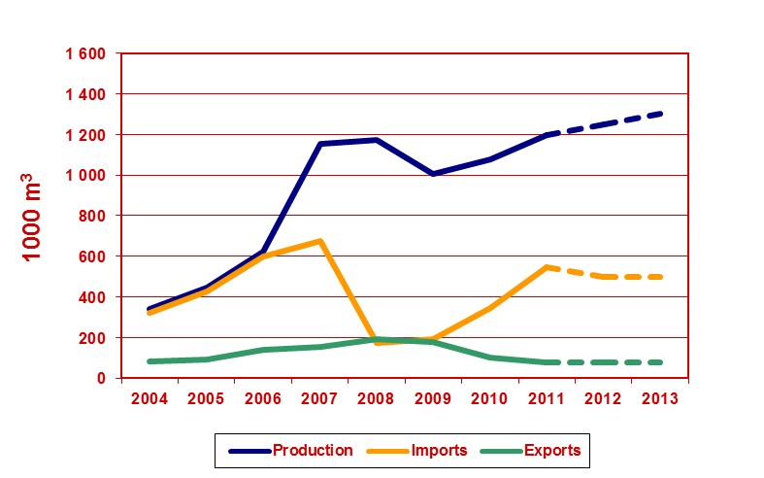
MDF – Russian Federation
UNECE Timber Committee, October 2012, Geneva

Slide 41
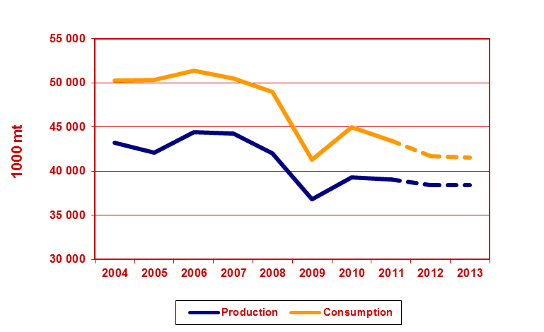
Wood Pulp – Europe (1)
UNECE Timber Committee, October 2012, Geneva

Slide 42
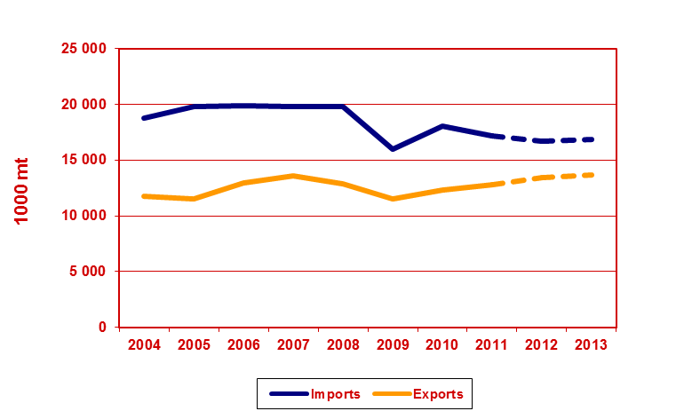
Wood Pulp – Europe (2)
UNECE Timber Committee, October 2012, Geneva

Slide 43
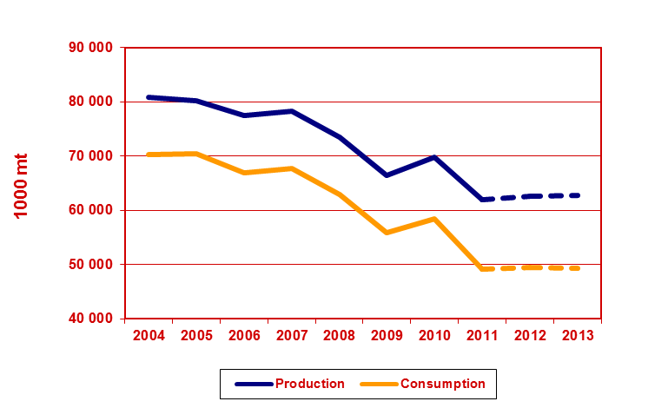
Wood Pulp – North America (1)
UNECE Timber Committee, October 2012, Geneva

Slide 44
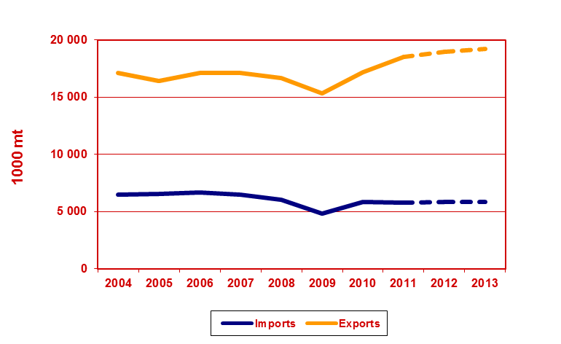
Wood Pulp – North America (2)
UNECE Timber Committee, October 2012, Geneva

Slide 45
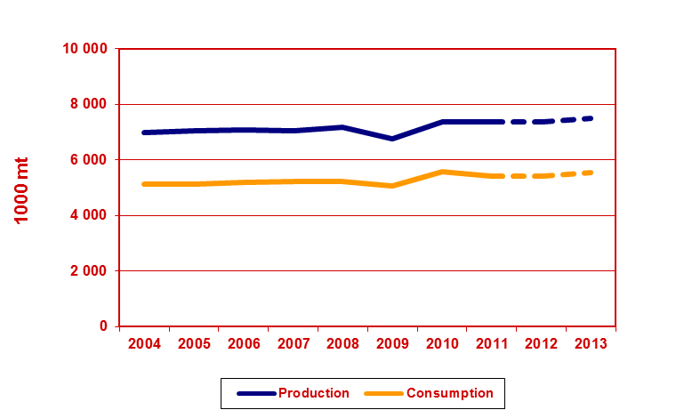
Wood Pulp – Russian Federation (1)
UNECE Timber Committee, October 2012, Geneva

Slide 46
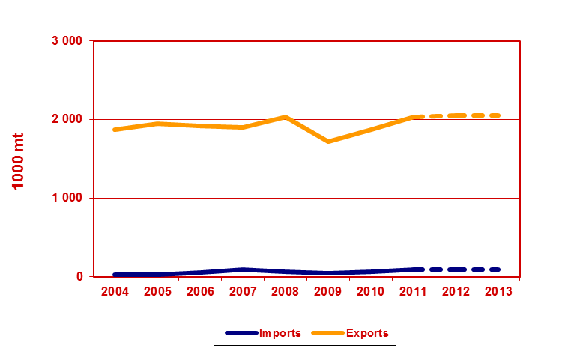
Wood Pulp – Russian Federation (2)
UNECE Timber Committee, October 2012, Geneva

Slide 47
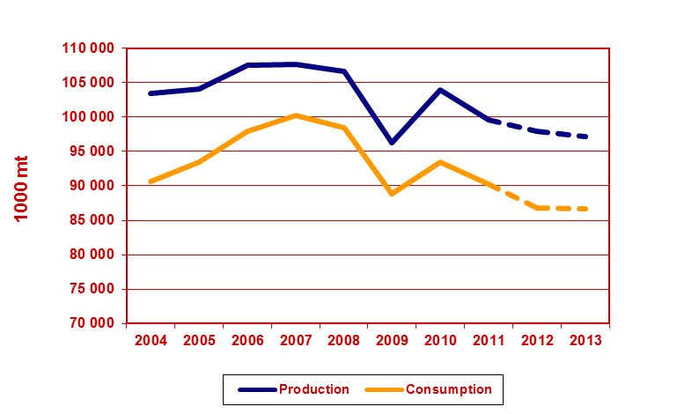
Paper and Board – Europe (1)
UNECE Timber Committee, October 2012, Geneva

Slide 48
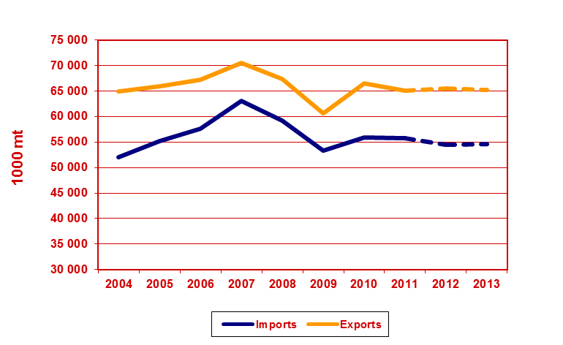
Paper and Board – Europe (2)
UNECE Timber Committee, October 2012, Geneva

Slide 49
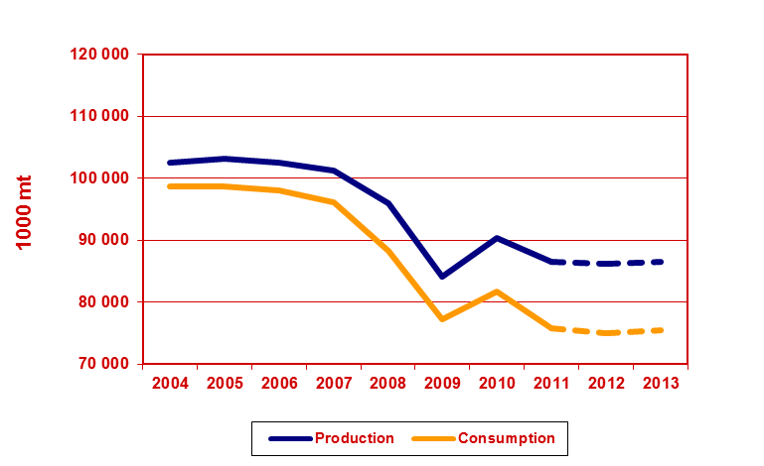
Paper and Board – North America (1)
UNECE Timber Committee, October 2012, Geneva

Slide 50
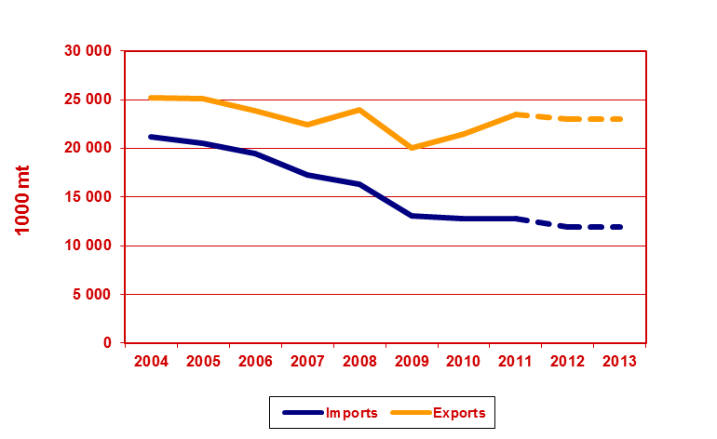
Paper and Board – North America (2)
UNECE Timber Committee, October 2012, Geneva

Slide 51
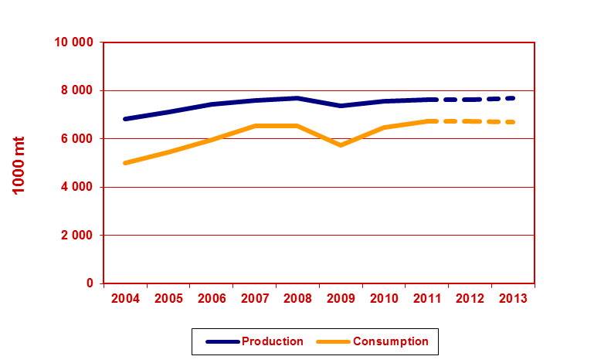
Paper and Board – Russian Federation (1)
UNECE Timber Committee, October 2012, Geneva

Slide 52
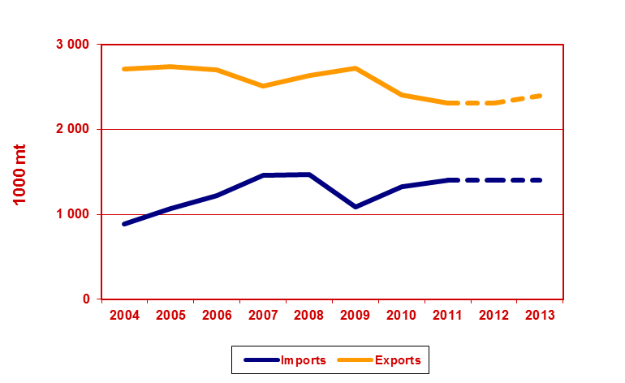
Paper and Board – Russian Federation (2)
UNECE Timber Committee, October 2012, Geneva

Slide 53
Contact
For additional information
please contact Alex McCusker stats.timber@unece.org

